Slide 1

Modeling of mismatch losses due to partial shading in PV plants with custom modules
Gianluca Corbellini

Slide 2
Agenda
Context of the project
Mismatch in PV fields
Case studies
Machine learning approaches
Results
Conclusions and next steps

Slide 3


Context of the project
PV plants are becoming very cheap, already in grid parity in most of countries
lower margins → short time to optimize the design (15min)
designers not specialized in PV technology → lack of know how
DSOs reducing feed-in tariffs → self consumption improves ROI
MLPE are becoming more competitive → when are they convenient?
There is a need in the market for a tool that has an high accuracy and can easily optimize the design of overall PV plant in energetic and economic meanings

Slide 4

Context of the project
The DesignPV project aims to support the development of inSun, a new tool for the design and simulation of PV plants, implementing innovative features to:
Improve the accuracy of irradiation patterns
Simulate the mismatches occurring in complex PV installation
Optimize the electrical layout of PV plants (orientation, inverters, arrays, cabling, BoS)
The project is financed by the Commission for Innovation and Technology of the Swiss Confederation

Slide 5

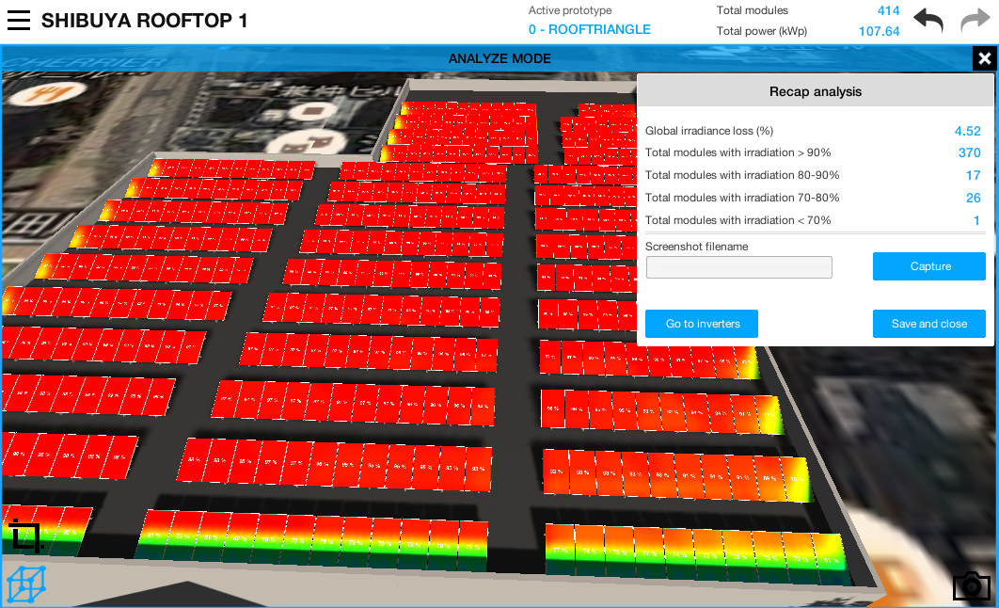
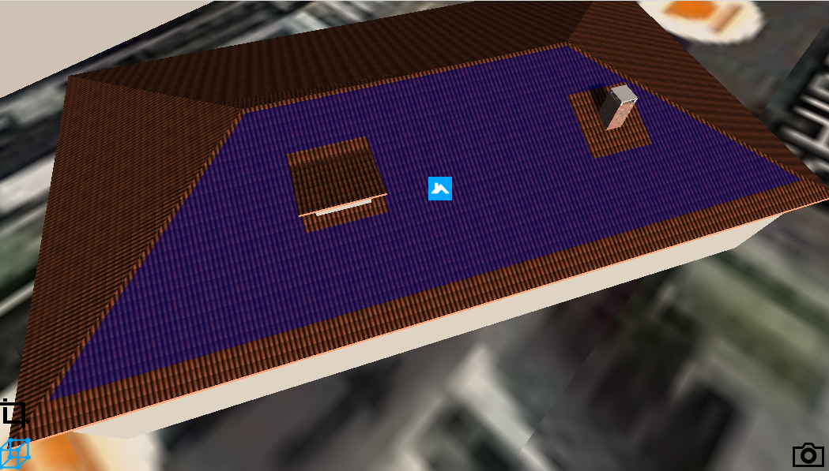
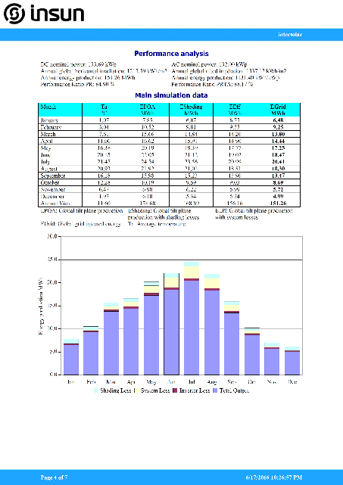
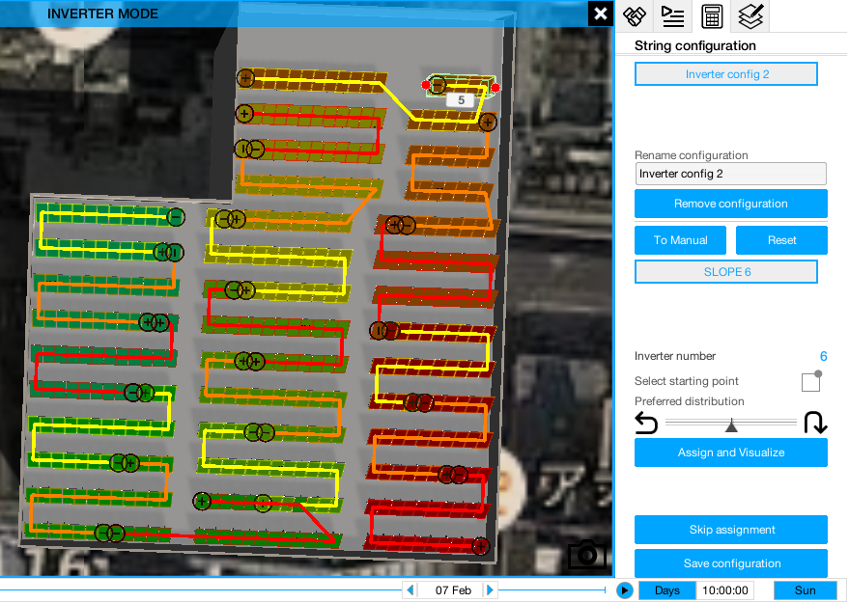
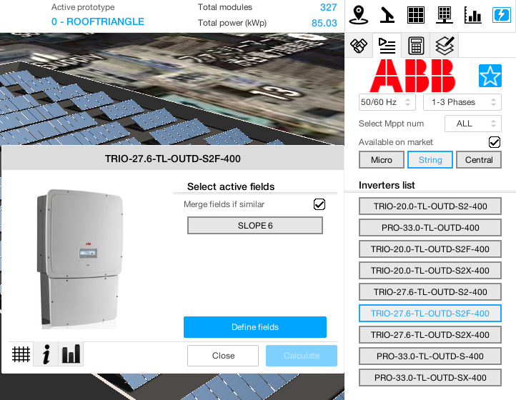
inSun

Slide 6
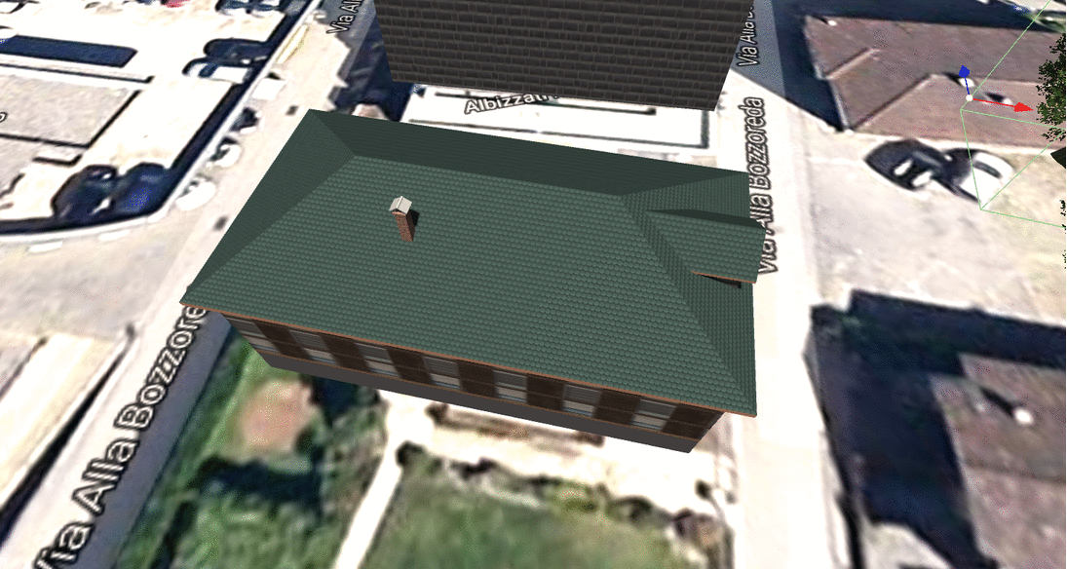
Test case - Residential
House fully covered with BIPV modules and complex shadings due to obstacles and surrounding buildings – Optimal economic (LCOE) solution is not trivial.

Slide 7
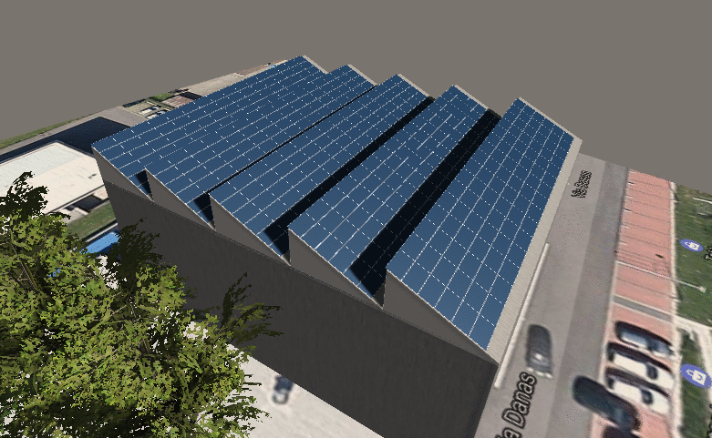
Test cases - Industrial
Industrial building with sheds and trees, a good positioning of modules and cabling into string and MPPTs can improve significantly overall performances.
It could be hard to find the best trade off between cablings and energy yield.

Slide 8
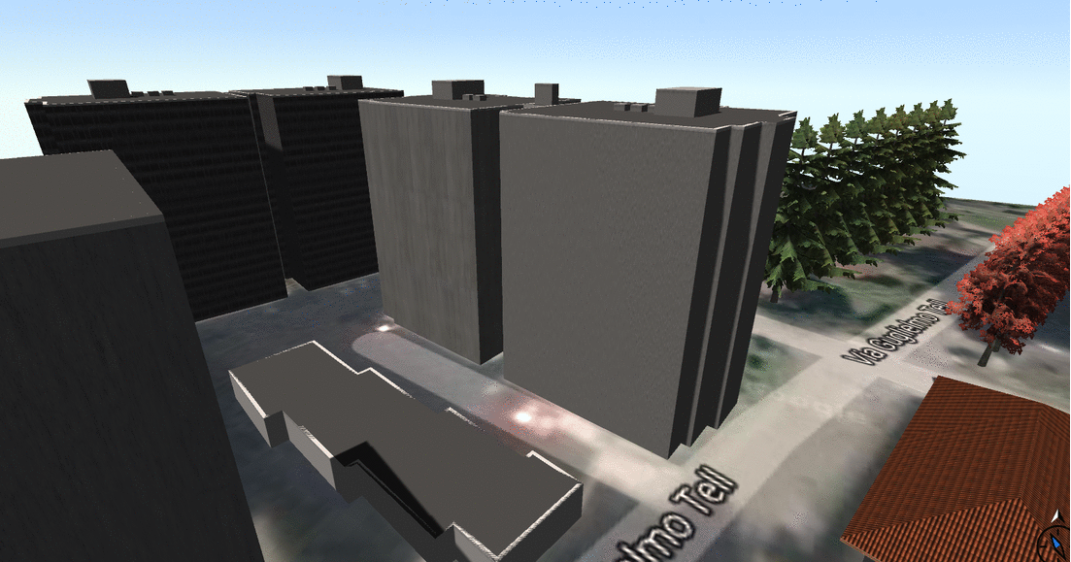
Test cases - BIPV
Installation on façade need to have a smart cabling of modules, very hard to design it manually depending on obstacles.

Slide 9
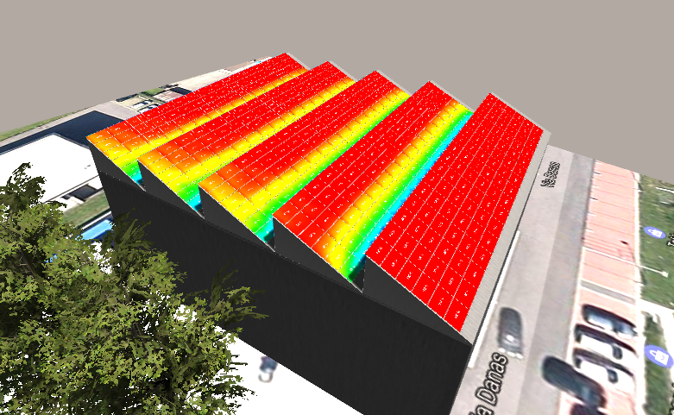
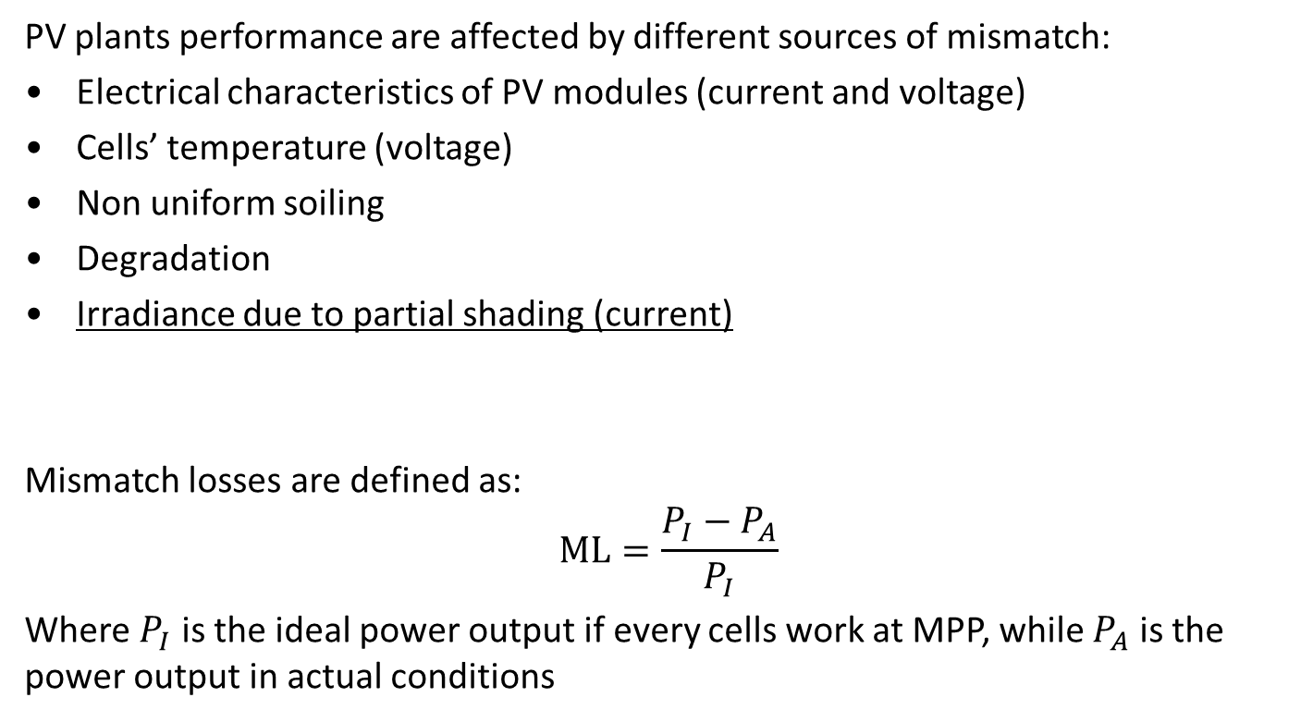
Mismatch in PV fields
PV plants performance are affected by different sources of mismatch:
Electrical characteristics of PV modules (current and voltage)
Cells’ temperature (voltage)
Non uniform soiling
Degradation
Irradiance due to partial shading (current)
Mismatch losses are defined as:
$$ML=\frac{P_{I}−P_{A}}{P_{I}}$$
Where $P_{I}$ is the ideal power output if every cells work at MPP, while $P_{A}$ is the power output in actual conditions

Slide 10
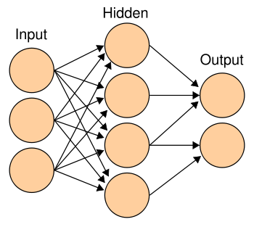
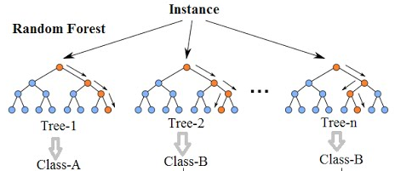
Approximation of Mismatch
For big PV plants and complex irradiation patterns the exact computation of mismatch losses can be computationally expensive, so an approximated model could speed up the energy yield simulation.
Two machine learning approaches have been studied:
Artificial Neural Newtork
Approximate the target iteratively transforming affine functions of the inputs with a nonlinear 'activation function' (usually sigmoid)
Random Forest
Averages the output of regression trees that approximate the target as a piecewise-constant function for different subset of the inputs
Averaging

Slide 11

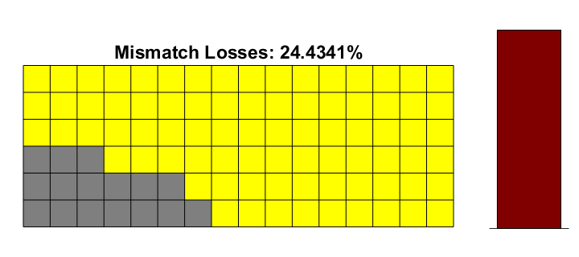

PV Field modelling
To generalize the model to any number of submodules per string, the input of the ANN and RF have been normalized to the length of the string (shading fraction), moreover the diffuse fraction is considered as input. The test case is a Poly-Si module.
Machine Learning
s_{i} $∈[0, 1]$ k_{D} $∈\left[0.1, 1\right]$ ML $∈[0.1, 1]$
s₁
s₂
…
s_{N}
k_{D}
Both machine learning approaches need to be trained with a large dataset of examples, to minimize the size of the training dataset some equivalence classes are considered:
the shading fraction is sorted
Position of modules inside its string is not considered
The computation of the prediction is extremely fast in both cases.
Mismatch
Losses
Example
ML = 0.244
s = [7/16 6/16 3/16 0 0 0]
k_{D} = 0.3

Slide 12

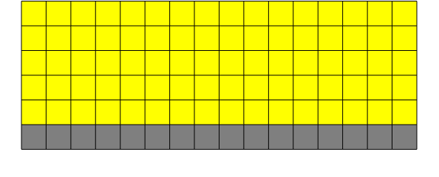
Optimal cabling of modules in arrays
Case Study
PV Plant with a single inverter (single MPPT), field of 6 strings of 16 submodules each.
Yellow submodules get full irradiance (global) while grey ones get only diffuse irradiance, different diffuse ratio are simulated, results below are referring to 0.3 (e.g. global of 1000 W/m² of which 300 W/m of diffuse).
16 submodules are shaded, how the mismatch loss is affected from the distribution of the shading pattern among the strings?
WORST CASE - 24.4%
BEST CASE - 0.1%

Slide 13
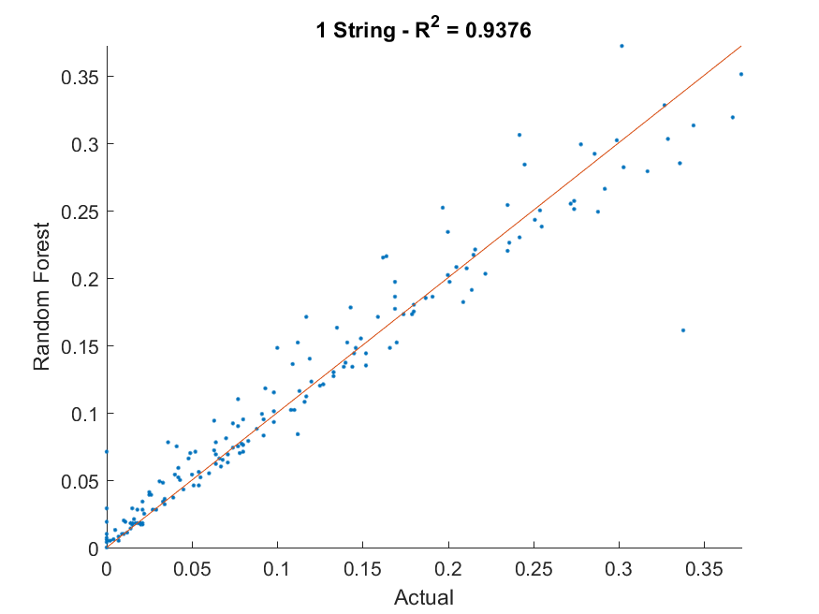
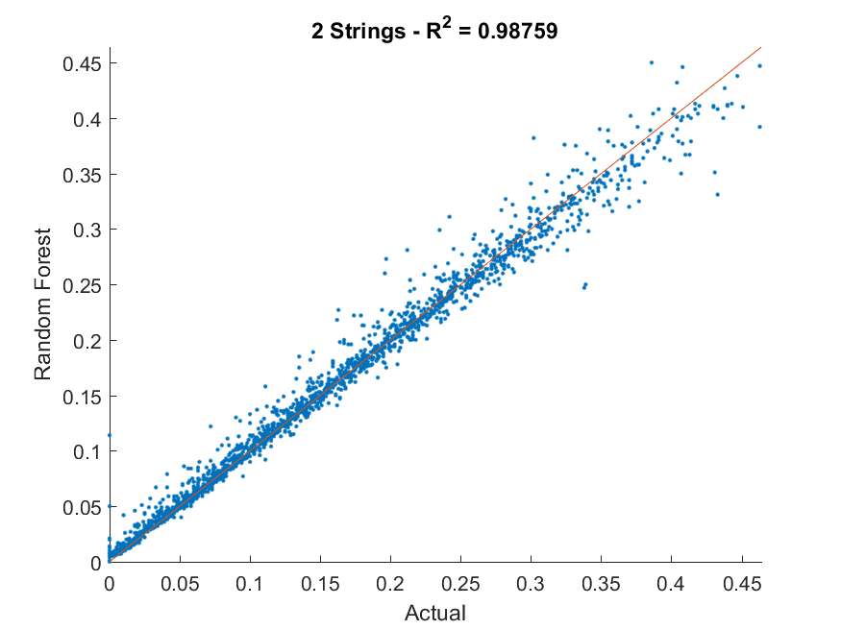
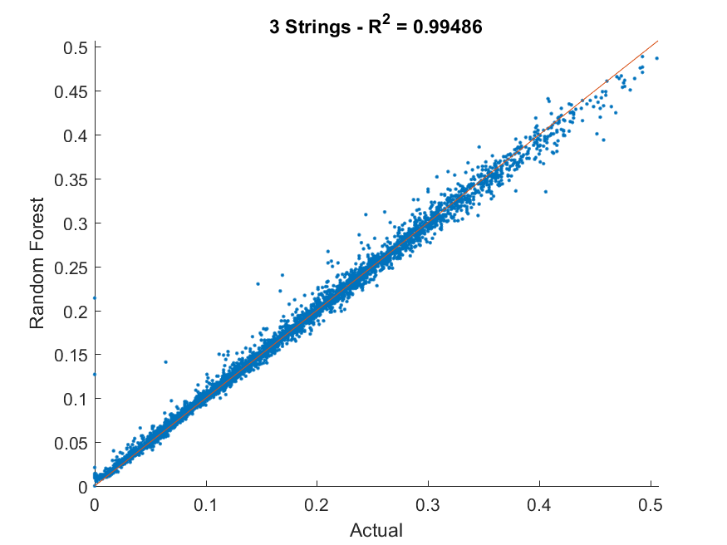
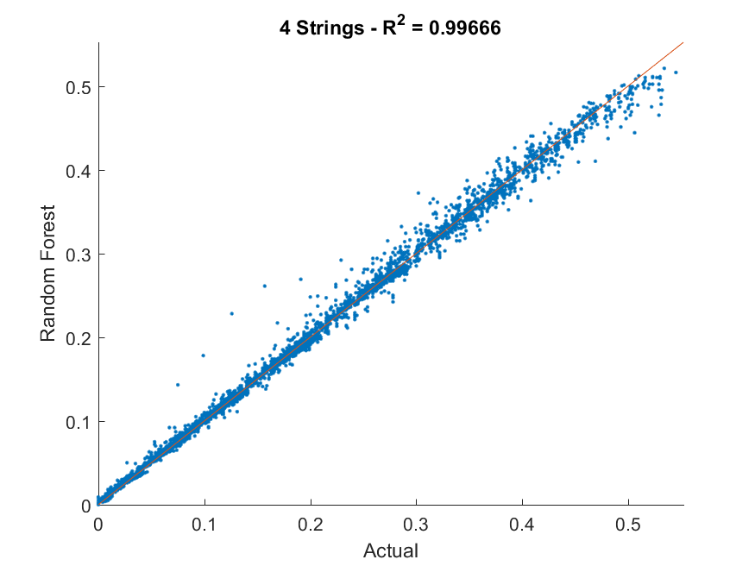
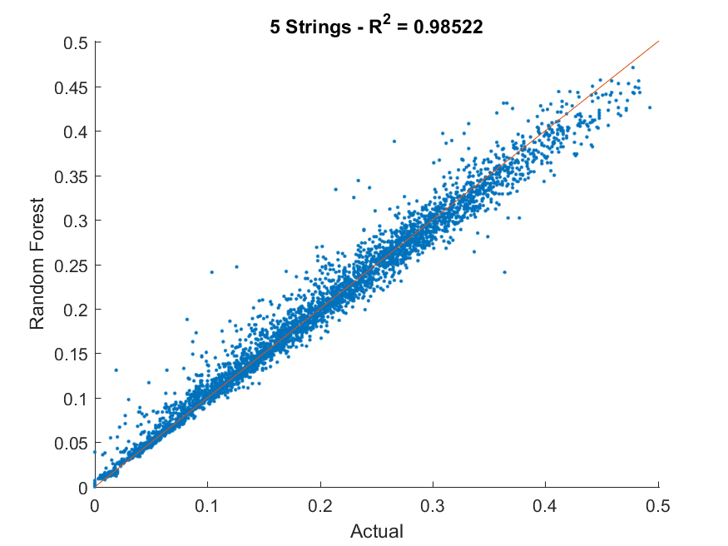
Results
Results are presented for number of strings between 1 and 5, the correlation coefficient are very high, guaranteeing good approximation and also good ranking capabilities (optimization tool)
# of strings | RMSE | R² | Spearman correlation | Pearson correlation
1 | 0.0279 | 0.937 | 0.981 | 0.968
2 | 0.0128 | 0.988 | 0.996 | 0.994
3 | 0.0084 | 0.995 | 0.998 | 0.997
4 | 0.0082 | 0.997 | 0.998 | 0.998
5 | 0.0148 | 0.985 | 0.994 | 0.992

Slide 14
Conclusions and next steps
The Random Forest model provide a very good accuracy and is fast to run inside a simulation tool
Generalize the approach to different technologies, high efficiency modules (> losses) and modules with lower fill factor (< losses)
  → New Random Forest can be easily trained
Validate the exact and approximated models with real PV plants
→ Measurement during the summer with natural and artificial shadings
Design and implementation of a tool for the layout optimization of PV fields, arrangement of modules in strings to minimize the mismatch losses
    → Ongoing CTI project with inSun

Slide 15
Thank you for you attention

