Slide 1
Simulation-based energy yield analysis of building integrated photovoltaic systems
Johannes Eisenlohr, Claudio Ferrara, Helen Rose Wilson, Tilmann E. Kuhn
7th Energy Rating and Module Performance Modeling Workshop
Cannobio, March 31st
Fraunhofer Institute for Solar Energy Systems ISE
www.ise.fraunhofer.de

Slide 2
Agenda
Challenges and needs for the simulation of building integrated photovoltaics
Tool-chain of Fraunhofer ISE including examples from real projects: Simulation of irradiance, cell temperature, electrical cell behaviour, module interconnection and inverter behaviour
Results of an example project

Slide 3
BIPV – a short definition
BIPV = Building-Integrated Photovoltaics
  Components of the building skin, that additionally generate electrical power output
Requirements and possible issues
  Fulfilling of building norms, statics, durability (higher demands than for standard PV), appearance from outside and inside, thermal insulation, watertightness, electrical efficiency…
Notes:
Bindestrichkorrektur

Slide 4
Challenges for BIPV systems regarding electrical system design
Planning and construction process much more complex
Different orientations of modules
Partial shading
Different module sizes
Complex module interconnections
Complex inverter requirements
…

Slide 5
Needs for the simulation of BIPV systems
3D geometry of building and its surroundings with a reasonable level of detail
Optical properties of the materials in this 3D geometry
Low light behavior of modules
Incidence angle modifier (more often oblique incidence)
Knowledge about characteristics of blocking and bypass diodes as well as IV-curve of cells in reverse bias to describe behavior under partial shading correctly
Weather data with high time resolution

Slide 6
Simulation-based approach for complex BIPV systems
For each time step:
1
Irradiance
Notes:
Bindestrichkorrektur

Slide 7
Simulation-based approach for complex BIPV systems
For each time step:
1
2
Irradiance
Cell temperature

Slide 8
Simulation-based approach for complex BIPV systems
For each time step:
1
2
Irradiance
Cell temperature
3
Cell IV curves
Notes:
Bindestrichkorrektur

Slide 9
Simulation-based approach for complex BIPV systems
For each time step:
1
2
Irradiance
Cell temperature
3
Cell IV curves
4
System IV curves
(DC output)
Notes:
Bindestrichkorrektur

Slide 10
Simulation-based approach for complex BIPV systems
For each time step:
1
2
Irradiance
Cell temperature
3
Cell IV curves
4
System IV curves
(DC output)
5
Inverter
(AC output)
Notes:
Bindestrichkorrektur

Slide 11
Simulation-based approach for complex BIPV systems
For each time step:
1
2
Irradiance
Cell temperature
3
Cell IV curves
4
System IV curves
(DC output)
5
Inverter
(AC output)
W. Sprenger et al., Solar Energy 135 (2016) 633-643
Notes:
Bindestrichkorrektur

Slide 12
Topic I: Irradiance Calculation
Open Source Ray-Tracing Program RADIANCE
Calculation of the sky radiance distribution based on horizontally measured irradiance values according to Perez model¹
Backward ray-tracing of scene with the geometry of the building and its surroundings with corresponding optical properties of materials including:
    Partial shading
    Multiple reflections from ground or other surfaces
Output
Irradiance values for each PV cell involved and each time step of the defined time range
¹ R. Perez et al., Solar Energy, Vol. 50, No. 4, pp. 235-245 (1993)
Notes:
Bindestrichkorrektur

Slide 13
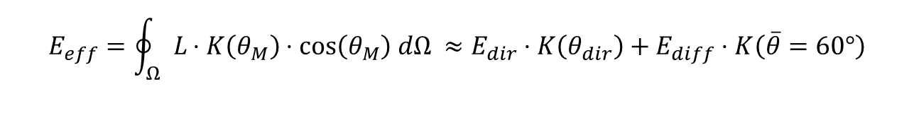
Topic I: Irradiance Calculation
Angular Correction
$$E_{eff}=\oint_{Ω}{L⋅K\left(θ_{M}\right)⋅cos\left(θ_{M}\right) dΩ ≈E_{dir}⋅K\left(θ_{dir}\right)+E_{diff}⋅K\left(\overline{θ}=60°\right)}$$
Examples of different $K\left(θ_{M}\right)$ curves (Martin, 2001¹):
→ $E_{eff}$ can be directly compared to the irradiance level at STC.
¹ N. Martin, J.M. Ruiz, Solar Energy Materials & Solar Cells 70 (2001) 25-38

Slide 14
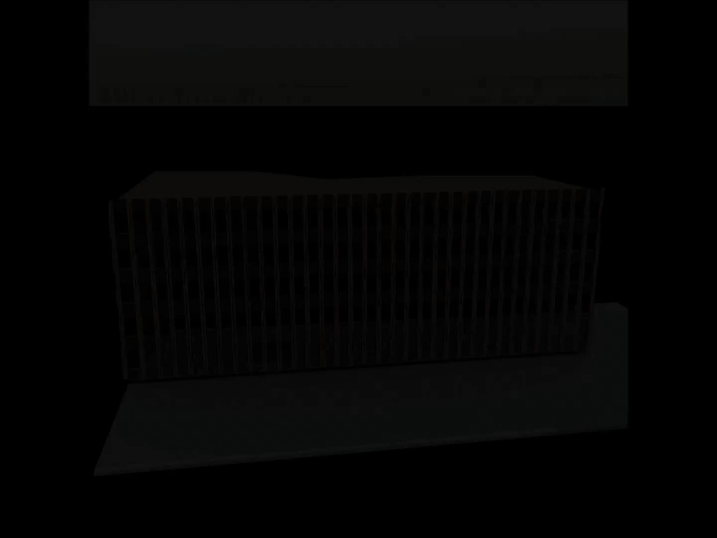
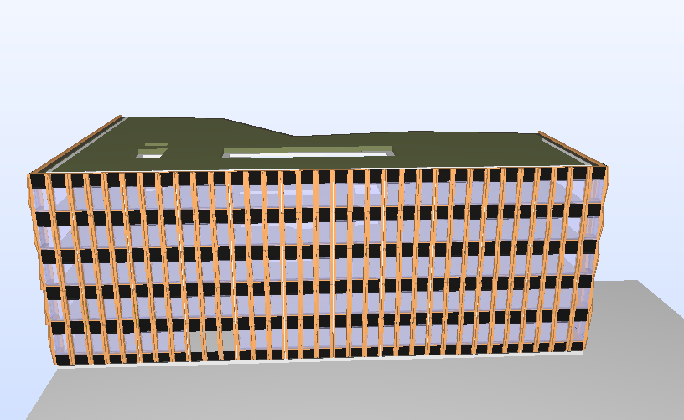
Example: Irradiance calculation
Basis for the calculation of the irradiance
  Meteorological data of the corresponding site
  3D-geometry of the building and its surroundings
  Geometrical positions and orientations of all cells
IFC → Radiance

Slide 15
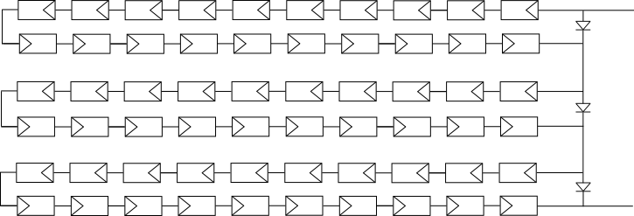
Topic IV: Electrical simulation of the DC circuit
Simple Example: Standard Module
Interconnection:
PV cells, resistances, diodes
parallel, series, cross-connected
the electrical circuit of a standard 60-cell PV module
Notes:
Series statt serial (englisch ist nicht immer logisch!)

Slide 16
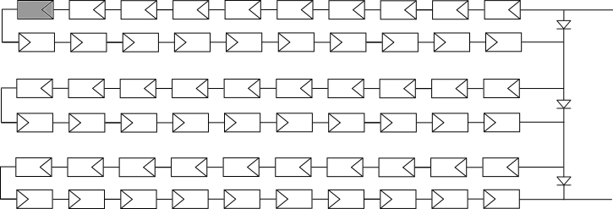
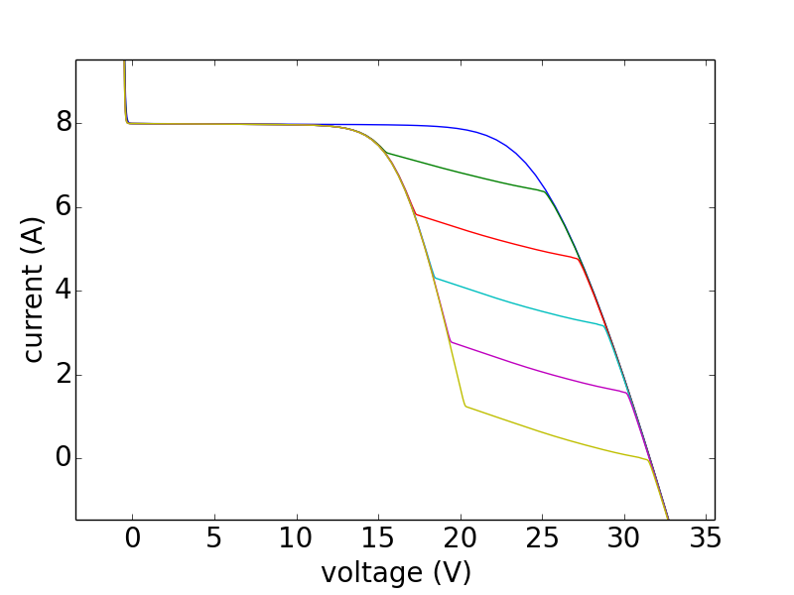
Topic IV: Electrical simulation of the DC circuit
Simple Example: Standard Module
Interconnection:
PV cells, resistances, diodes
parallel, series, cross-connected
1. Calculation of the IV curves
the electrical circuit of a standard 60-cell PV module
IV curve of the standard 60-cell PV module at different (homogeneous) irradiance levels on one shaded PV cell at 1000 W/m² irradiance on all other PV cells.
Blue: 1000 W/m², green: 800 W/m², …, yellow: 0 W/m²
Notes:
Series statt serial (englisch ist nicht immer logisch!)

Slide 17
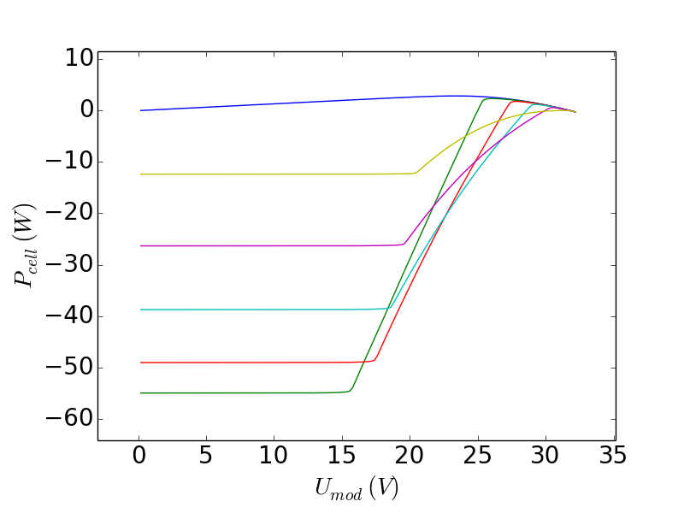
Topic IV: Electrical simulation of the DC circuit
Simple Example: Standard Module
Interconnection:
PV cells, resistances, diodes
parallel, series, cross-connected
2. Calculation of the
operation points
the electrical circuit of a standard 60-cell PV module
Operation points of the shaded PV cell in a standard 60-cell PV module at different (homogeneous) irradiance levels on the shaded PV cell and 1000 W/m² irradiance on all other PV cells, vs. the applied PV module voltage.
Blue: 1000 W/m², green: 800 W/m², …, yellow: 0 W/m²
Notes:
Series statt serial (englisch ist nicht immer logisch!)

Slide 18
Summary of important points for BIPV simulation
In almost all cases, BIPV systems have to deal with
inhomogeneous irradiation.
The impact of shading and multiple reflections (ground, other buildings) is not negligible and can be calculated.
Inhomogeneous irradiation leads to module/system IV curves and cell operation points that vary strongly in time and are difficult to predict.
They have to be simulated.
The temperature situation has to be investigated in advance. Especially for thermally insulated facades, peak temperatures can be higher than expected.
The inverter has to be chosen with care. Voltage or power restrictions can lead to serious losses or damage.

Slide 19
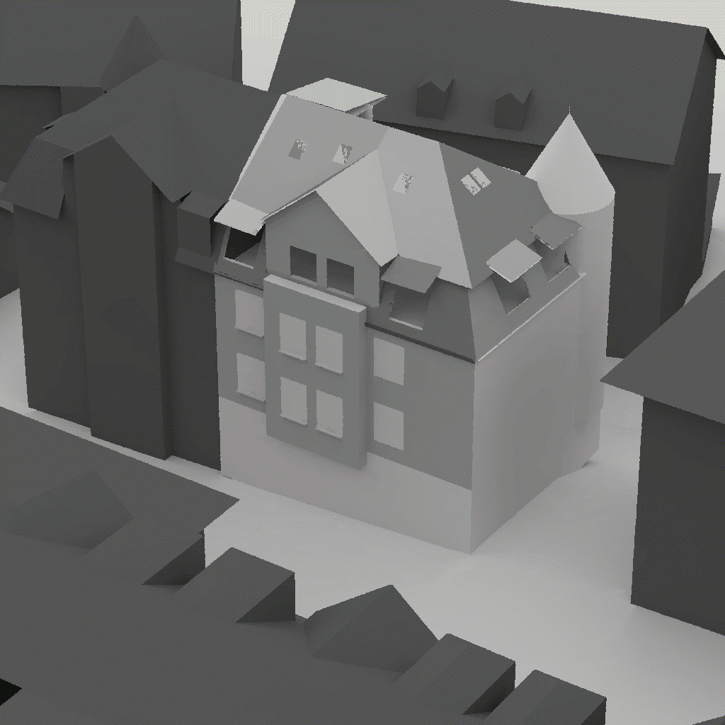
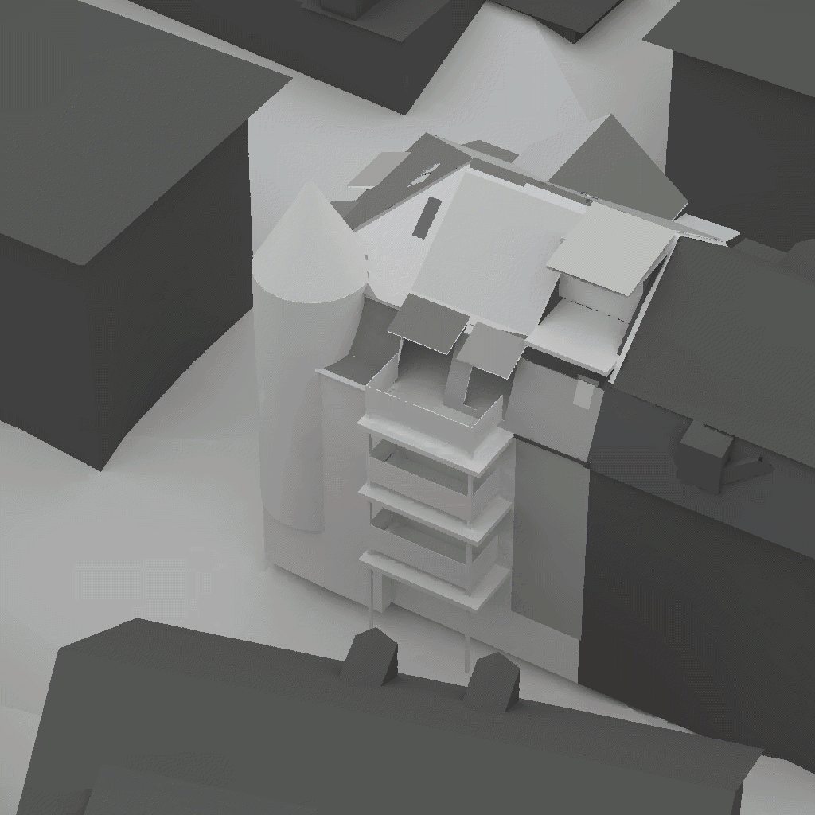
Example Project in Zürich
Renovation of an urban building. Goal: “Plus Energy Building”
view from north-east
view from south-west

Slide 20
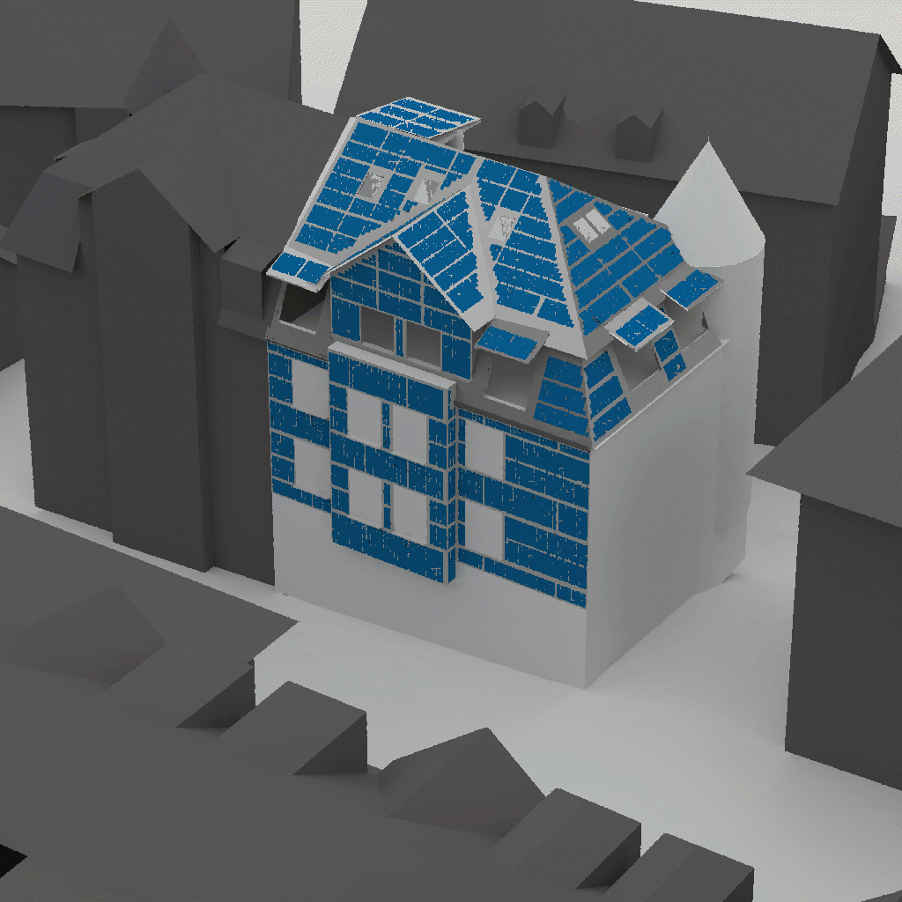
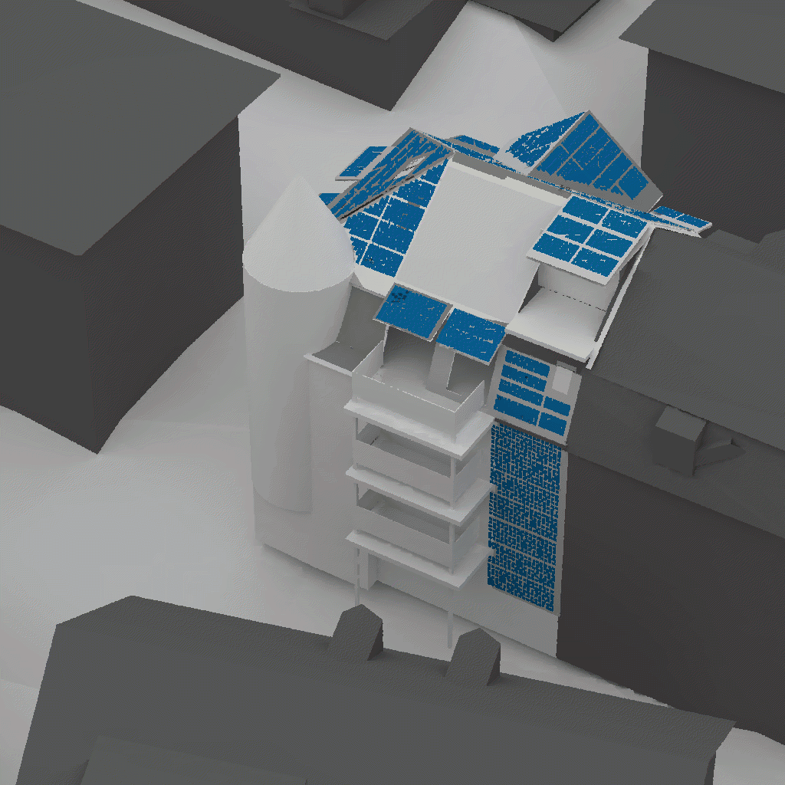
Example Project in Zürich
Renovation of an urban building. Goal: “Plus Energy Building”
view from north-east
view from south-west

Slide 21
Example Project in Zürich
Data in brief:
100% power supply (grid connection)
Nominal system power: 27.94 kWp
198 PV modules with 112 different
sizes
19 different module expositions
PV cells from SunPower Corp.
PV modules from ertex solartechnik GmbH
Inverters from SolarInvert GmbH
Goal: 14000 kWh per year
north-east view
south-west view

Slide 22
Example Project in Zürich
Calculation of time-dependent irradiance (1)
Calculation of time-dependent module temperature (2)
Calculation of cell IV characteristics for all irradiance and temperature levels (3)
Calculation of system IV curve based on the electrical interconnections of cells and modules including bypass diodes (DC output) (4)
Calculation of inverter output (AC output) (5)

Slide 23
Example Project in Zürich
Calculation of time-dependent irradiance (1)
Calculation of time-dependent module temperature (2)
Calculation of cell IV characteristics for all irradiance and temperature levels (3)
Calculation of system IV curve based on the electrical interconnections of cells and modules including bypass diodes (DC output) (4)
Calculation of inverter output (AC output) (5)
Notes:
Bindestrichkorrektur

Slide 24
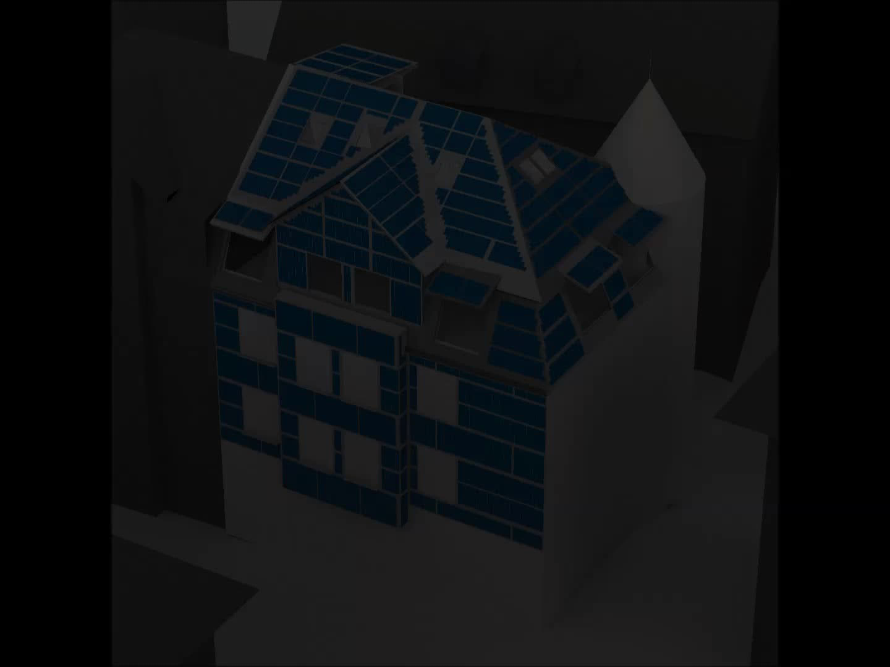
Example Project in Zürich
Irradiance simulation
Calculation of irradiance for every PV cell (time steps: 10 min)

Slide 25
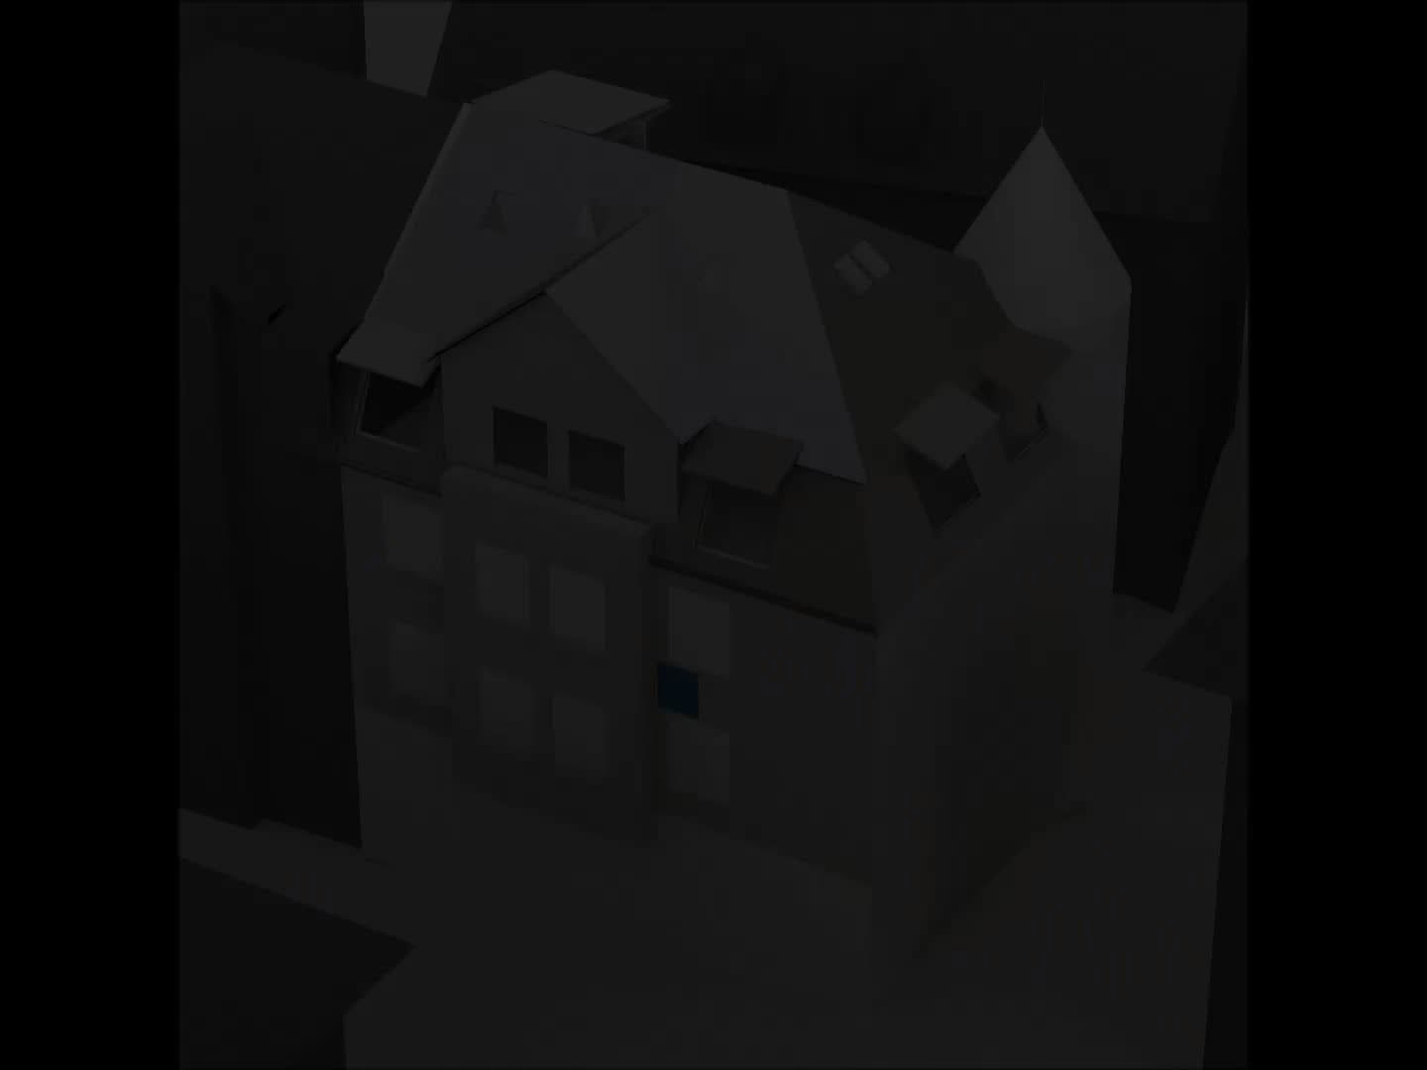
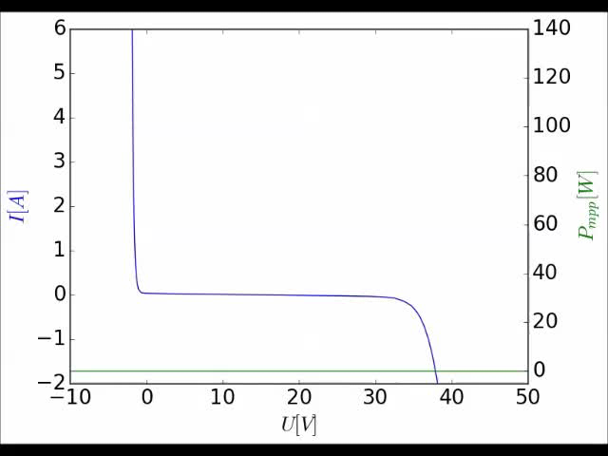
Example Project in Zürich
Calculation of DC-output
                Example of subsystem: One PV Module
Notes:
„Example of“ statt exemplary

Slide 26
Example Project in Zürich
Various challenges to electrical system design
Which modules can be interconnected in series to strings?
Which strings can be interconnected in parallel?
Inverter restrictions (MPP tracking range, voltage range) very important for systems with frequent partial shading
Result: 14 sub-systems with minimized mismatch losses of 6.2 %
Calculated yield: 512.78 kWh / kWp; 14328 kWh
Notes:
Überschrift – challenges to
3. Punkt shading
Bindestrichkorrektur

Slide 27
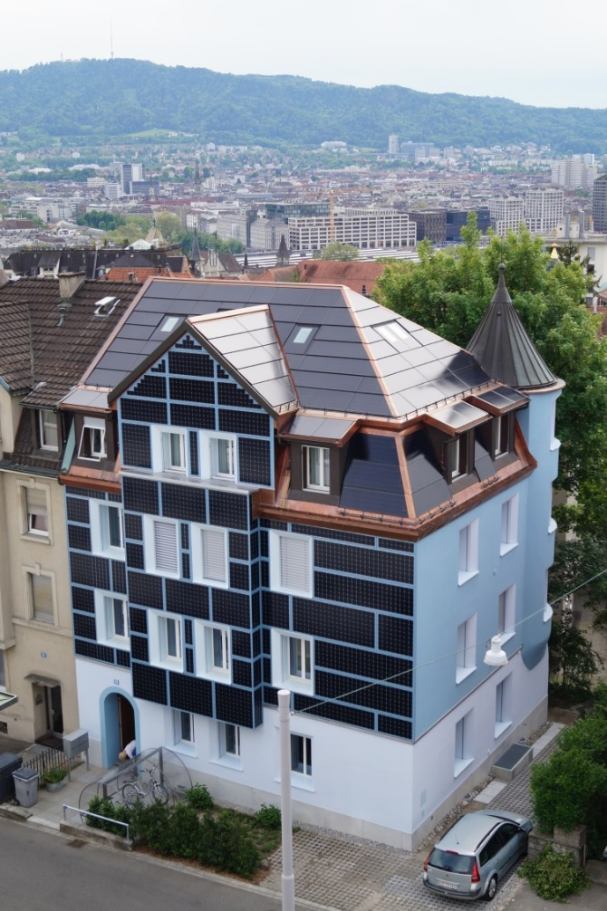
Example Project in Zürich
Status
System built and converting energy
since March 2016
Goal:14000 kWh/year
Predicted complete year (TRY):
14328 kWh
Predicted April to February (TRY):
13317 kWh
Measured yield April to February:
11736 kWh (88% of prediction)
(preliminary data)
Notes:
Ich würde mehr die Verwendung des TRY betonen und die zu erwartende Abweichung von jedem beliebigen Messjahr stärker betonen. Z.B. statt „(TRY)“ „(based on data from Test Reference Year)“

Slide 28
Summary and Outlook
Detailed simulation approach for (BI)PV systems allows for an accurate calculation and optimization with regard to:
Irradiance conditions including shading
Electrical design (cell and module interconnection)
Inverter behavior
Fail-safe design
For an exemplary project in Zürich, a 27.9 kWp BIPV system with 198 modules,112 different module sizes and 14 inverters has been electrically designed and simulated.
Predicted annual yield : 14328 kWh/year
Yield after construction April – February: 11736 kWh (88% of prediction for April - February)

Slide 29





Thanks to all project partners and colleauges!
Gallus Cadonau
FENT Solare Architektur
Ertex solar
Solarinvert
Fraunhofer ISE
TU Darmstadt
Ed. Züblin AG

Slide 30
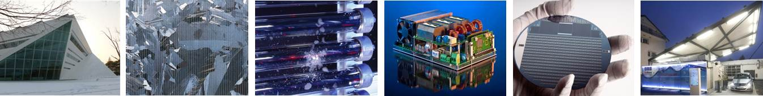
Thank you for your attention!
Fraunhofer Institute for Solar Energy Systems ISE
Johannes Eisenlohr
www.ise.fraunhofer.de
johannes.eisenlohr@ise.fraunhofer.de
Notes:
Energy Dream Center, Seoul, Korea
Multicrystalline Silicium Solarzelle
Hail test stand (solar thermal evacuated tube collectors)
>99% inverter
Concentrator Photovoltaics (CPV)
Solar hydrogen fueling station at Fraunhofer ISE, opened in 2012

Slide 31
Simulation based approach for complex BIPV systems
For each time step:
1
2
Irradiance
Cell temperature
Raytracing based on
3D geometry
Meteoroligical data (diffuse and direct irradiation)
3
Calculation based on
Module layer structure
Irradiance
Cell IV-curves
Calculation based on
Datasheet specifications
Two diode model
4
System IV-curves
(DC-output)
Calculation based on
Electrical interconnection including diodes, resistances etc.
5
Inverter
(AC-output)
Calculation based on
Inverter specifications

Slide 32
Example Project in Zürich – detailed result of optimization
Sub system | Inverter input ports | No. of PV cells | No. of module orientations | Nominal power [Wp] | Calculated DC-output per kWp and year (without inverter) | Calculated mismatch losses
A | 6 | 613 | 2 | 1951.8 | 472.2 | 7.0%
B | 3 | 296 | 1 | 942.5 | 375.1 | 12.3%
C | 5 | 901 | 4 | 2868.8 | 796.2 | 3.6%
D | 6 | 921 | 5 | 2932.5 | 601.8 | 2.0%
E | 3 | 288 | 1 | 917.0 | 195.1 | 16.6%
F | 3 | 405 | 3 | 1289.5 | 364.2 | 8.6%
G | 6 | 634 | 3 | 2018.7 | 626.9 | 3.0%
H | 5 | 744 | 3 | 2368.9 | 804.3 | 2.5%
I | 6 | 720 | 2 | 2292.5 | 908.0 | 1.4%
J | 6 | 830 | 1 | 2642.7 | 421.1 | 9.4%
K | 5 | 802 | 1 | 2553.6 | 404.8 | 13.8%
L | 5 | 600 | 1 | 1910.4 | 403.4 | 11.4%
M | 5 | 528 | 1 | 1681.2 | 385.8 | 18.5%
N | 4 | 494 | 1 | 1572.9 | 415.7 | 16.5%
gendaylit 1 22 15:00 -G 400 500 -a 35.660337 -o -139.745280 -m -135 > gendaylit.sky
oconv gendaylit.sky sky.rad > sky.oct
rpict -vta -vv 180 -vh 180 -vd 0 0 1 -vu 0 1 0 sky.oct > sky.hdr

Slide 33
Example Project in Zürich
Status

Slide 34

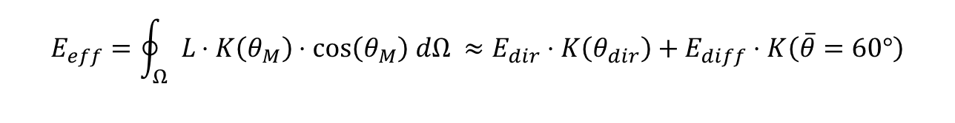

Topic I: Irradiance Calculation
Needed: Irradiance level in the PV module that can be compared to STC irradiance
Step 1: Irradiance in front of the PV Module
$$L:$$
$E$:
$θ_{M}$:
radiance (W/m²/K)
irradiance (W/m²)
Incident polar angle on the
PV module
$$E=\oint_{Ω}{L\cos\left(θ_{M}\right) dΩ}$$
→ E doesn’t include the higher
reflectance of the PV module at large incidence angles!
Step 2: Calculation of an “effective” irradiance
$$E_{eff}=\oint_{Ω}{L⋅K\left(θ_{M}\right)⋅cos\left(θ_{M}\right) dΩ ≈E_{dir}⋅K\left(θ_{dir}\right)+E_{diff}⋅K\left(\overline{θ}=60°\right)}$$
W. Sprenger, PhD Thesis 2013, TU Delft

Slide 35

Example: Irradiance calculation
Knowing the diffuse and direct radiation from the complete hemisphere is important for:
Calculation of the irradiance on tilted surfaces
Analysis of partial shading
→ The model of Perez (1993) allows the calculation of the sky radiance distribution and is implemented in the ray-tracing program RADIANCE (gendaylit).

