Slide 1
Performance of PV modules under different irradiances and temperatures
Robert Kenny

Slide 2
Why the need for Energy Rating
Peak power (Wp) at Standard Test Conditions (STC) is currently the standard performance guide for modules
End users need kWh NOT Wp!
Energy Rating Procedure
The performance is measured over a range of irradiances and temperatures to simulate the conditions that will be experienced outdoors
Outdoor verification: The module is placed outdoors on the Energy Rating (ENRA) fixed rack and continuously monitored for up to one year

Slide 3


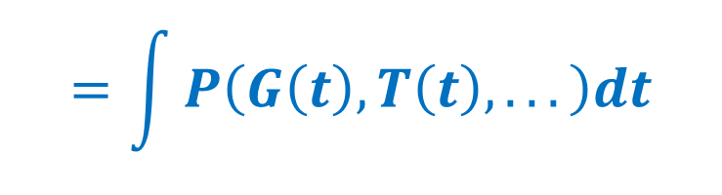
Energy Rating requires Power Rating at different conditions
$$U=\int{P\left(t\right)dt}$$
STC measurement:
25°C
1000W/m²
AM1.5G
$$=\int{P\left(G\left(t\right),T\left(t\right),...\right)dt}$$
POWER RATING
$$U=\sum_{g,k}{P\left(g,k\right)}∆t\left(g,k\right)$$
IEC 61853-1
Where:
g=[100,200,400,600,800,1000,1100]W/m²
k=[15,25,50,75]°C

Slide 4
Characterising PV modules
IEC 61853-1 specifies:
Ranges of Irradiance and Temperature
Different measurement methods
Interpolation methods
But:
Different methods cannot always meet the full ranges
Different measurement systems have particular limitations, e.g. ranges and uncertainties
Not all measurement systems are suitable for all module technologies (e.g. steady-state Vs pulsed simulators)

Slide 5
IEC 61853 Part 1
Power versus Irradiance and Temperature
POWER RATING
(FLAT PLATE MODULES)
61853-1 PHOTOVOLTAIC (PV) MODULE PERFORMANCE TESTING AND ENERGY RATING Part 1: Irradiance and temperature performance measurements and Power Rating
IRR | Spectrum | Module Temperature
W-m⁻² |  | 15°C | 25°C | 50°C | 75°C
1100 | AM1.5 | NA
1000 | AM1.5
800 | AM1.5
600 | AM1.5
400 | AM1.5 |  |  |  | NA
200 | AM1.5 |  |  |  | NA
100 | AM1.5 |  |  | NA | NA

Slide 6
IEC 61853-1 methods
‘Simplified’ procedure (linear modules)
IEC 60904-10
Natural sunlight with tracker
Mesh filters/angle of incidence
Natural sunlight without tracker
Solar simulator
Distance/angle of incidence/mesh filters (calibrated or uncalibrated)/decaying flash

Slide 7
Measurement systems at ESTI
Irradiance variation methods
Simulators
Pulsed: meshes/masks/flash decay
Steady-state: meshes/# lamps/lamp voltage
Natural sunlight with tracker
Mesh filters
Natural sunlight without tracker
‘The weather’

Slide 8
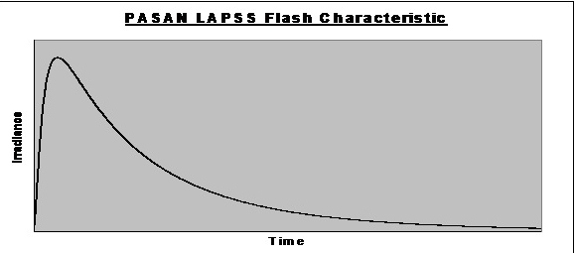
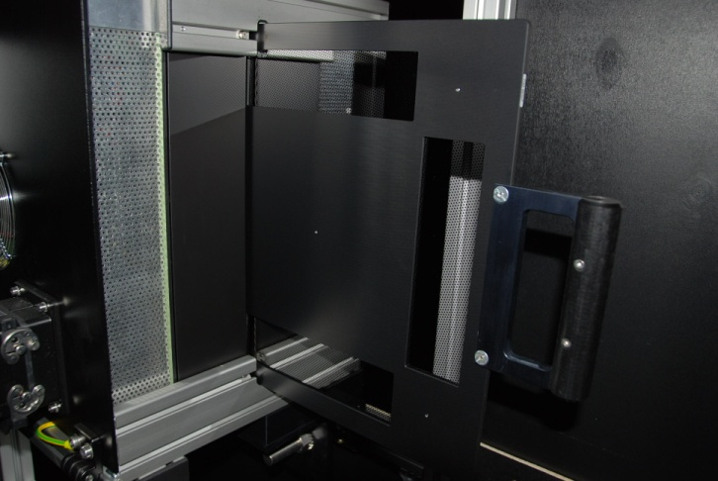
IEC 61853-1 Indoor method
<<Procedure with solar simulator>>
P2B
P3B
decay
varying G
masks
heated box
varying T
none
P2B LAPSS pulse characteristic
Irradiance
0
20
Time (ms)
g=[100,200,400,600,800,1000]W/m²
k=[25,35,45,55,65]°C

Slide 9
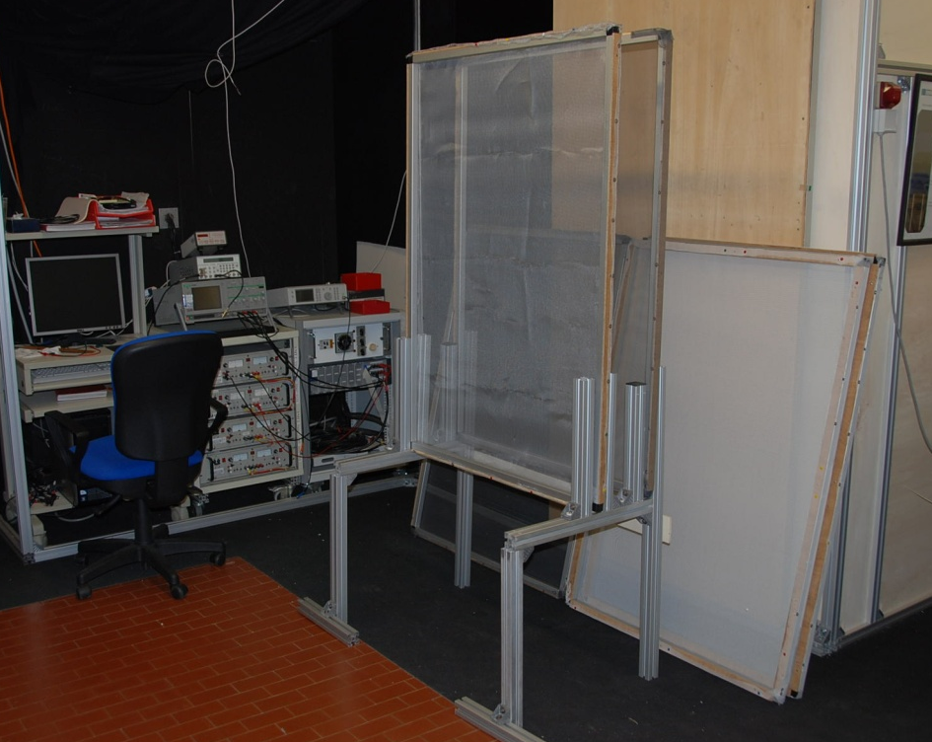
Mesh Filtering (uncalibrated)
<<uncalibrated mesh filters>>
Mesh Assembling | Typical measured mean irradiance (W/m²) | Nominal corrected irradiance (W/m²)
A | ≈ 740 | 800
Bx | ≈ 635 | 600
B1·B2 | ≈ 405 | 400
A·B1·B2·Cx | ≈ 195 | 200
A·B1·B2·C1·C2 | ≈ 125 | 100
1300
900
150
Constraints:
IEC 60891 within 30%
IEC 61853-1 less than 100W/m²

Slide 10
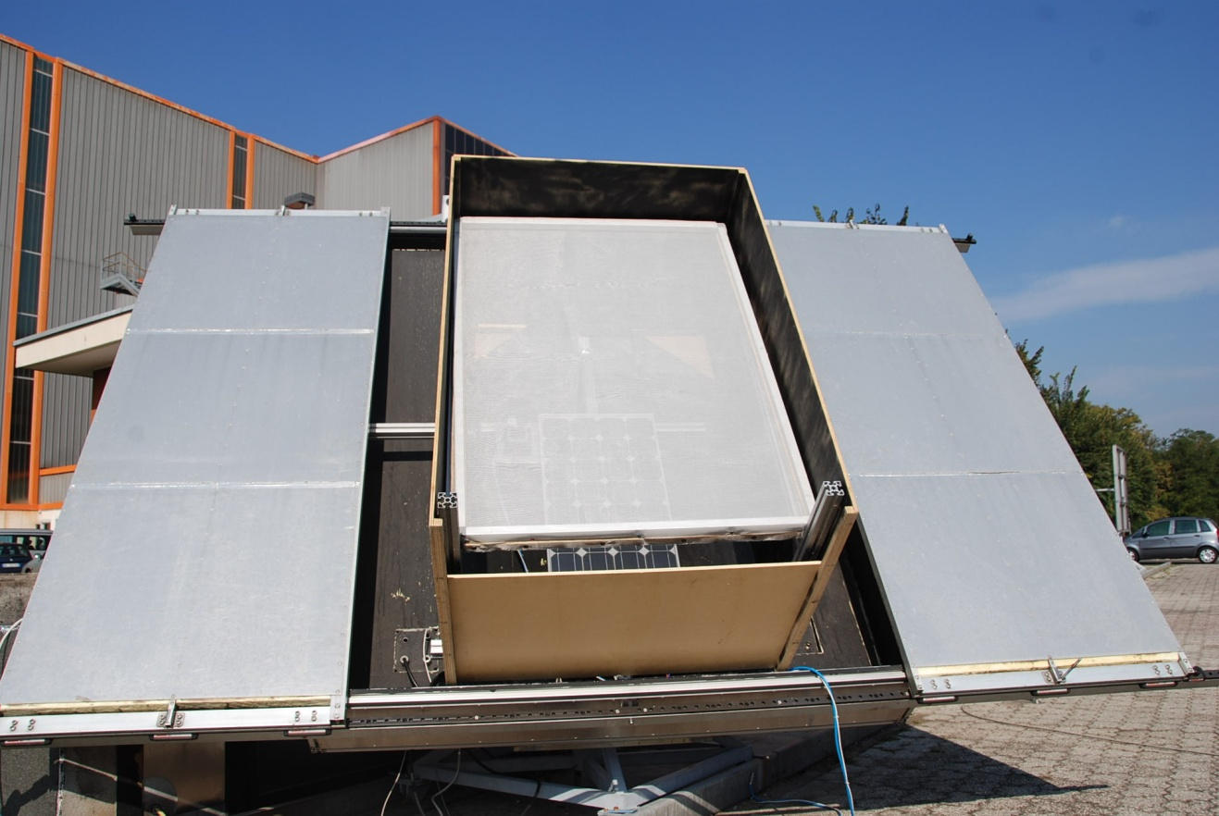
Outdoor with tracker
<<under natural sunlight with tracker>>
Temperature:
Heated up by sun
Cooled down with water
Fine control using an opaque lid
Mesh filters
RefCell
D.U.T.
Irradiance:
Mesh Filters
Wooden box
Aluminum structure
g=[100,200,400,600,800,1000]W/m²
k=[25,35,45,55]°C

Slide 11
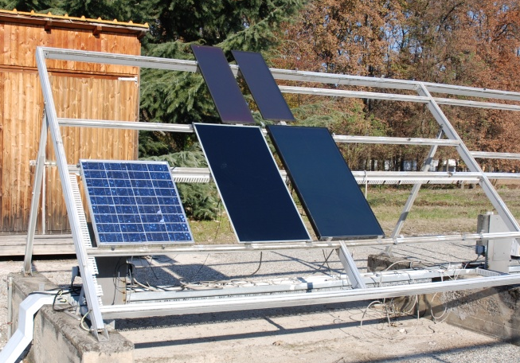
Outdoor field (ENRA)
<<under natural sunlight without tracker>>
No Rs,
No Spectral Corrections
BINNING TRESHOLDS:
G within ± 2% the target irradiance
T within ± 1°C the target temperature
G high & T high
G low & T low

Slide 12

IV Curve Corrections
IEC 60891
$$I2=I1+\frac{G1′}{Gsc}Isc\left(\frac{G2}{G1′}−1\right)+…$$
NO Temperature corrections
$$V2=V1−Rs\left(I2−I1\right)+…$$
Rs effect
740 → 800 W/m²
MMF correction
IEC 60904-3,7

Slide 13
Results
varying G,
fixed T=25±0.5°C
decay, mesh on P2B
masks, mesh on P3B
4 methods:
Poly-Si
Dev(P_{max}) ≈ 5%
CdTe
Dev(P_{max}) ≈ 3%
@100 W/m²
@100 W/m²

Slide 14
Results (poly-Si)
Poly-Si | Mean Irradiance (W/m²) | Max Power (W)
1000 (W/m²)
PASAN STC1 | 998.5 | 54.2
PASAN STC2 | 995.2 | 54.1
PASAN IIIB STC1 | 1006.4 | 54.4
PASAN IIIB STC2 | 1008.7 | 54.3
Mean Power ± % Std Dev. | 54.25 W ± 0.27%
800 (W/m²)
PASAN DECAY | 742.5 | 43.4
PASAN MESH | 744.8 | 43.3
PASAN IIIB MASK | 704.3 | 43.7
PASAN IIIB MESH | 807.3 | 43.6
Mean Power ± % Std Dev. | 43.51 W ± 0.41%
600 (W/m²)
PASAN DECAY | 631.2 | 32.5
PASAN MESH | 631.9 | 32.4
PASAN IIIB MASK | 704.2 | 32.7
PASAN IIIB MESH | 602.4 | 32.6
Mean Power ± % Std Dev. | 32.54 W ± 0.40%
400 (W/m²)
PASAN DECAY | 405.1 | 21.3
PASAN MESH | 403.3 | 21.3
PASAN IIIB MASK | 402.3 | 21.5
PASAN IIIB MESH | 403.2 | 21.4
Mean Power ± % Std Dev. | 21.38 W ± 0.33%
200 (W/m²)
PASAN DECAY | 191.8 | 10.1
PASAN MESH | 189.8 | 10.0
PASAN IIIB MASK | 201.0 | 10.2
PASAN IIIB MESH | 197.8 | 10.5
Mean Power ± % Std Dev. | 10.20 W ± 2.42%
100 (W/m²)
PASAN DECAY | 126.7 | 4.7
PASAN MESH | 125.7 | 4.3
PASAN IIIB MASK | 101.0 | 4.7
PASAN IIIB MESH | 113.9 | 4.4
Mean Power ± % Std Dev. | 4.52 W ± 4.97%

Slide 15
Results (CdTe)
CdTe | Mean Irradiance (W/m²) | Max Power (W)
1000 (W/m²)
PASAN STC | 995.0 | 68.0
PASAN IIIB STC1 | 974.2 | 67.5
PASAN IIIB STC2 | 974.3 | 67.6
Mean Power ± % Std Dev. | 67.68 W ± 0.39%
800 (W/m²)
PASAN DECAY | 798.2 | 54.8
PASAN MESH | 742.7 | 55.0
PASAN IIIB MASK | 779.7 | 54.8
PASAN IIIB MESH | 782.6 | 54.8
Mean Power ± % Std Dev. | 54.85 W ± 0.15%
600 (W/m²)
PASAN DECAY | 591.7 | 41.1
PASAN MESH | 628.6 | 41.4
PASAN IIIB MASK | 575.4 | 41.2
PASAN IIIB MESH | 579.2 | 41.2
Mean Power ± % Std Dev. | 41.25 W ± 0.32%
400 (W/m²)
PASAN DECAY | 400.0 | 27.0
PASAN MESH | 403.7 | 27.2
PASAN IIIB MASK | 388.2 | 27.2
PASAN IIIB MESH | 387.1 | 27.2
Mean Power ± % Std Dev. | 27.15 W ± 0.46%
200 (W/m²)
PASAN DECAY | 202.7 | 12.5
PASAN MESH | 189.9 | 12.7
PASAN IIIB MASK | 193.6 | 12.7
PASAN IIIB MESH | 188.6 | 12.4
Mean Power ± % Std Dev. | 12.58 W ± 1.11%
100 (W/m²)
PASAN DECAY | 101.2 | 5.3
PASAN MESH | 115.5 | 5.7
PASAN IIIB MASK | 96.9 | 5.5
PASAN IIIB MESH | 91.9 | 5.5
Mean Power ± % Std Dev. | 5.49 W ± 2.76%

Slide 16
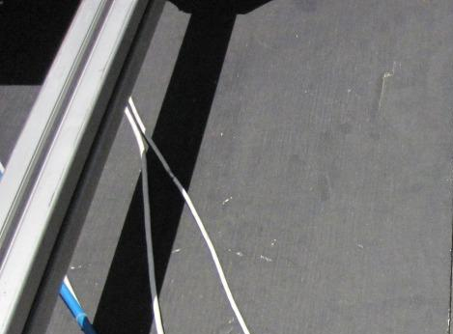
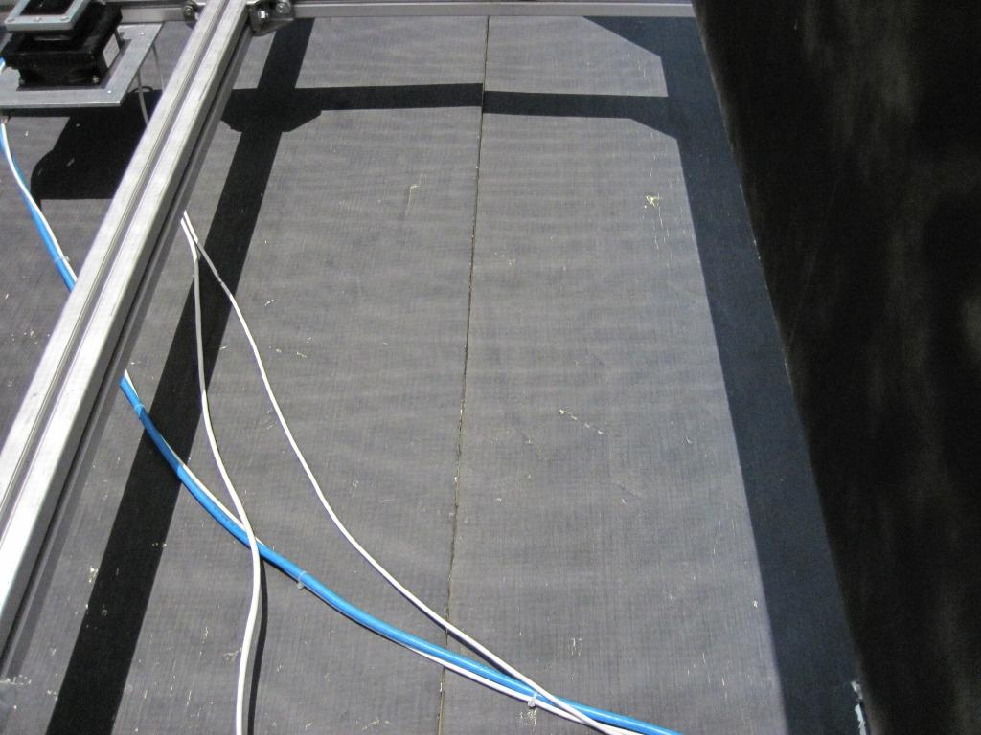
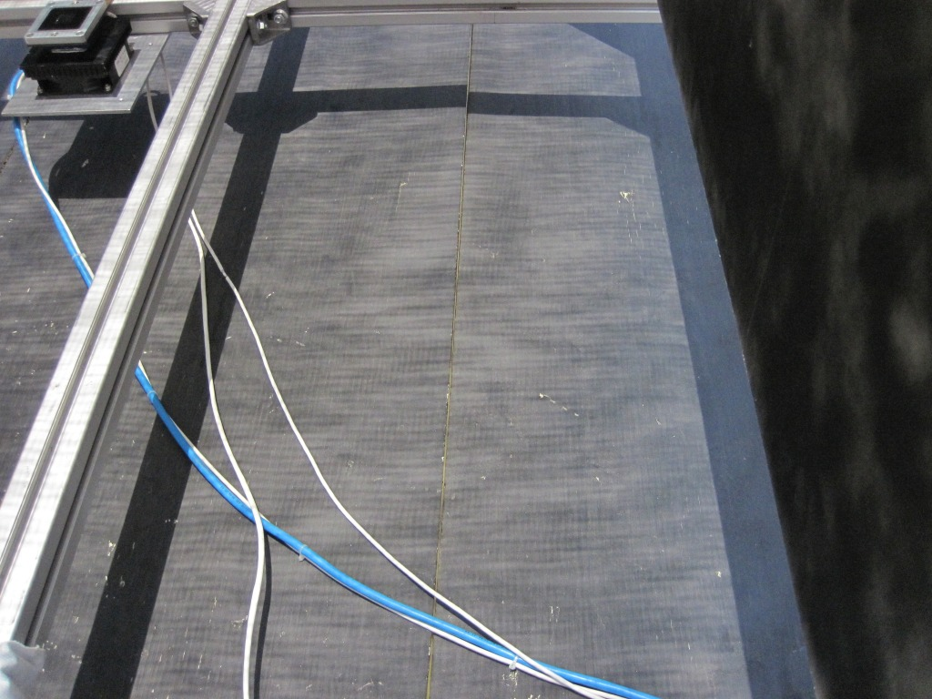
Non uniformity
Low irradiance 100-200W/m²
4 or 5 filters stacked together
No spaces among filters
Spatial uniformity issues
Indoor Isc deviation > 10%
Visible Moiré pattern:
800 W/m²
400 W/m²
100 W/m²
1 mesh
2 meshes
5 meshes

Slide 17
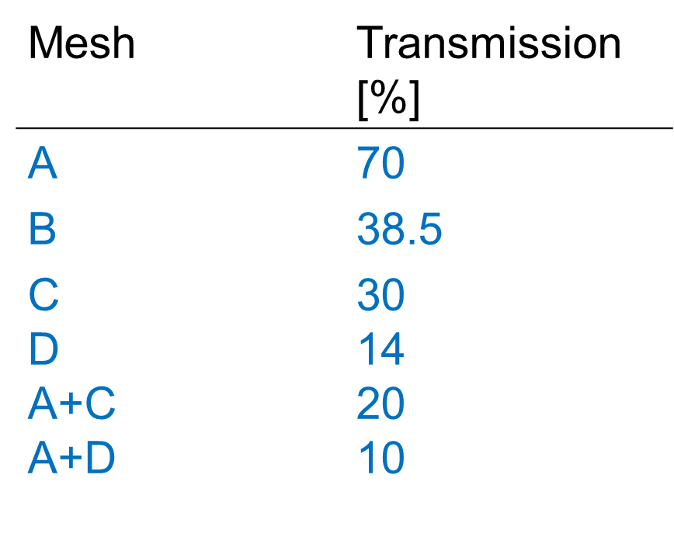
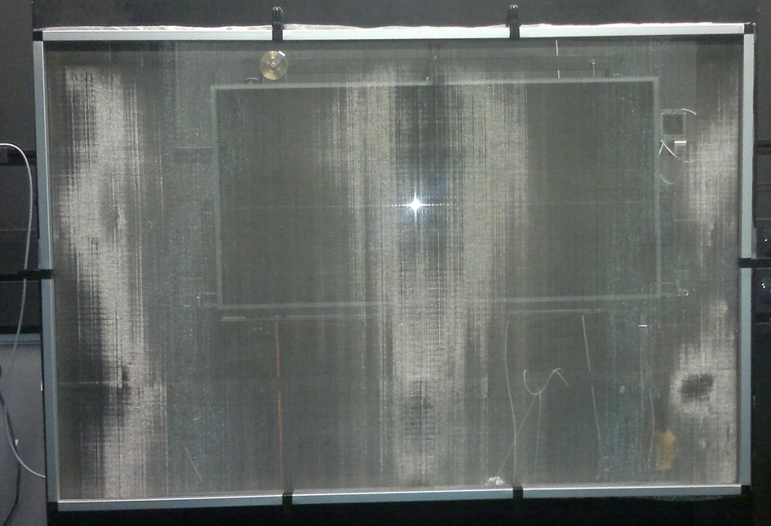
Mesh Filtering - improved filters
<<uncalibrated mesh filters>>
1.2 m width

Slide 18
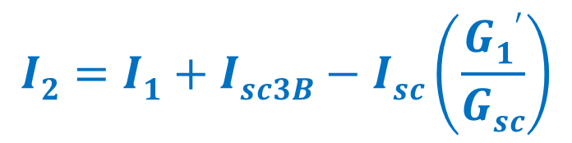
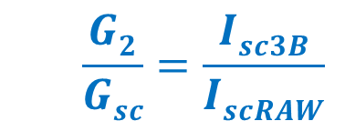
Self-Reference method
Isc of module measured with Pasan 3B as reference
Linearity check (IEC 60904-10)
MMF corrected
Determination of Isc(T)
$$\frac{G2}{Gsc}=\frac{Isc3B}{IscRAW}$$
$$I2=I1+Isc3B−Isc\left(\frac{G1′}{Gsc}\right)$$
Envisaged by IEC 61853-1
Further corrections:
Advantages:
Rs correction
NO spectral mismatch (MMF=1)
ratio A_{DUT}/A_{refcell} ≈ 100
different geometry of the cells

Slide 19
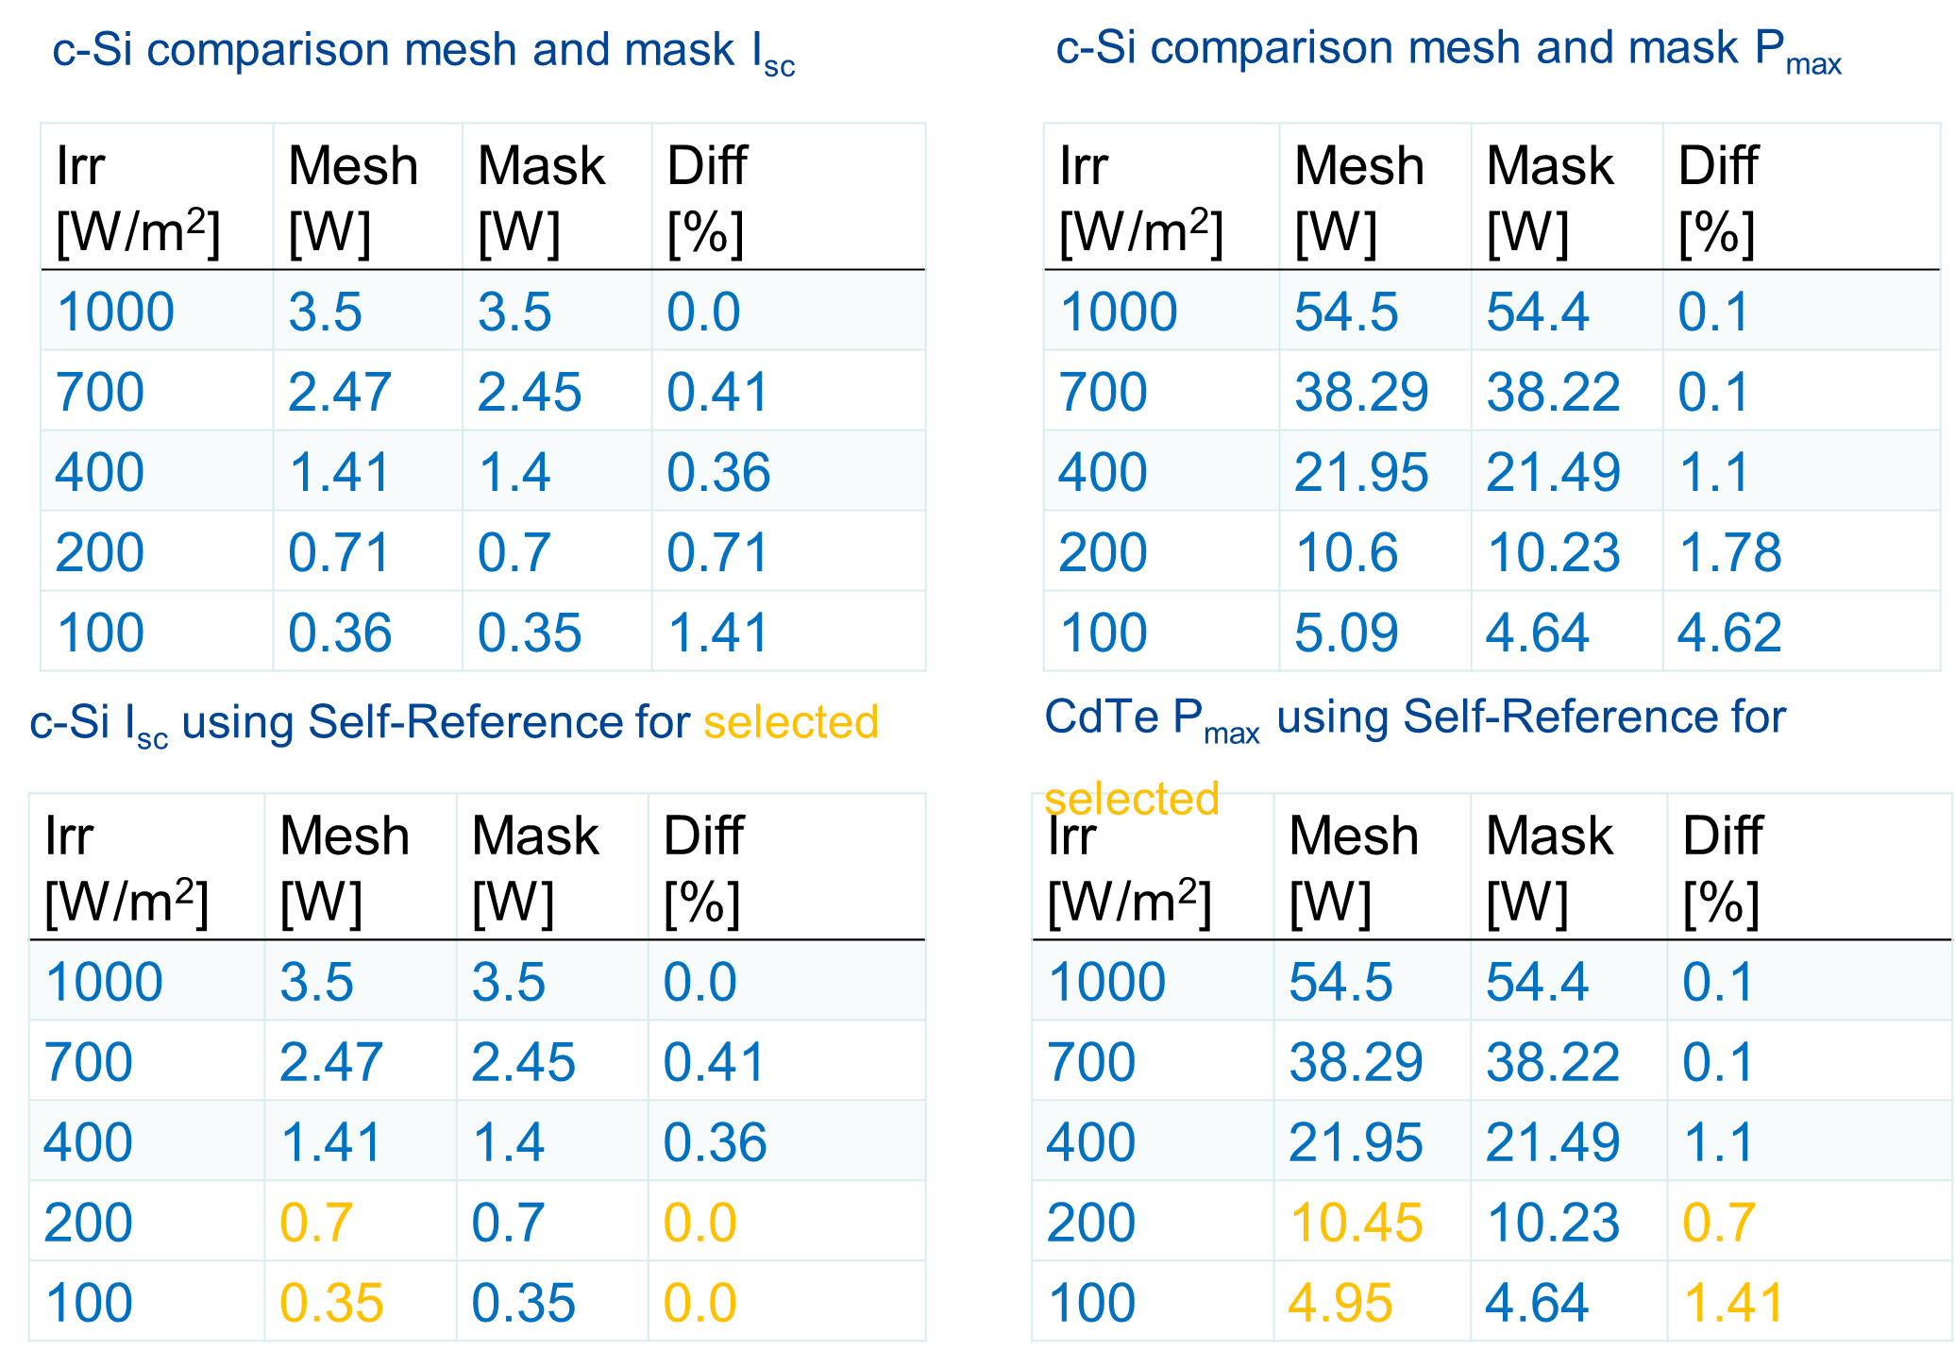
Pasan 3B improved meshes (c-Si)

Slide 20
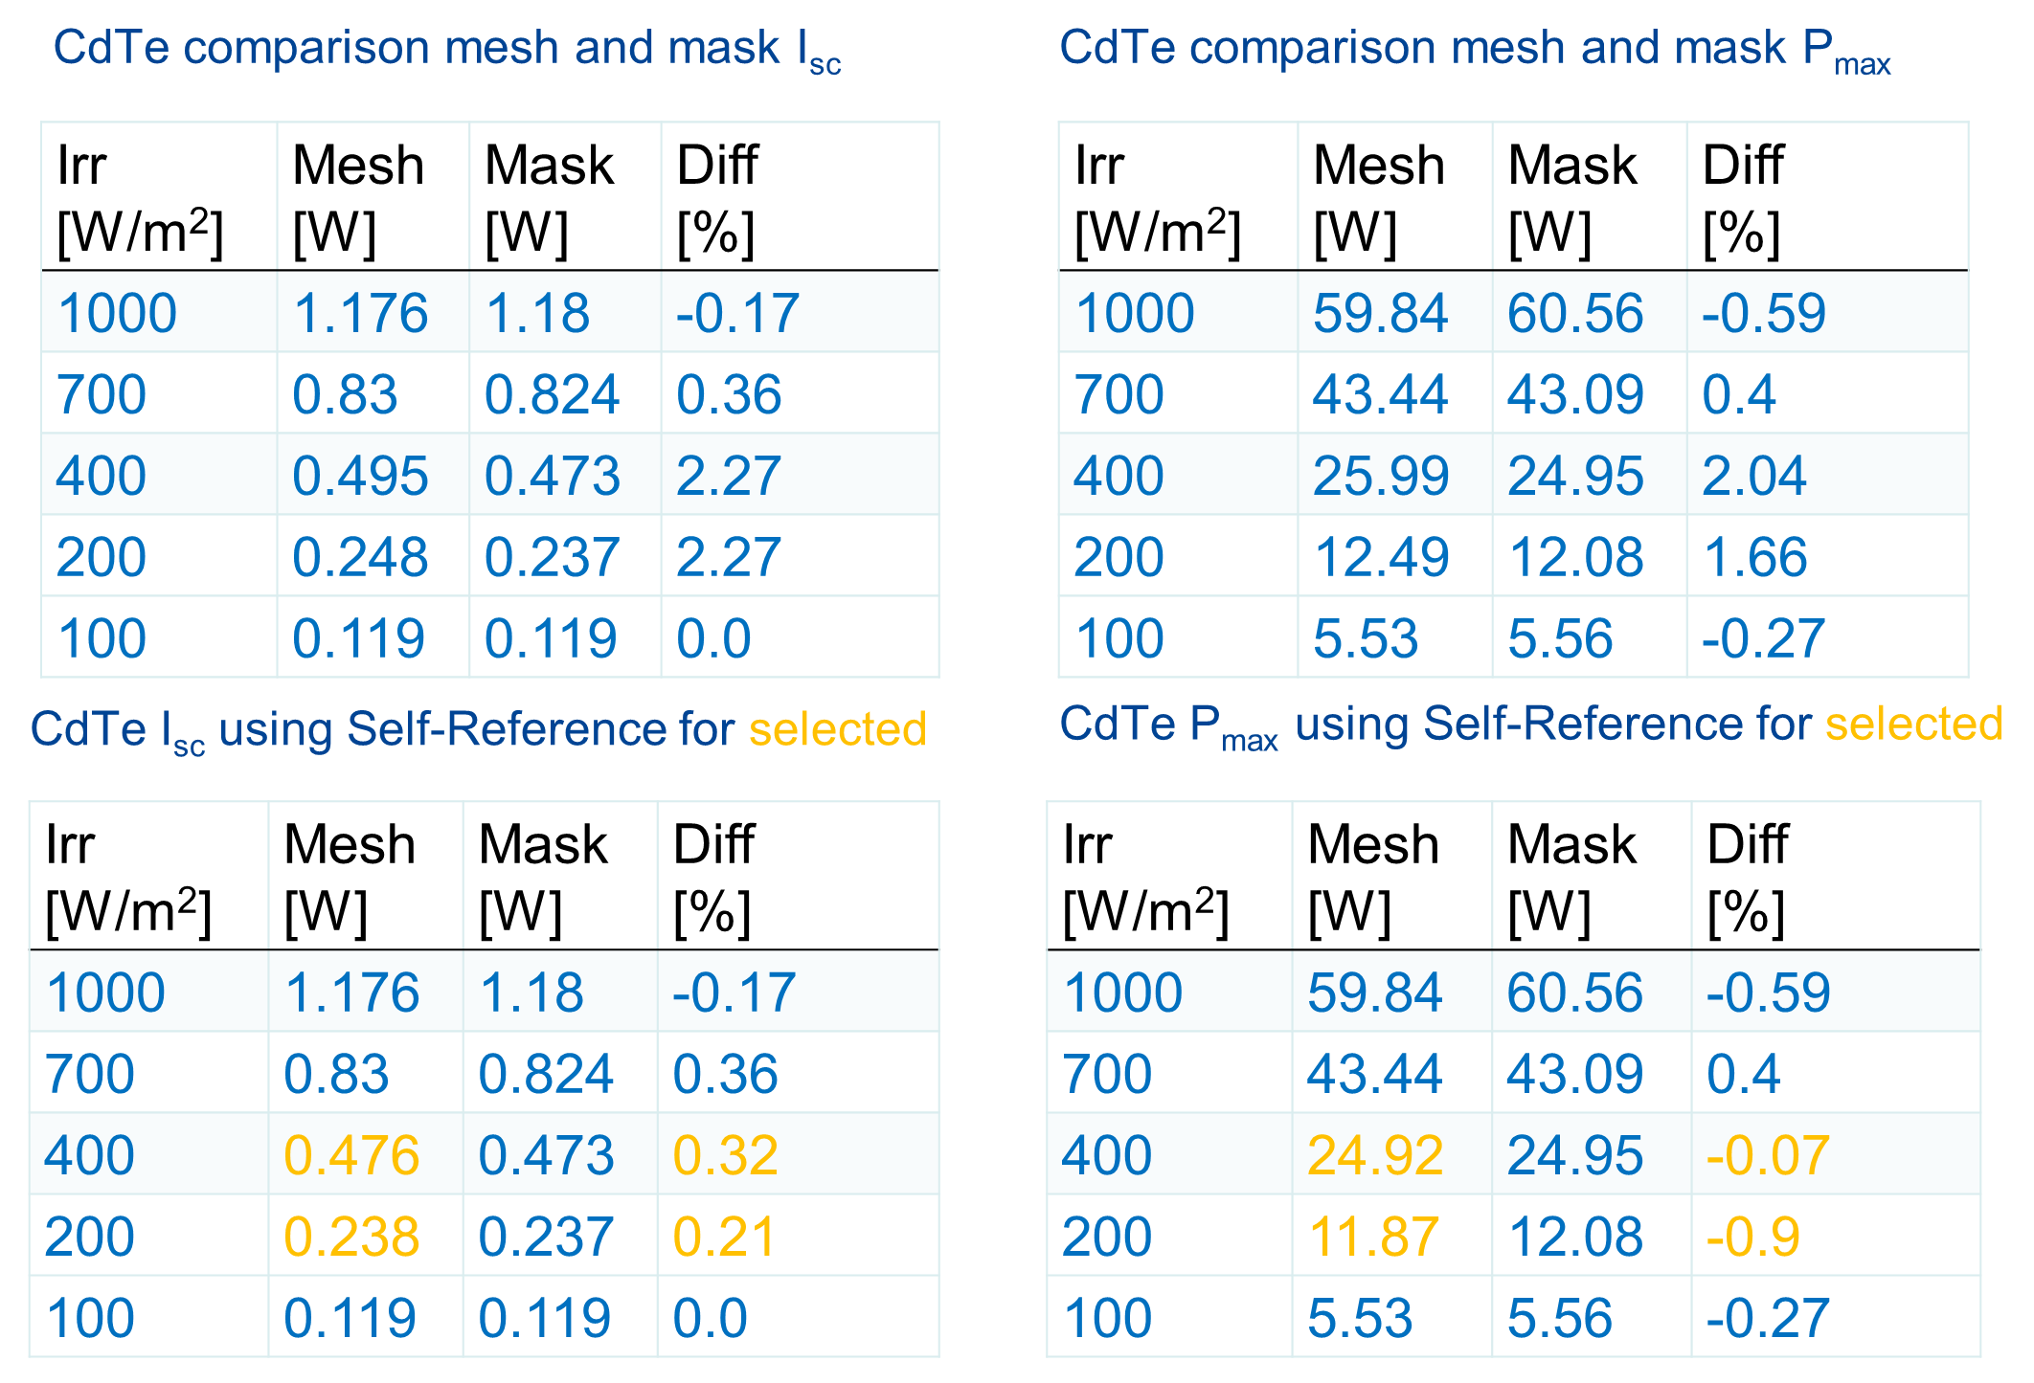
Pasan 3B improved meshes (CdTe)

Slide 21
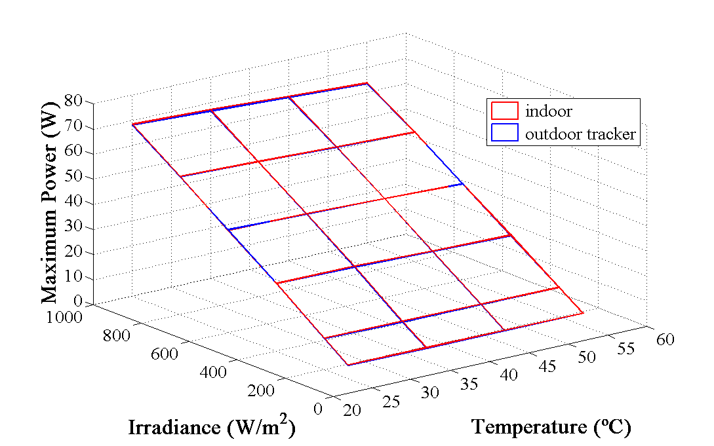
Comparing indoor and outdoor methods
indoor
(mesh & decay)
outdoor tracker
Average of 2
data sets for
each plotted
surface
Avg % difference:
Poly-Si ~1%
CdTe ~1%
CIS ~2%
CdTe

Slide 22
Comparing outdoor methods
Poly-Si
in-ENRA (%) | 25 | 35 | 45 | 55
100 | 5.41 | - | - | -
200 | 0.77 | 1.53 | - | -
400 | 0.08 | 0.49 | 4.31 | 5.03
600 | 0.12 | 1.60 | 1.00 | 4.17
800 | 2.35 | 0.91 | 0.15 | 3.58
1000 | - | - | 4.21 | 5.40
Outdoor field
P_{max}(W) | 25 | 35 | 45 | 55
100 | 5.03 | - | - | -
200 | 10.15 | 9.63 | - | -
400 | 21.74 | 20.62 | 18.74 | 17.69
600 | 32.66 | 31.74 | 30.09 | 27.06
800 | 42.57 | 41.27 | 39.72 | 36.31
1000 | - | - | 48.99 | 44.24
out-ENRA (%) | 25 | 35 | 45 | 55
100 | 2.28 | - | - | -
200 | 0.34 | 2.35 | - | -
400 | 1.35 | 1.92 | 3.16 | 3.57
600 | 0.81 | 2.94 | 2.39 | 3.05
800 | 1.71 | 0.55 | 2.33 | 2.54
1000 | - | - | 1.19 | 4.04
AVG % dev:
In-ENRA ≈ 2.5 %
outrk-ENRA ≈ 2 %

Slide 23
Comparing outdoor methods
CIS
in-ENRA (%) | 25 | 35 | 45 | 55
100 | 7.98 | 3.94 | - | -
200 | 6.57 | 0.82 | - | -
400 | 4.48 | 3.76 | 1.79 | 1.40
600 | 3.09 | 3.04 | 2.41 | 1.38
800 | - | 4.06 | 3.52 | 1.52
1000 | - | 4.53 | 1.19 | 3.90
Outdoor field
P_{max}(W) | 25 | 35 | 45 | 55
100 | 2.28 | 2.16 | - | -
200 | 7.22 | 6.74 | - | -
400 | 19.82 | 19.23 | 18.61 | 17.70
600 | 33.93 | 33.11 | 32.19 | 31.07
800 | - | 47.98 | 46.34 | 44.11
1000 | - | 63.03 | 57.75 | 57.24
out-ENRA (%) | 25 | 35 | 45 | 55
100 | 13.05 | - | - | -
200 | 10.14 | 5.04 | - | -
400 | 5.64 | 6.44 | 6.03 | 3.80
600 | 3.79 | 4.60 | 4.26 | 2.64
800 | - | 4.77 | 3.89 | 1.96
1000 | - | 4.35 | 1.77 | 0.83
AVG % dev:
In-ENRA ≈ 3.3 %
outrk-ENRA ≈ 4.8 %

Slide 24
Comparing outdoor methods
CdTe
in-ENRA (%) | 25 | 35 | 45 | 55
100 | 8.50 | 2.43 | - | -
200 | 4.80 | 4.79 | 6.73 | -
400 | 1.53 | 3.89 | 1.85 | 1.18
600 | 3.08 | 1.46 | 1.18 | 1.72
800 | 1.52 | 0.08 | 0.60 | 0.08
1000 | - | 2.74 | 1.34 | 0.46
Outdoor field
P_{max}(W) | 25 | 35 | 45 | 55
100 | 5.98 | 5.53 | - | -
200 | 13.21 | 12.96 | 12.91 | -
400 | 27.38 | 27.67 | 25.45 | 24.88
600 | 39.60 | 39.77 | 39.86 | 38.92
800 | 54.09 | 53.85 | 52.84 | 51.35
1000 | - | 65.58 | 64.92 | 64.37
out-ENRA (%) | 25 | 35 | 45 | 55
100 | 12.60 | 7.53 | - | -
200 | 6.76 | 7.83 | 8.90 | -
400 | 1.49 | 4.83 | 0.84 | 0.07
600 | 3.65 | 1.12 | 1.30 | 1.59
800 | 1.16 | 0.21 | 0.49 | 0.41
1000 | - | 1.75 | 0.27 | 1.40
AVG % dev:
In-ENRA ≈ 2.4 %
outrk-ENRA ≈ 2.2 %

Slide 25
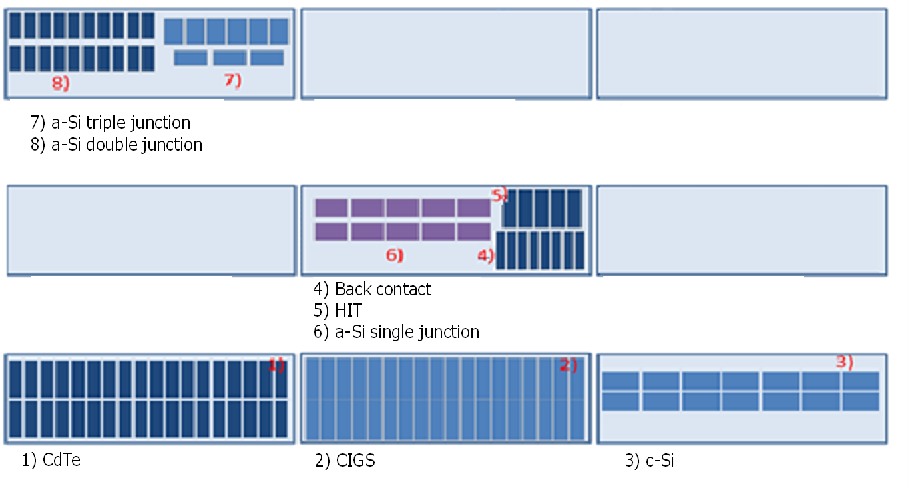
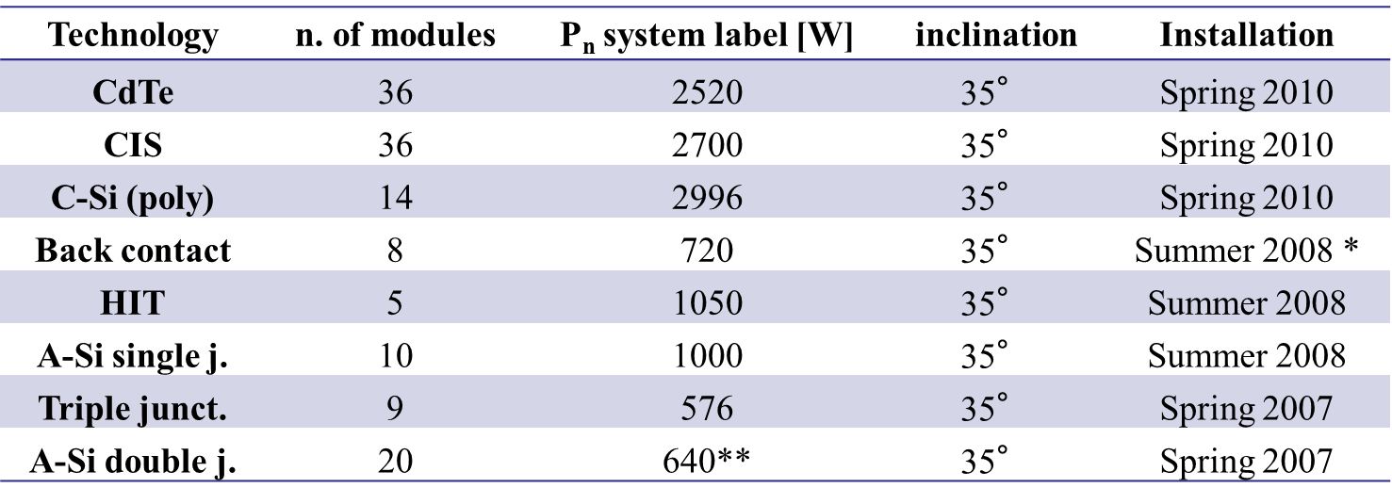
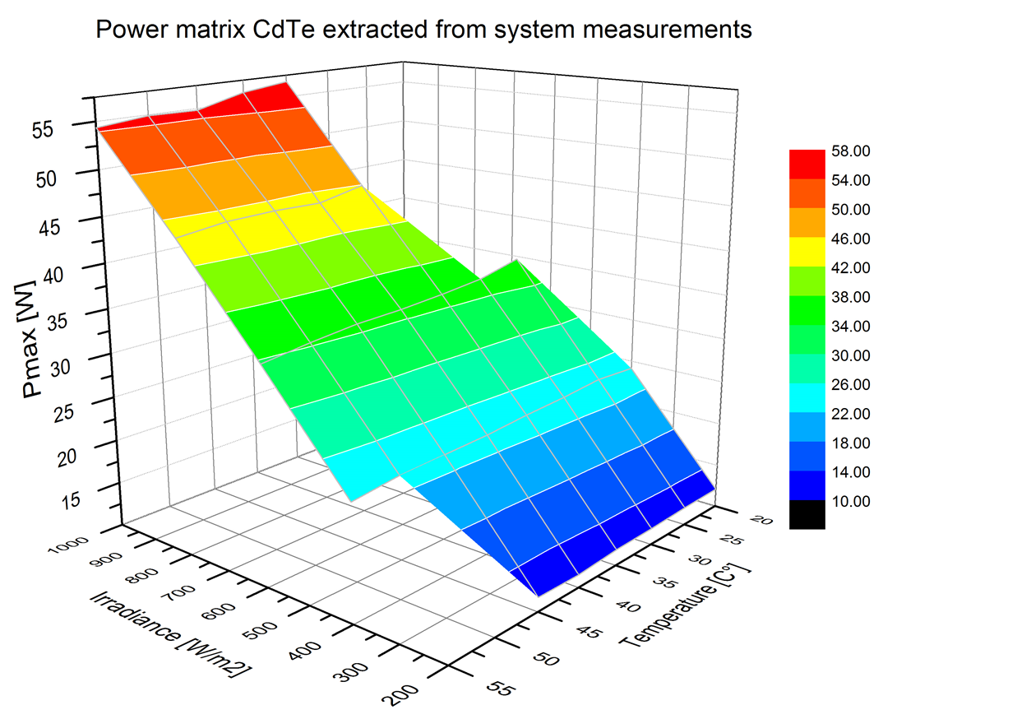
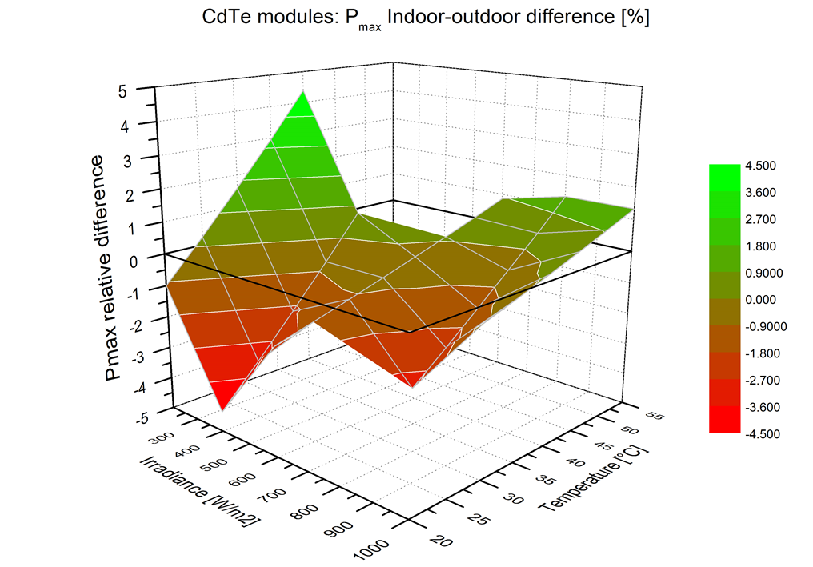
What about PV systems?
Indoor-outdoor comparison of power matrices in the range of T and G considered:
c-Si modules: ±1.5% (after removing an offset of -2.9%)
CdTe modules: ±4.4% (after removing an offset of -4.1%)

Slide 26
Results & Conclusions
Mesh filtering technique is promising for outdoor measurements.
IN-OUT agreement within 3%.
Fixed-rack data, on average, deviation less than 5%.
Self-Reference method improve results.
Different technique appropriate for different technologies, but none ideal.
Issues
Mesh filters availability/size.
Non uniformity at low irradiance, especially for thin film modules.
Outdoors cannot reach 1100Wm⁻² in many sites.

Slide 27
References
[1] Photovoltaic (PV) module performance testing and energy rating - Part1: Irradiance and temperature performance measurements and Power Rating, IEC61853-1, Edition 1.0, 2011-01
[2] Robert P. Kenny, Davide Viganó, Elena Salis, Matthew Norton, Harald Müllejans, Willem Zaaiman, ‘Power rating of photovoltaic modules including validation of procedures to implement IEC 61853-1 on solar simulators and under natural sunlight’, Prog. Photovolt: Res. Appl. 2013; 21:1384–1399
[3] Adrián A. Santamaría Lancia, Giorgio Bardizza, Harald Müllejans, ‘Assessment of uncalibrated light attenuation filters constructed from industrial woven wire meshes for use in photovoltaic research’, presented at this conference: paper number 5CV.2.2
References
[1] Robert P. Kenny, Davide Viganó, Elena Salis, Matthew Norton, Harald Müllejans, Willem Zaaiman, ‘Power rating of photovoltaic modules including validation of procedures to implement IEC 61853-1 on solar simulators and under natural sunlight’, Prog. Photovolt: Res. Appl. 2013; 21:1384–1399
[2] Adrián A. Santamaría Lancia, Giorgio Bardizza, Harald Müllejans, ‘Assessment of uncalibrated light attenuation filters constructed from industrial woven wire meshes for use in photovoltaic research’, presented at EUPVSEC conference

