Slide 1
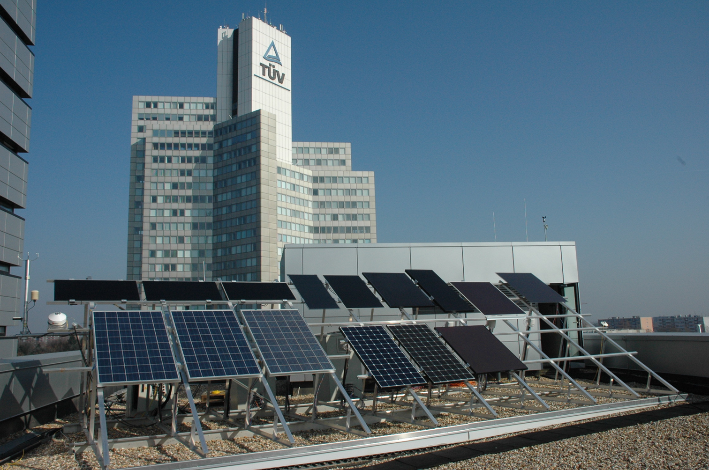
Measurement techniques for energy rating of PV modules at TÜV Rheinland PV test laboratories
7th Energy Rating and Module Performance Modelling Workshop
30/31 March 2017, Lugano, Switzerland
Werner Herrmann, Markus Schweiger
TÜV Rheinland Energy GmbH

Slide 2
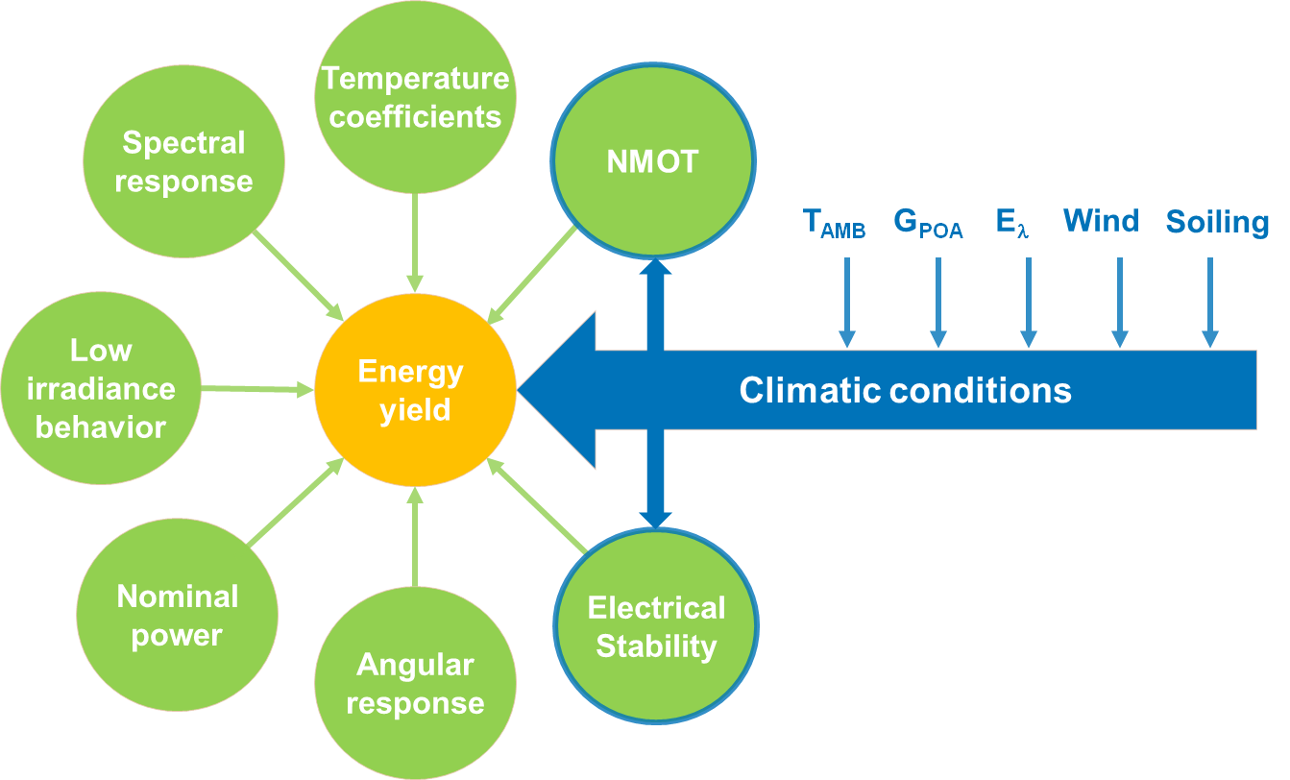
Introduction
Assessment of the PV module energy yield performance requires knowledge of specific module parameters
Measurement procedures are defined in IEC 61853-1 and IEC 61853-2
TÜV Rheinland operates five energy yield test sites and has more than 10 years experience in energy yield testing of PV modules
2
30.03.2017
7th Energy Rating and Module Performance Modelling Workshop
30/31 March 2017, Lugano, Switzerland

Slide 3
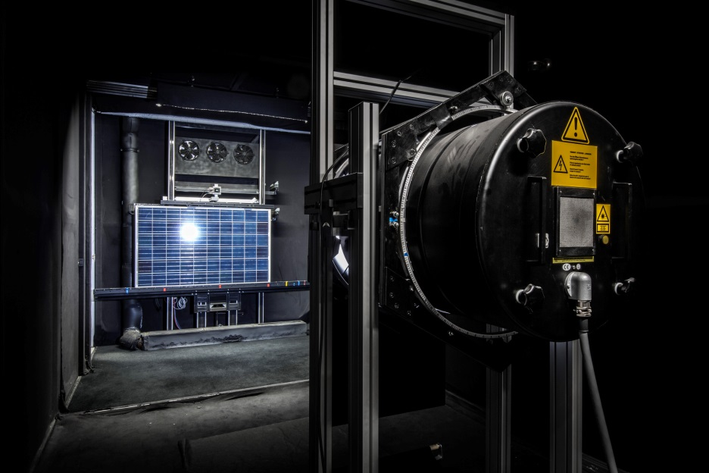
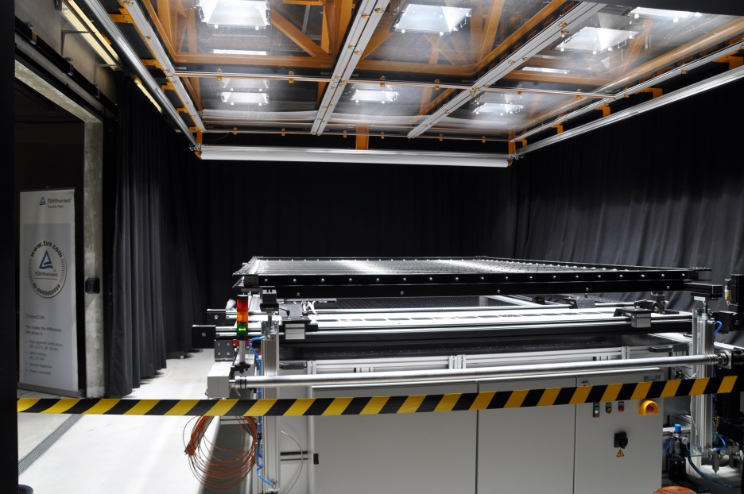
Output power under variable temperature and irradiation
Test equipment
Pulsed solar simulator: Pasan SunSim 3b (Multiflash / Dragon-back technique, spectrally neutral attenuation masks)
              Berger Lichttechnik PSS30 (Separable test chamber for temperature conditioning of the PV module)
Steady state solar simulator: Customized set-up with 12 metal halide lamps (Reduction of thermal radiation, temperature conditioning of the PV module under illumination)
Pulsed solar simulator
Steady state solar simulator
3
30.03.2017
7th Energy Rating and Module Performance Modelling Workshop
30/31 March 2017, Lugano, Switzerland

Slide 4
Output power under variable temperature and irradiation
PV Module I-V correction parameters (IEC 60891)
Two options to cover the range of test conditions:
Measurement of performance matrix in accordance with IEC 61853-1
I-V reference curve + Determination of I-V correction parameters in accordance with IEC 60891
IEC 60891
Procedure 2
Legend:
I₁, I₂: Module current
V₁, V₂: Module voltage
T₁, T₂: Module temperature
G₁, G₂: Irradiance
Index 1: Measurement conditions
Index 2: Target conditions (i.e. STC)
Module parameters:
_{rel} : Temperature coefficient I_{SC} [1/K]
_{rel} : Temperature coefficient V_{OC} [1/K]
R_{S}’: Internal series resistance [Ω]
κ’ : Temperature coefficient R_{S} [Ω/K]
a: Irradiance correction factor of V_{OC}
Note:
Temperature coefficients are typically related to STC
4
30.03.2017
7th Energy Rating and Module Performance Modelling Workshop
30/31 March 2017, Lugano, Switzerland

Slide 5
Output power under variable temperature and irradiation
Determination of I-V correction parameters (IEC 60891)
Variable temperature
Module I-V correction parameters
(Module type: multi c-Si, 60 cells)
α _{REL} = -0.042% K⁻¹ R_{S}’ = 460 mOhm
β _{REL} = -0.46% K⁻¹ a = 0.054
κ‘ = -0.004% K⁻¹
Matrix measurements
@ 1000 W/m², 25 – 65°C
Variable irradiance
IEC 60891 Parameter
Optimierung
Translated I-V curves at STC
Matrix measurements
@ 25°C, 450 – 1000 W/m²
Note:
I-V correction parameters may be subject to production tolerances
5
30.03.2017
7th Energy Rating and Module Performance Modelling Workshop
30/31 March 2017, Lugano, Switzerland

Slide 6
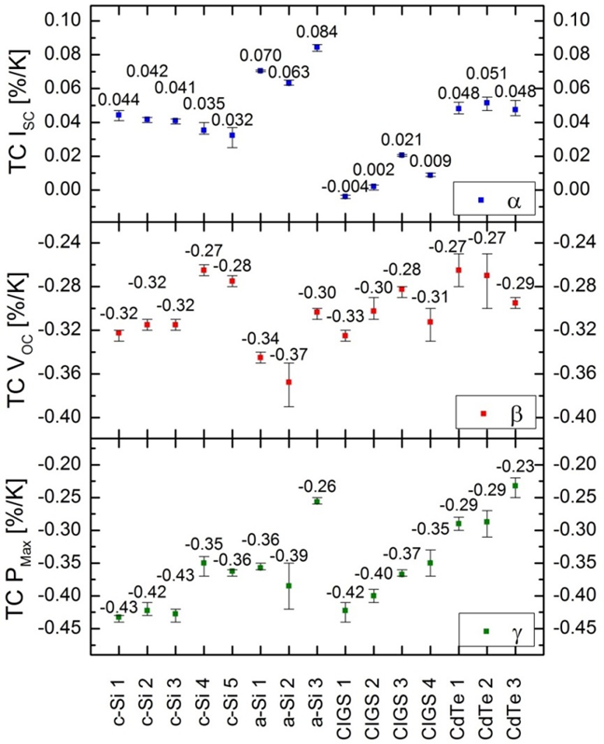
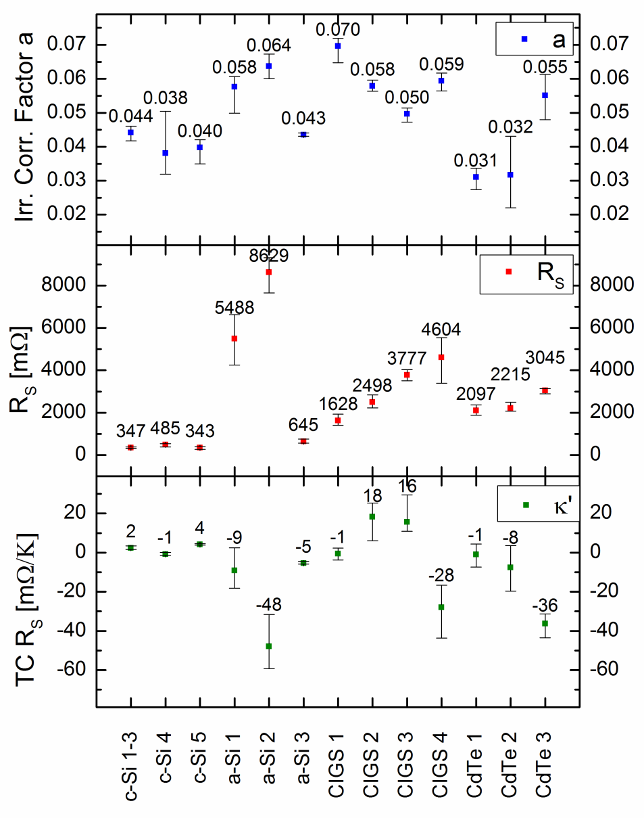
Output power under variable temperature and irradiation
Spread of I-V correction parameters
6
30.03.2017
7th Energy Rating and Module Performance Modelling Workshop
30/31 March 2017, Lugano, Switzerland

Slide 7
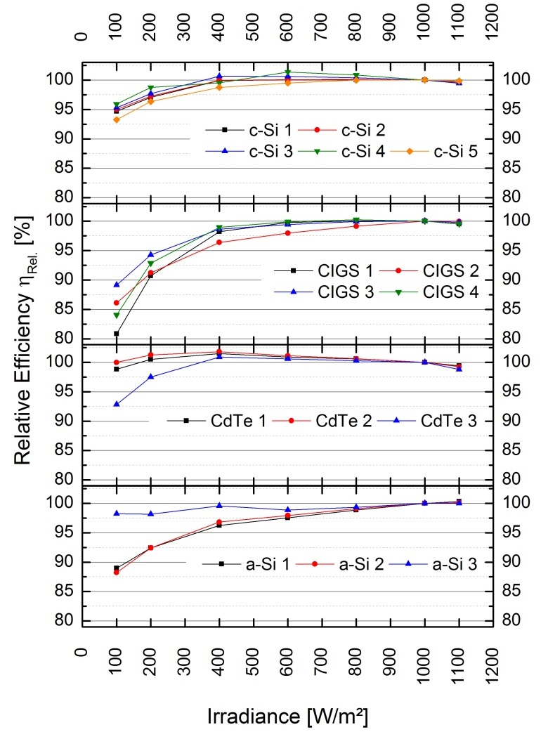
Output power under variable temperature and irradiation
Low irradiance behavior of different PV modules
PV module performance under variable irradiation is important for locations with high low irradiance contribution to annual insolated solar radiation (i.e. Cologne: 19%)
Drop of module efficiency in the low irradiance range <200 W/m²
c-Si PV technologies: -2% to -4%
CIGS thin-film: -5% to -10%
CdTe thin-film: 0% to -3%
a-Si thin-film: -2% to -8%
No generalization possible
!
References:
M. Schweiger et al.: Understanding the energy yield of photovoltaic modules in different climates by linear performance loss analysis of the module performance ratio, IET Renewable Power Generation, ISSN 1752-1416, 2017
Schweiger et al.: Performance Stability of Photovoltaic Modules in Different Climates, Paper submitted to Progress in PV
7
30.03.2017
7th Energy Rating and Module Performance Modelling Workshop
30/31 March 2017, Lugano, Switzerland

Slide 8
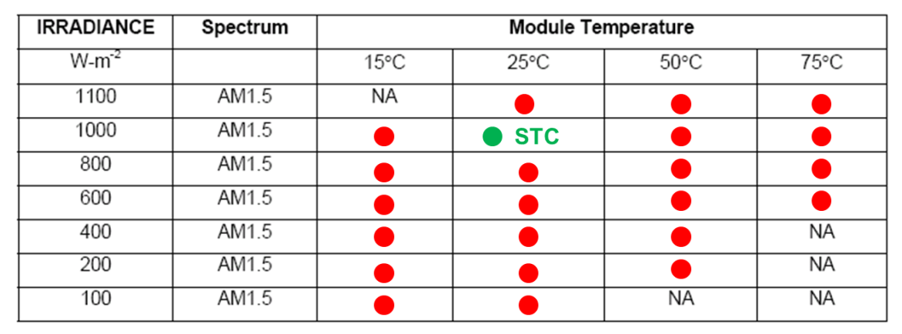
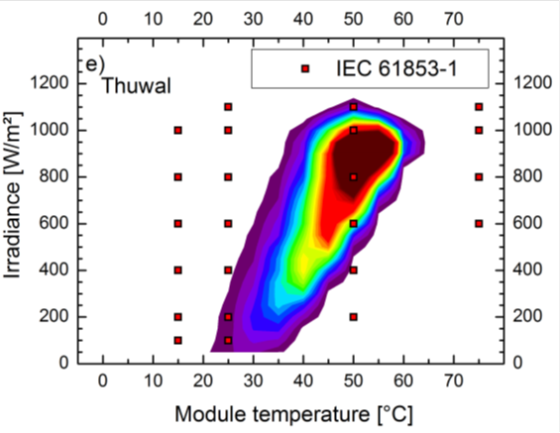
Output power under variable temperature and irradiation
Improvement of IEC 61853-1
Cologne
Test program:
3 Test samples
x 23 Test conditions
x 3 I-V measurements
207 I-V measurements
Saudi-Arabia
Number of test conditions shall be reduced:
  Temperature coefficients at 200 /1000 W/m²
  Variable irradiation at 25°C
  Other data points can be extrapolated (IEC 60891)
8
30.03.2017
7th Energy Rating and Module Performance Modelling Workshop
30/31 March 2017, Lugano, Switzerland

Slide 9
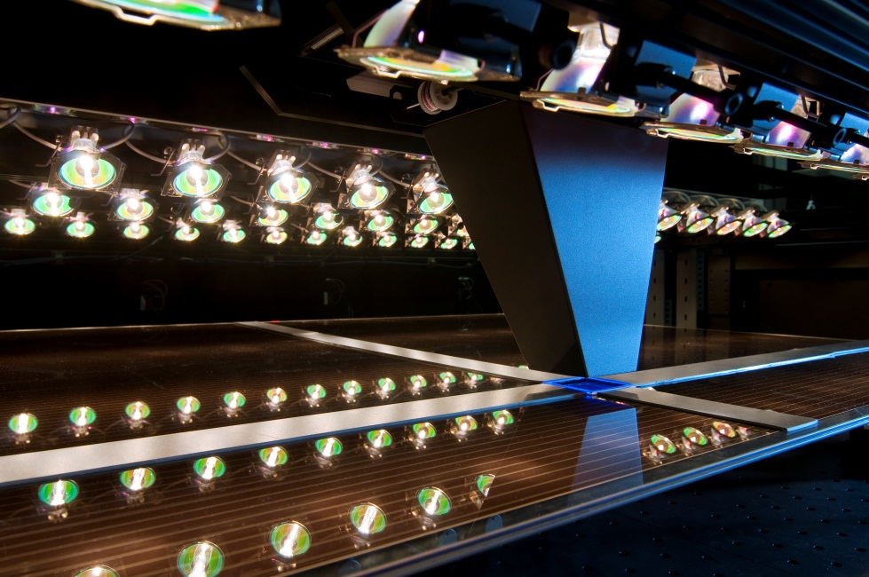
Spectral response
Spectral response measurement (IEC 60904-8)
Test equipment:
High resolution monochromator, Model: Bunkoh-Keiki CEP-M77
Features:
Non-destructive measurement of full-size PV module
Measurement procedures for crystalline silicon and thin-film PV modules
White and color bias light: Single junction and multi junction measurements
Measurement of SR non-uniformity in the active module area
Technical data:
Monochromatic light: | 50 mm x 50 mm
Wavelength range: | 300 – 1700 nm
Wavelength interval: | 1, 5, 10, 50 nm
Max. module dimension: | 200 cm
References:
Y. Hishikawa et al.: Spectral response measurements of PV modules and multi-junction devices, 22nd EU PVSEC, 2007
Y. Tsuno et al.: A method for spectral response measurements of various PV modules, 23rd EU PVSEC, 2008
9
30.03.2017
7th Energy Rating and Module Performance Modelling Workshop
30/31 March 2017, Lugano, Switzerland

Slide 10
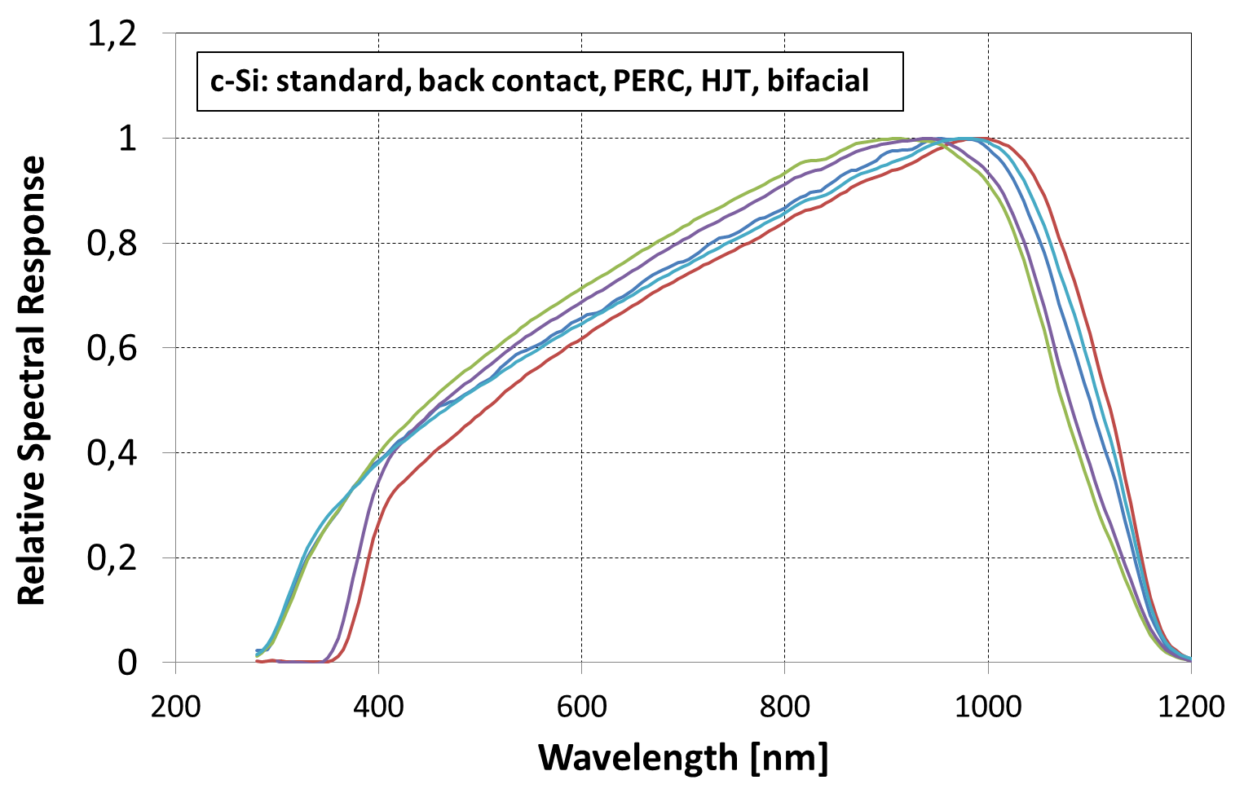
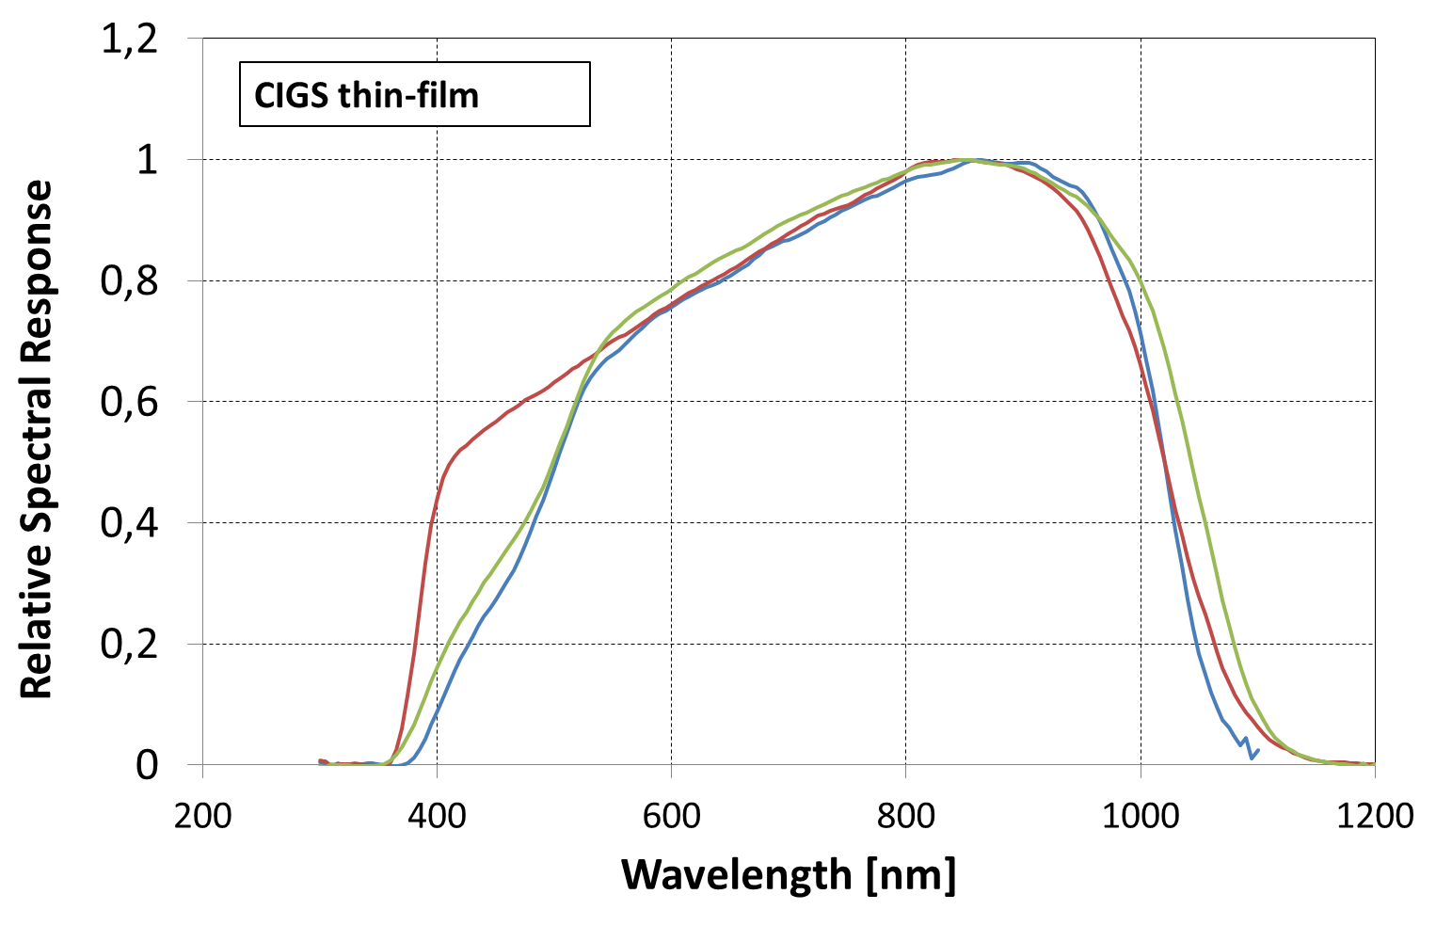
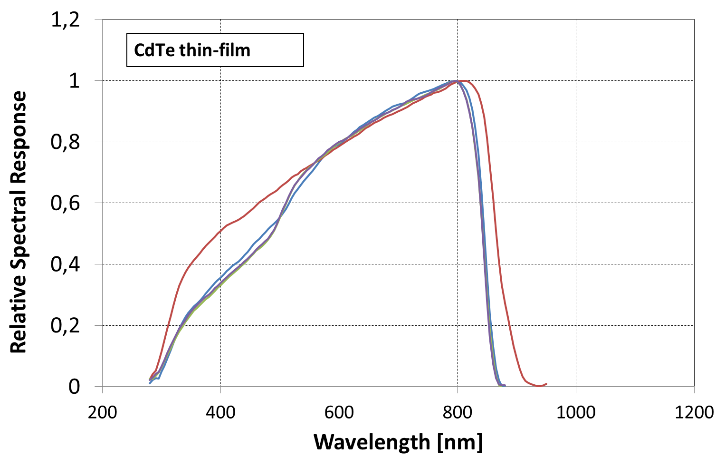
Spectral response
Spread of SR curves for different PV technologies
Spread of SR curves is observed for all PV technologies
Future advances in cell technology will increase the spread
10
30.03.2017
7th Energy Rating and Module Performance Modelling Workshop
30/31 March 2017, Lugano, Switzerland

Slide 11
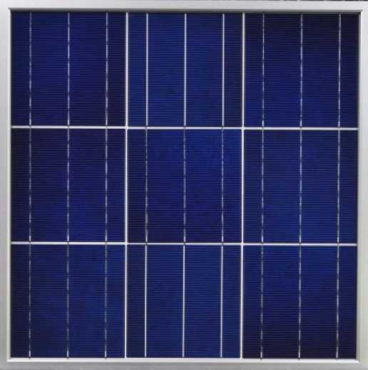
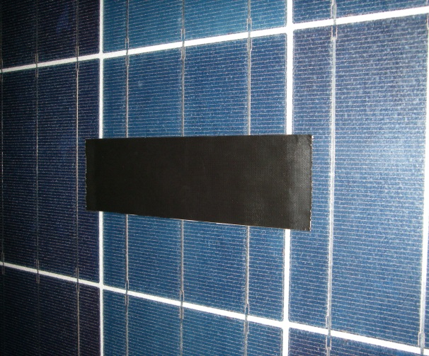
Angular response
Concepts for angular response measurement on cell level
Manufacture of a mini-module:
Identical optical construction compared to PV module
Test cell = center cell
Destructive test method:
PV module
Test cell is electrically contacted through backsheet
TUV non-destructive test method:
PV module
Isc of test cell is concluded from PV module I-V curve under partially shading
11
30.03.2017
7th Energy Rating and Module Performance Modelling Workshop
30/31 March 2017, Lugano, Switzerland

Slide 12
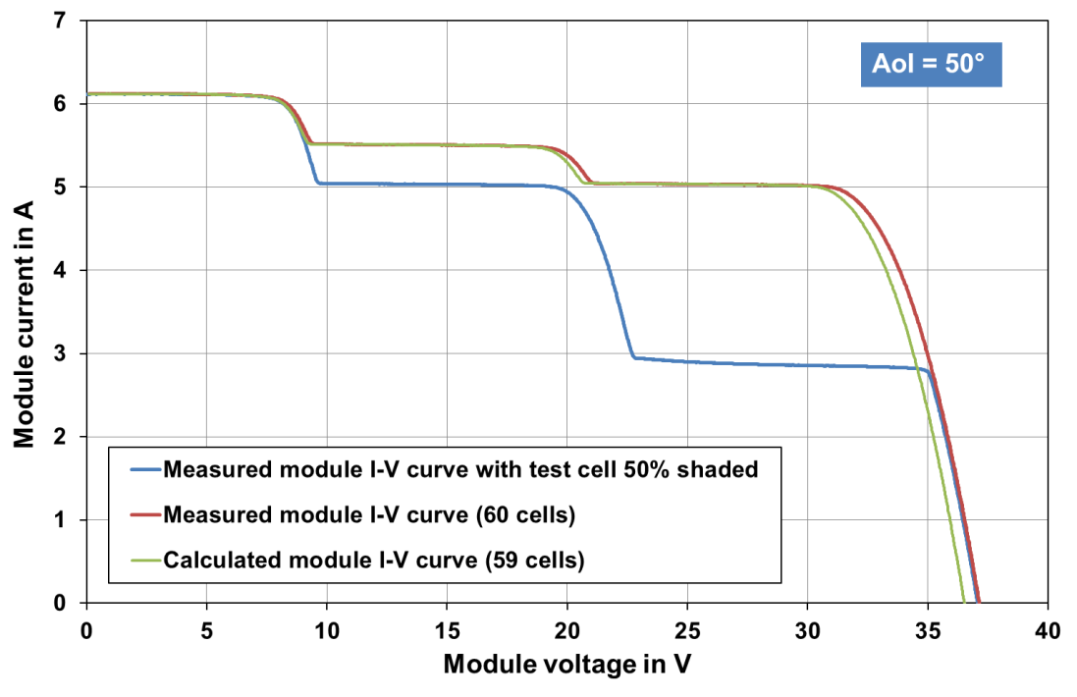
Angular response
Non-destructive angular response measurement
Measurements for each AoI setting:
I-V curve of fully irradiated PV module with N cells ⇨ (I-V)_{N}
I-V curve of PV module with test cell 50% partially shaded ⇨ (I-V)_{50%}
Calculations for each AoI setting:
PV module I-V curve of (N-1) solar cells ⇨ (I-V)_{N-1}
Intercept point between I-V curves (I-V)_{N-1} and (I-V)_{50%} ⇨ Isc of test cell
Isc of test cell:
2.83 A
Note:
Steps in I-V curves originate from non-uniform illumination of the PV module when rotating around the vertical axis through the module center.
– I-V curve (I-V)_{N} : Non-shaded, N cells
– I-V curve (I-V)_{N-1} : Non-shaded, (N-1) cells
– I-V curve (I-V)_{50%} : Test cell 50% shaded
Reference:
W. Herrmann et al.: Solar simulator measurement procedures for determination of the angular characteristic of PV modules, 29th EU PVSEC, Amsterdam, 2014
12
30.03.2017
7th Energy Rating and Module Performance Modelling Workshop
30/31 March 2017, Lugano, Switzerland

Slide 13
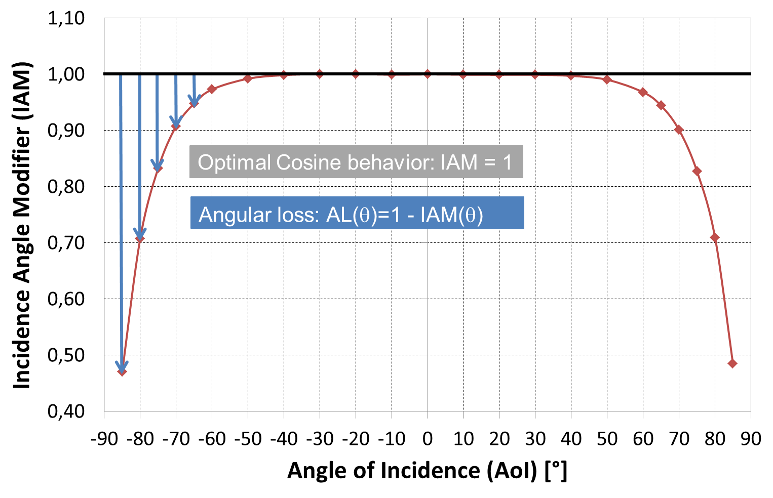
Angular response
Non-destructive angular response measurement
Angular response (AR) curve /Incident angle modifier (IAM)
c-Si PV module
13
30.03.2017
7th Energy Rating and Module Performance Modelling Workshop
30/31 March 2017, Lugano, Switzerland

Slide 14
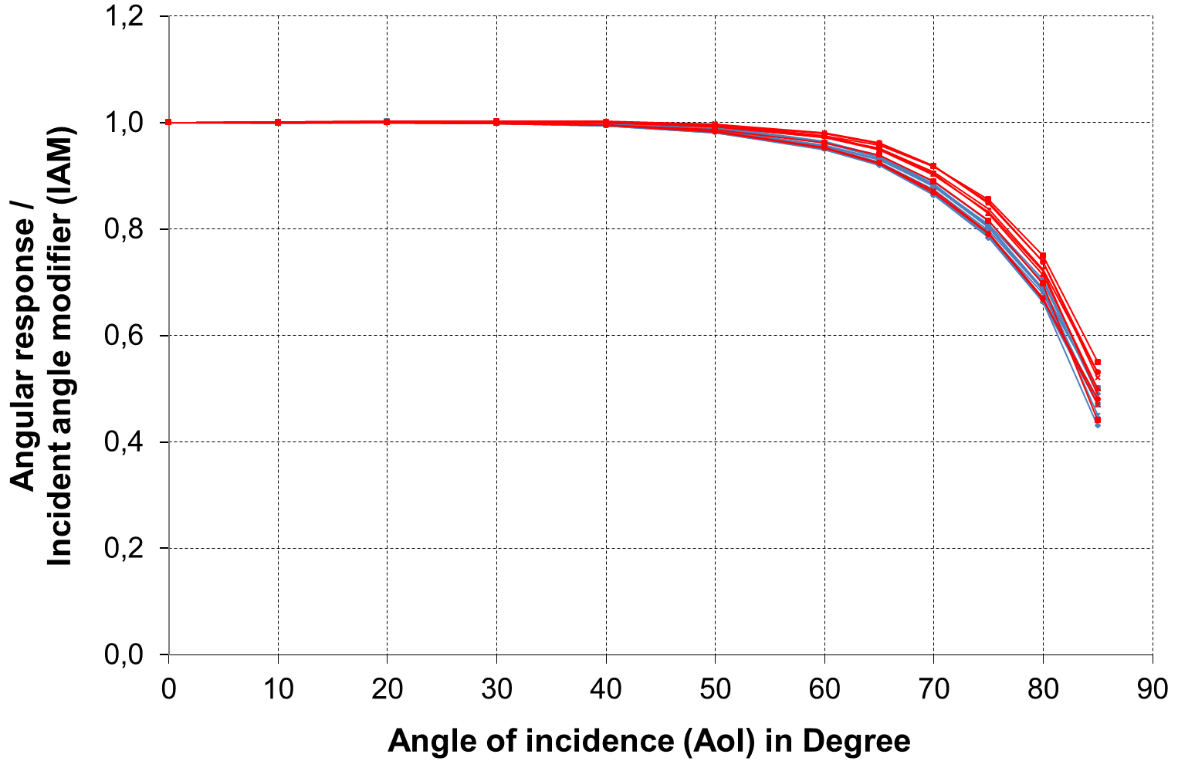
Angular response
Angular response range of different glass types
Modelling of angular response curve (IEC 61853-2):
Good fit in the angular range < 80° (RSME <1%)
Standard float glass (SFG): a_{r} = 0.159
AR coated glass (ARC): a_{r} = 0.144
Type | a_{r}
SFG1 | 0.167
SFG2 | 0.154
SFG3 | 0.166
SFG4 | 0.165
SFG5 | 0.159
SFG6 | 0.155
SFG7 | 0.153
SFG8 | 0.149
SFG9 | 0.157
SFG10 | 0.163
SFG11 | 0.155
Average | 0.159
Type | a_{r}
ARC1 | 0.151
ARC2 | 0.133
ARC3 | 0.164
ARC4 | 0.163
ARC5 | 0.133
ARC6 | 0.139
ARC7 | 0.142
ARC8 | 0.141
Average | 0.144
Standard float glass (SFG)
AR coted glass (ARC)
References:
W. Herrmann et al.: Optical characteristics of PV module front glasses – Incidence angle effects of various glass types and impact on annual energy yield, 28th EU PVSEC, Paris, 2013
N. Martin et al.: Calculation of the PV modules angular losses under field conditions by means of an analytical model, Solar Energy Materials & Solar Cells 70 (2001) 25-38
14
30.03.2017
7th Energy Rating and Module Performance Modelling Workshop
30/31 March 2017, Lugano, Switzerland

Slide 15

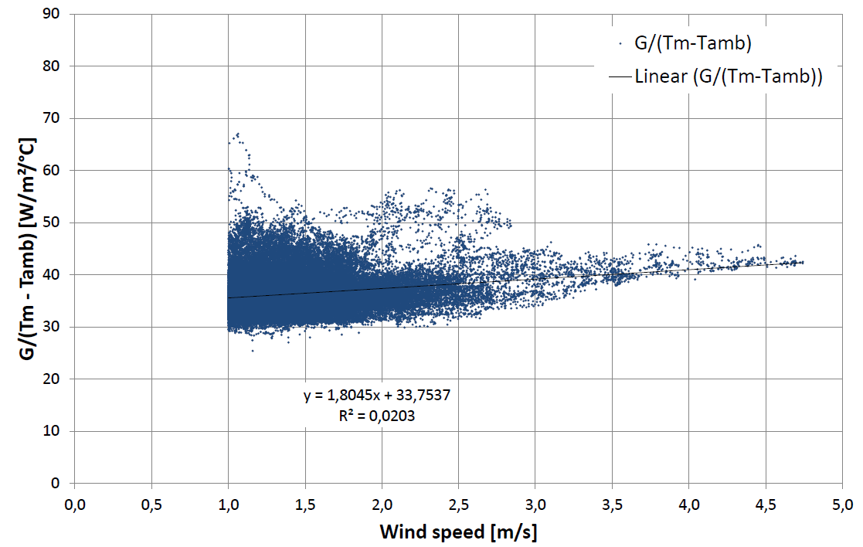
Nominal module operating temperature
IEC 61853-2 procedure
Modelling of module operating temperature:
u₀ ⬄ Impact of solar irradiance
u₁ ⬄ Impact of wind speed (WS)
Note:
Coefficients are dependent on installation conditions and test location
Data filtering ⇨ No valid data set for Cologne since March 2016!
!
Problems:
Required wind speed interval of 4 m/s is too large for urban test locations
⇨ Reduce minimum WS interval to 3 m/s
Data filtering still results in large scattering of accepted data points
⇨ Wind direction should be considered
Required WS interval
15
30.03.2017
7th Energy Rating and Module Performance Modelling Workshop
30/31 March 2017, Lugano, Switzerland

Slide 16
Conclusions
Within all PV technologies (thin-film and c-Si) significant scattering of energy yield performance was observed
Individual performance characterization of a module type is required
Data sheet information of PV modules does not cover the needs for energy rating
Test requirements of IEC 61853-1 and IEC 61853-2 shall be improved to perform measurements with reasonable constrains of costs and time
IEC 60891 shall be applied to reduce test work in the laboratory
16
30.03.2017
7th Energy Rating and Module Performance Modelling Workshop
30/31 March 2017, Lugano, Switzerland

Slide 17
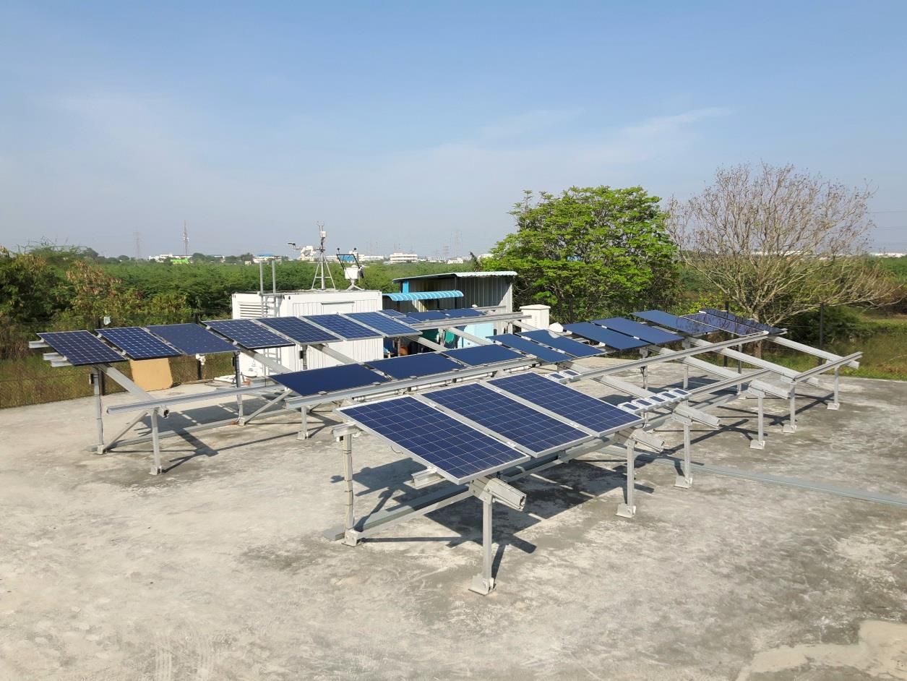
Thank you for your attention!
Dr. Werner Herrmann
TÜV Rheinland Energy GmbH
werner.herrmann@de.tuv.com http://www.tuv.com/solarpower
7th Energy Rating and Module Performance Modelling Workshop
30/31 March 2017, Lugano, Switzerland

