Slide 1
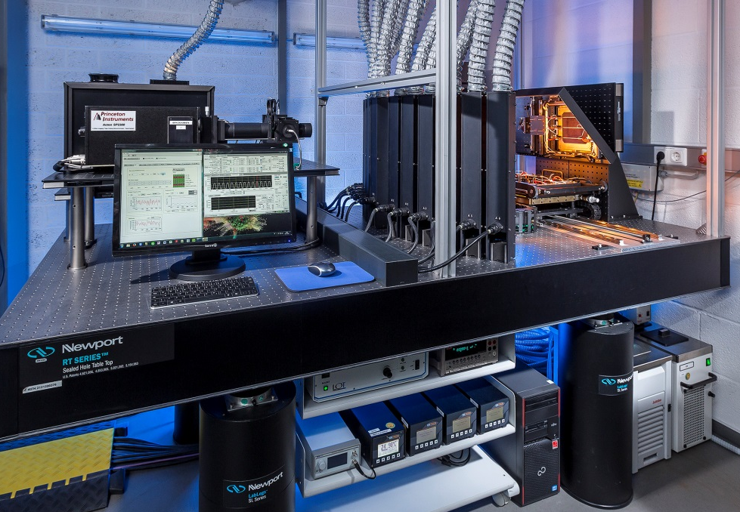
Uncertainty of DSR measurements according to approximations defined in the IEC 60904-8 standard
  K. Bothe, D. Hinken and C. Schinke
  Calibration and Test Center Solar Cells
  Institute for Solar Energy Research
  SUPSI-Workshop, Photoclass Project (4/2017)

Slide 2
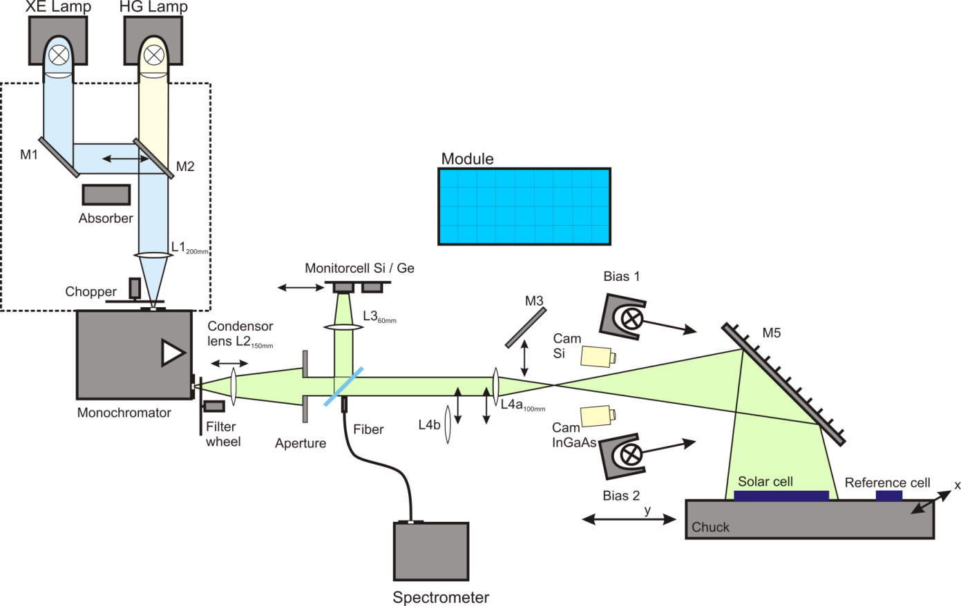


DSR system at ISFH CalTeC
Grating monochromator:
280 to 1200nm in 10nm steps
48 bias lamps, bias current up to 14A for large-area solar cells
Three transimpedance amplifiers (small: 250mA, large: 14A, V_{mon})
Two light fields:
50x50mm² and 160x160mm²
Motorized axis for reference and sample cells
Sample Temperatures from 20 to 40°C (determination of TC)
ISO 17025 accredited by DAkkS since 2016

Slide 3
Measurement procedure
Calibration of monochromatic light and bias light (E_{bias}) using a WPVS reference solar cell
DSR measurement of device under test at various (usually 8) bias levels:
10, 100, 200, 400, 600, 800, 1000 and 1100 W/m²
Integration over E_{bias}
Calculation of relative sstc-curves, s_{stc.rel}(λ) and mismatch correction factor
Determination of I_{STC} at sun simulator
Scaling of DSR curves and s_{stc.rel}(λ) using I_{STC}
Difference to PTB approach (previous talk by I. Kröger): Integration is not carried out over I_{bias} since only relative (unscaled) DSR values are measured

Slide 4
Measurement uncertainty
Monte-Carlo uncertainty analysis with 12 uncertainty components:
f_{dist}: Height-difference of reference and DUT
f_{wlshift}: Deviation in wavelength of monochromatic light
f_{bandwidth}: Bandwidth of monochromatic light
f_{TRef}: Temperature difference to 25°C of reference
f_{TDUT}: Temperature difference to 25°C of DUT
f_{cellinhom}: Impact of light inhomogeneity on cells with current collection inhomogeneity
f_{repRef}: Reproducibility of measurement of reference
f_{repDUT}: Reproducibility of measurement of DUT
f_{scale}: Uncertainty of Isc from IV measurement
f_{nonlin}: Non-linearity of transimpedance amplifier
f_{ref}: Uncertainty of primary normal
f_{hom}: Reproducibility of inhomogeneity correction

Slide 5
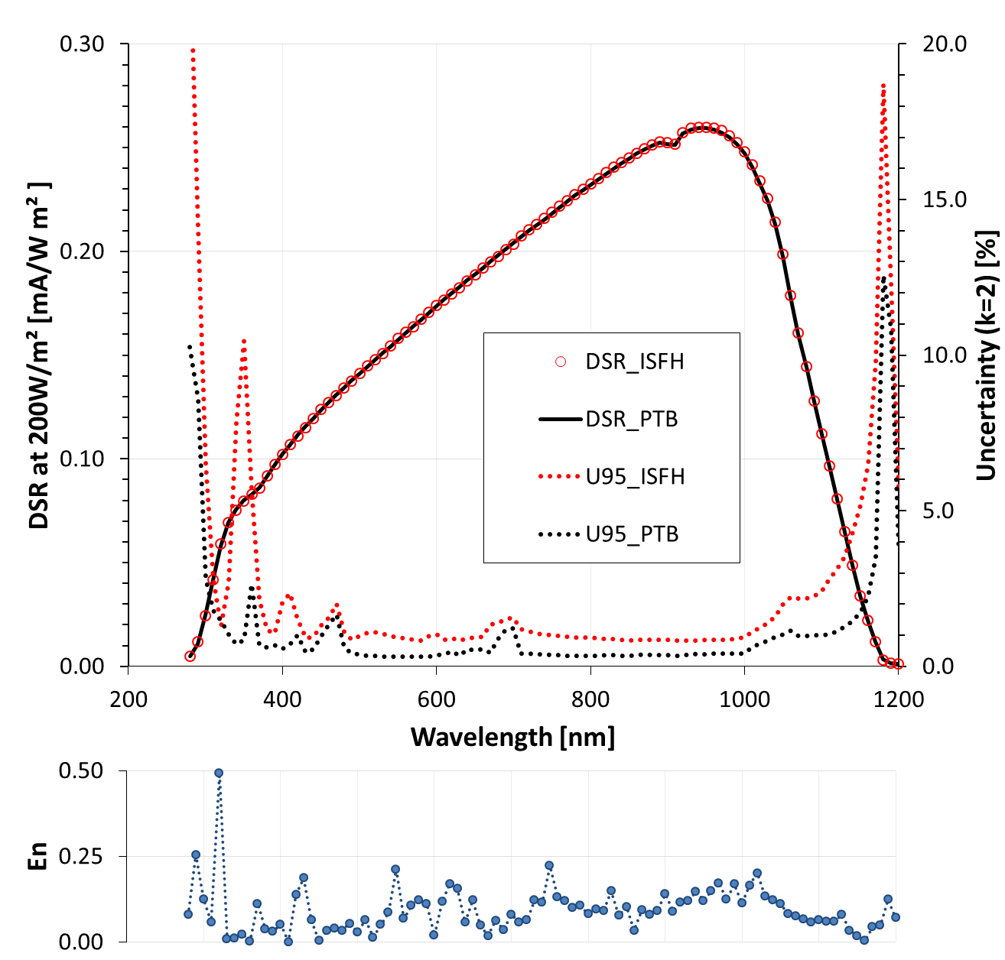
Comparison to PTB:
WPVS reference solar cell
WPVS reference solar cell
Fixed bias intensity/current
Curves of PTB (black) and ISFH-CalTeC (red)
En_{avg} = 0.1

Slide 6
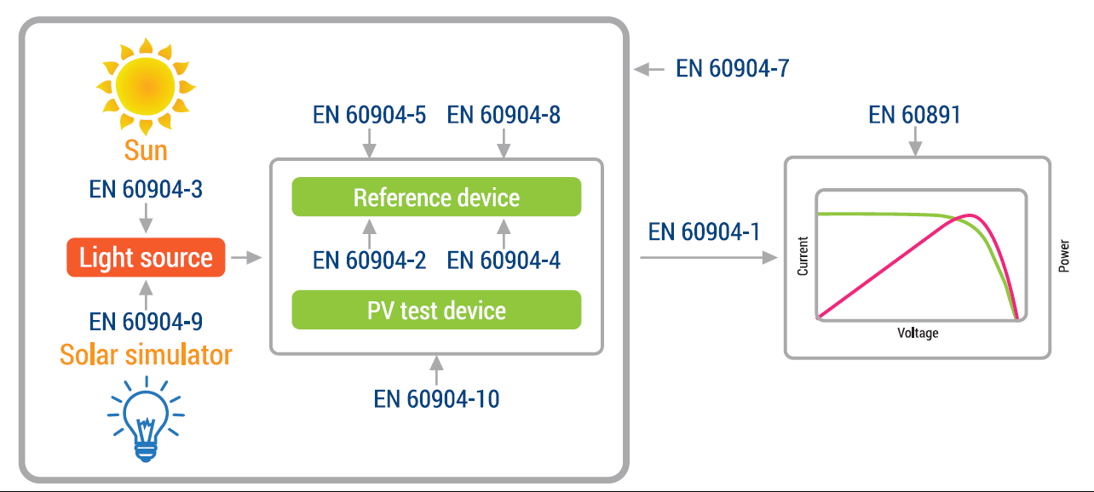
Solar Cell Calibration Standards
F. D‘Amore, Solar standards and certification, www.med-desire.eu, 2015

Slide 7
IEC 60904-8 Ed. 3.0
F. D‘Amore, Solar standards and certification, www.med-desire.eu, 2015

Slide 8
IEC 60904-8 Ed. 3.0
F. D‘Amore, Solar standards and certification, www.med-desire.eu, 2015
Required for spectral
mismatch correction

Slide 9
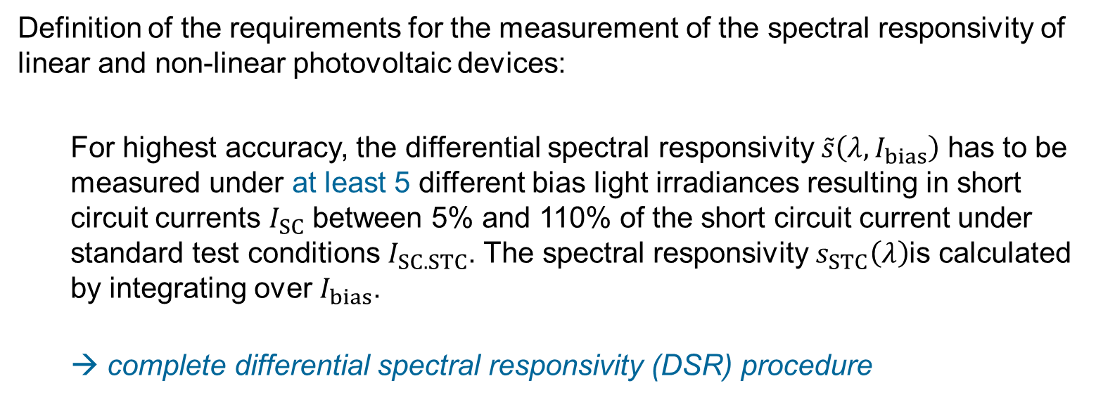
IEC 60904-8 Ed. 3.0
→ complete DSR procedure
Definition of the requirements for the measurement of the spectral responsivity of linear and non-linear photovoltaic devices:
  For highest accuracy, the differential spectral responsivity $\tilde{s}\left(λ,I_{bias}\right)$ has to be measured under at least 5 different bias light irradiances resulting in short circuit currents $I_{SC}$ between 5% and 110% of the short circuit current under standard test conditions $I_{SC.STC}$. The spectral responsivity $s_{STC}\left(λ\right)$is calculated by integrating over $I_{bias}$.
  → complete differential spectral responsivity (DSR) procedure

Slide 10
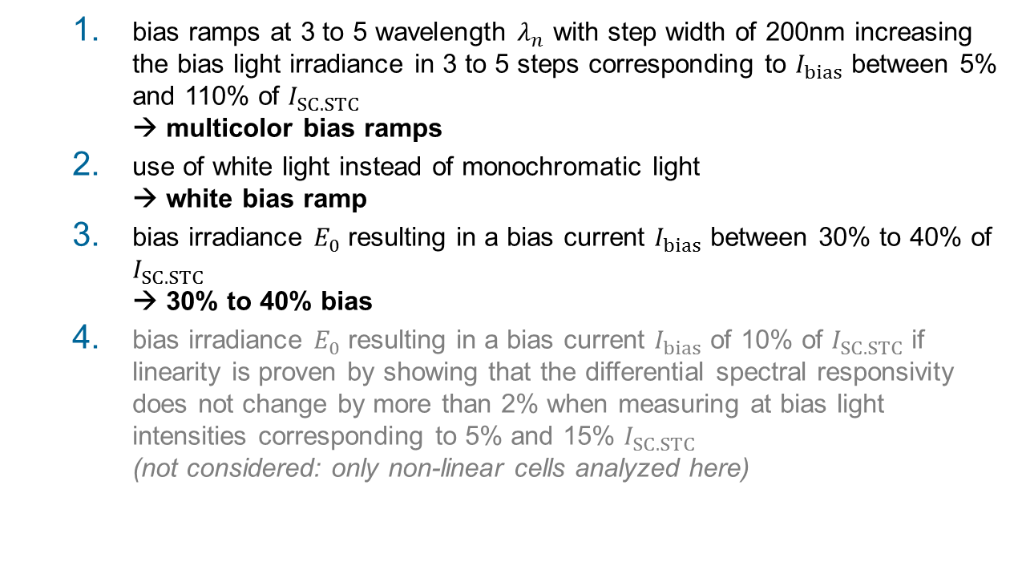
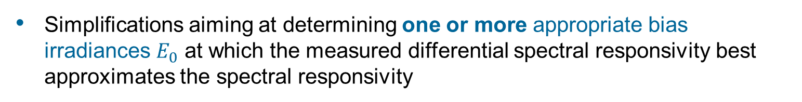
IEC 60904-8 Ed. 3.0
→ simplifications
Simplifications aiming at determining one or more appropriate bias irradiances $E_{0}$ at which the measured differential spectral responsivity best approximates the spectral responsivity
  bias ramps at 3 to 5 wavelength $λ_{n}$ with step width of 200nm increasing the bias light irradiance in 3 to 5 steps corresponding to $I_{bias}$ between 5% and 110% of $I_{SC.STC}$
  → multicolor bias ramps
  use of white light instead of monochromatic light
  → white bias ramp
  bias irradiance $E_{0}$ resulting in a bias current $I_{bias}$ between 30% to 40% of $I_{SC.STC}$
  → 30% to 40% bias
  bias irradiance $E_{0}$ resulting in a bias current $I_{bias}$ of 10% of $I_{SC.STC}$ if linearity is proven by showing that the differential spectral responsivity does not change by more than 2% when measuring at bias light intensities corresponding to 5% and 15% $I_{SC.STC}$
  (not considered: only non-linear cells analyzed here)

Slide 11
IEC 60904-8 Ed. 3.0
→ simplifications
Simplifications aiming at determining one or more appropriate bias irradiances $E_{0}$ at which the measured differential spectral responsivity best approximates the spectral responsivity
  bias ramps at 3 to 5 wavelength $λ_{n}$ with step width of 200nm increasing the bias light irradiance in 3 to 5 steps corresponding to $I_{bias}$ between 5% and 110% of $I_{SC.STC}$
  → multicolor bias ramps
  use of white light instead of monochromatic light
  → white bias ramp
  bias irradiance $E_{0}$ resulting in a bias current $I_{bias}$ between 30% to 40% of $I_{SC.STC}$
  → 30% to 40% bias
  bias irradiance $E_{0}$ resulting in a bias current $I_{bias}$ of 10% of $I_{SC.STC}$ if linearity is proven by showing that the differential spectral responsivity does not change by more than 2% when measuring at bias light intensities corresponding to 5% and 15% $I_{SC.STC}$
  (not considered: only non-linear cells analyzed here)
9-25 (+1)
3-5 (+1)
no. of measurements
1
3

Slide 12
Deviations of simplifications compared to complete DSR procedure
Simulation of the DSR of a non-linear c-Si solar cell and analysis according to the complete DSR procedure as well as simplifications 1 to 3
Measurement of the DSR of a non-linear c-Si solar cell and analysis according to the complete DSR procedure as well as simplifications 1 to 3

Slide 13
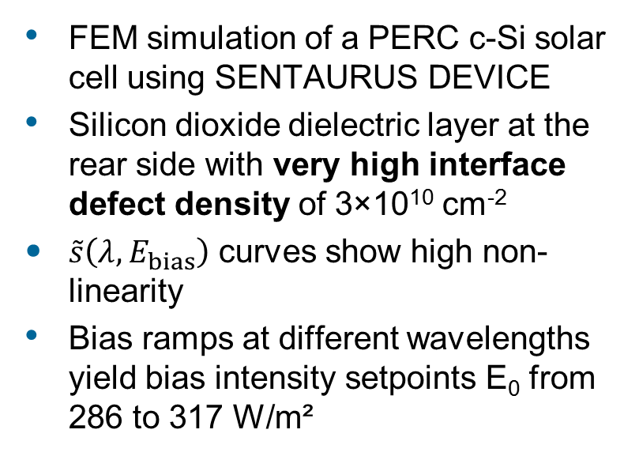
Simulation approach
J_{0e} = 59 fA/cm²
p-type Cz Si
τ_{SRH,n0} = 80 µs
SiO
τ_{SRH,p0} = 800 µs
S_{n} = 1.22×10⁴ cm/s
S_{p} = 5.92 cm/s
J_{0r,c} = 790 fA/cm²
FEM simulation of a PERC c-Si solar cell using SENTAURUS DEVICE
Silicon dioxide dielectric layer at the rear side with very high interface defect density of 3×10¹⁰ cm⁻²
$\tilde{s}\left(λ,E_{bias}\right)$ curves show high non-linearity
Bias ramps at different wavelengths yield bias intensity setpoints E₀ from 286 to 317 W/m²

Slide 14
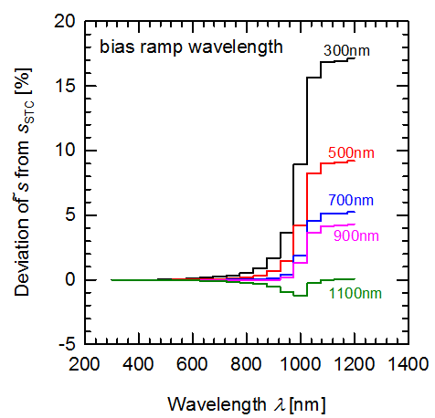
Impact of bias ramp wavelength and bias irradiance
How much do the simplifications deviate from the complete DSR method?
Simplification 1 (Multicolor bias ramps):
Deviations below -1.3%
Simplification 2 (White bias ramp):
Deviations below 4.6%
Simplification 3 (30% bias):
Deviations below 3.9%

Slide 15
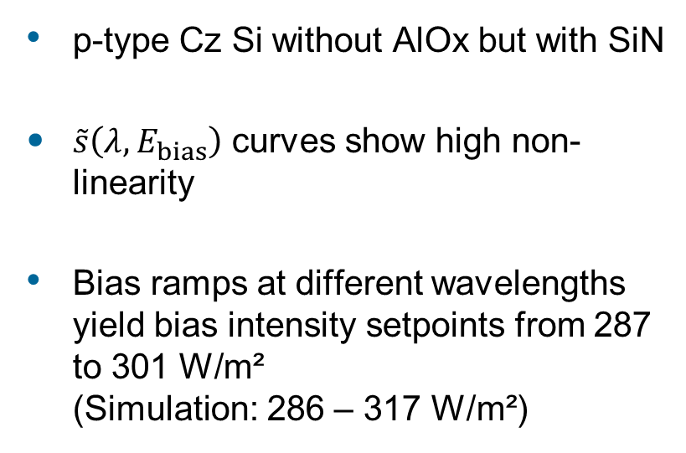
Measurement
p-type Cz Si
Si₃N₄
p-type Cz Si without AlOx but with SiN
$\tilde{s}\left(λ,E_{bias}\right)$ curves show high non-linearity
Bias ramps at different wavelengths yield bias intensity setpoints from 287 to 301 W/m²
(Simulation: 286 – 317 W/m²)

Slide 16
Impact of bias ramp wavelength and bias irradiance
How much do the simplifications deviate from the complete DSR method?
Simplification 1 (Multicolor bias ramps):
Deviations below -0.2%
Simplification 2 (White bias ramp):
Deviations below -1%
Simplification 3 (30% bias):
Deviations below -1%

Slide 17
Summary
Analysis of non-linear c-Si solar cell (simulation and measurement).
Deviations below 5% were determined from solar cell device simulations for all approximations.
Simplification 1 (Multicolor-biasramps) was the most robust approach (deviations below 1.3%).
Simplification 2 (White-biasramp) showed deviations below 4.6%.
Simplification 3 (30% bias) showed deviations below 3.9%.
For non-linear solar cells: Use the complete DSR procedure if possible.
If a simplification is required, use the multicolor-biasramps approach if possible.
Thank you for your attention!

Slide 18
Bias light intensities

