Slide 1
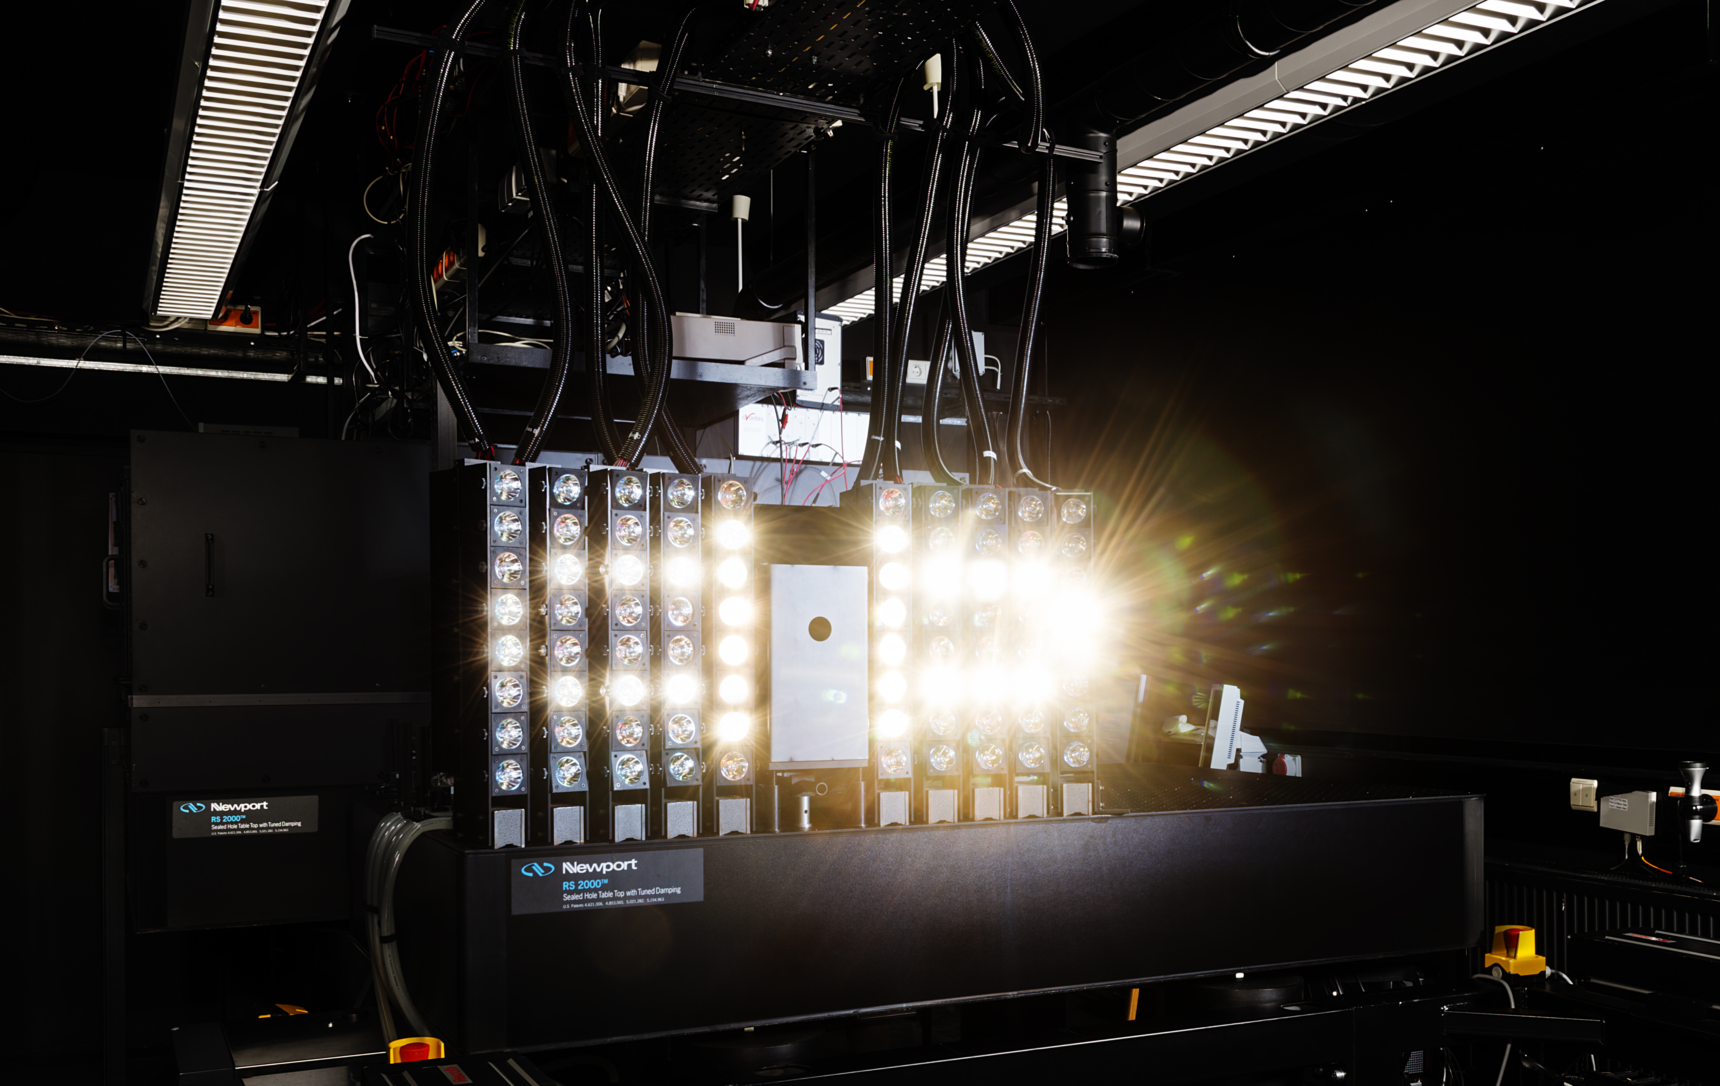


The laser-based differential spectral responsivity facility at PTB: Calibration services for energy rating
Ingo Kröger
Department 4.1: Photometry and Applied Radiometry
Working Group 4.14: Solar Cells

Slide 2
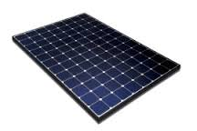

Metrological challenges related to energy rating?
Standard Test Conditions (STC)
+ irradiance dependence (Linearity)
+ temperature dependence
+ angular dependence
+ spectral dependence
state of the art: mature metrological infrastructure incl. Quality infrastructure, intercomparisons, round robins, validation,…
Energy rating: new metrological infrastructure is built up, new techniques are developed, only few intercomparions, round robins, …
IEC 61853-1
IEC 61853-2
Irradiance W m⁻² | Spectrum | 15°C | 25°C | 50°C | 75°C
1100 | AM1.5 | NA
1000 | AM1.5 |  | STC
800 | AM1.5
600 | AM1.5
400 | AM1.5 |  |  |  | NA
200 | AM1.5 |  |  | NA | NA
100 | AM1.5 |  |  | NA | NA
$$φ, θ$$
PTB wants to provide a high precision calibration facility covering spectral irradiance dependence, spectral temperature dependence and spectral angle of incidence measurements, i.e for validation purposes

Slide 3
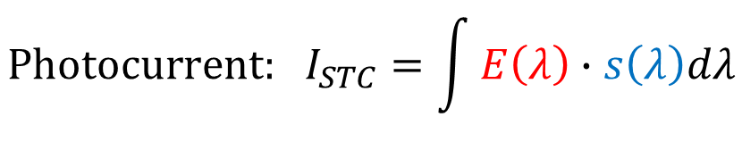
Differential spectral responsivity (DSR) method
Spektrale Empfindlichkeit s / A / W
$$\text{Photocurrent}\text{: }I_{STC}=\int{E\left(λ\right)∙s\left(λ\right)dλ}$$
Measurement of the absolute spectral irradiance responsivity under STC
Calculation of short circuit current for any given spectrum (AM1.5G, AM1.5D, AM0, measured/simulated spectra,…)

Slide 4
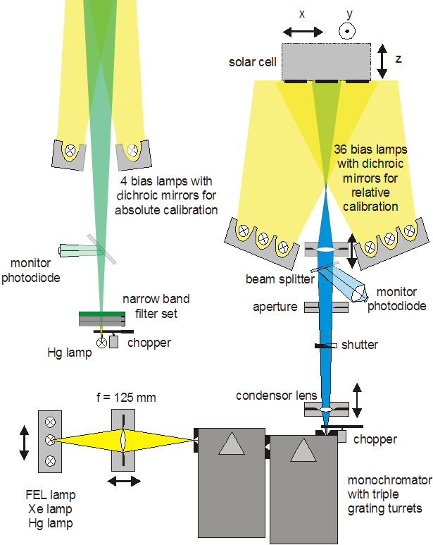
Differential spectral responsivity (DSR) method
E
ΔE(λ)
b
DSR- facility
2 beam technique:
→ monochromatic irradiation
→ Bias irradiation
Reference radiometer:
Photodiode, traceable to SI
Solarzelle
I_{b} + ΔI_{sc}(λ, E_{b})
0 – 1000 W/m²

Slide 5
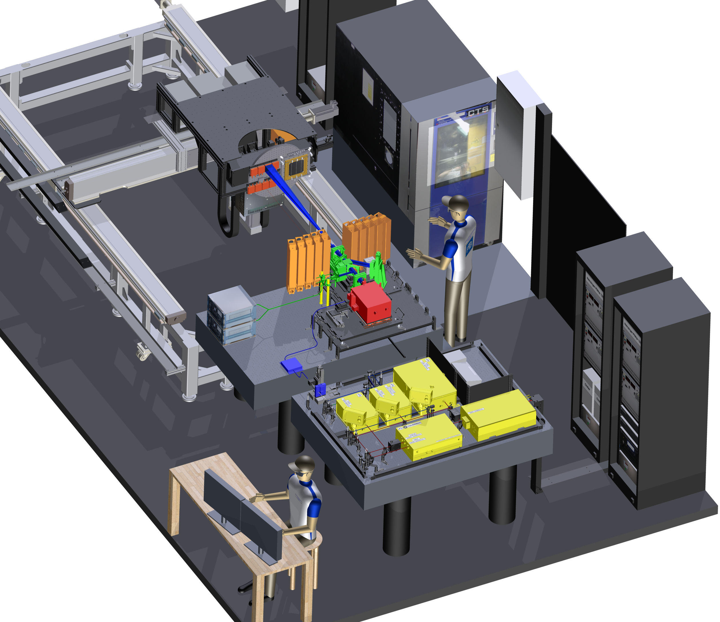
Laser-DSR facility @PTB
Optics (lenses, aperture,
monitor)
x,y,z-table
Monochromator
  ϑ,φ-Goniometer
Laser System
(Ti:Saphir Laser,
OPO, SHG, THG,
FHG)
Bias-turrets
Compact Array
Spectroradiometer
Puls-zu-CW
Konverter
(Glasfaser)
Chopper

Slide 6


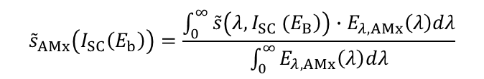
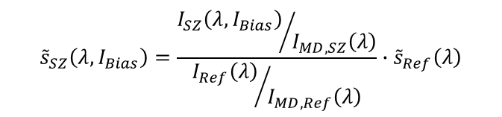
DSR fundamentals: From DSR to I_{STC}
Measurements of differential spectral responsivity curves ${\tilde{s}}_{SZ}\left({λ,E}_{b}\right)$ at different Bias irradiance levels E_{b}.
Comparison of solar cell against reference photodiode in homogeneous monochromatic fields, using monitor correction:
$${\tilde{s}}_{SZ}\left(λ,I_{Bias}\right)=\frac{{I_{SZ}\left(λ,I_{Bias}\right)}/{I_{MD,SZ}\left(λ\right)}}{{I_{Ref}\left(λ\right)}/{I_{MD,Ref}\left(λ\right)}}∙{\tilde{s}}_{Ref}\left(λ\right)$$
Determination of AMx weighted currents ${\tilde{s}}_{AMx}\left(I_{SC}\left(E_{b}\right)\right)$ for each DSR curve at given Bias irradiance level $I_{SC}\left(E_{b}\right)$:
If the solar cell would be linear, ${\tilde{s}}_{AMx}\left(I_{SC}\left(E_{b}\right)\right)$ would be constant and ${\tilde{s}}_{AMx}\left(I_{SC}\left(E_{b}\right)\right)=I_{STC}$
$${\tilde{s}}_{AMx}\left(I_{SC}\left(E_{b}\right)\right)=\frac{\int_{0}^{∞}{\tilde{s}\left(\left.λ, I_{SC} (E_{B}\right)\right)∙E_{λ, AMx}\left(λ\right)dλ}}{\int_{0}^{∞}{E_{λ, AMx}\left(λ\right)dλ}}$$
Where is I_{STC}?

Slide 7
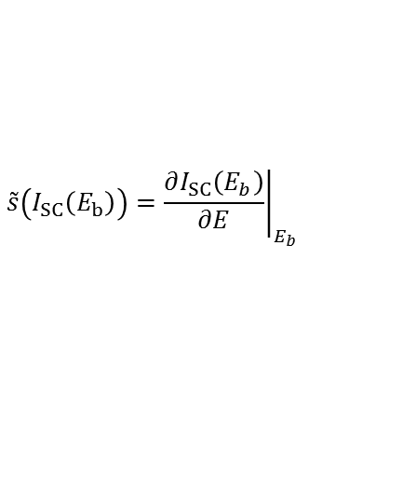
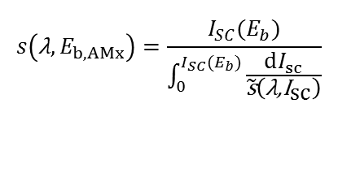
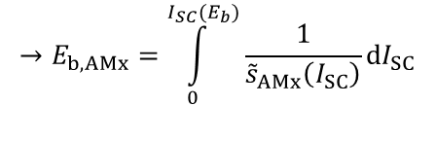
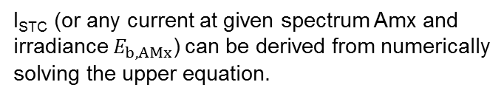
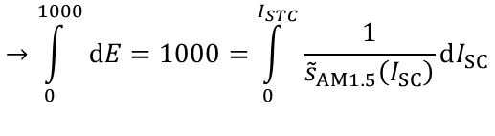
DSR fundamentals: From DSR to I_{STC}
BUT, what we actually measure is the differential
spectral responsivity (chopper, Lock-In technique)
$$\tilde{s}\left(I_{SC}\left(E_{b}\right)\right)={\left.\frac{∂I_{SC}\left(E_{b}\right)}{∂E}\right|}_{E_{b}}$$
Corresponds to the slope of the linearity curve at given points E_{b}
$$→\int_{0}^{1000}{dE}=1000=\int_{0}^{I_{STC}}{\frac{1}{{\tilde{s}}_{AM1.5}\left(I_{SC}\right)}}dI_{SC}$$
I_{STC} (or any current at given spectrum Amx and irradiance$E_{b, AMx}$) can be derived from numerically solving the upper equation.
$$→E_{b, AMx}=\int_{0}^{I_{SC}(E_{b})}{\frac{1}{{\tilde{s}}_{AMx}\left(I_{SC}\right)}}dI_{SC}$$
The absolute AMx spectral irradiance responsivity is derived from:
$$s\left(\text{λ},E_{b, AMx}\right)=\frac{I_{SC}(E_{b})}{\int_{0}^{I_{SC}(E_{b})}{\frac{dI_{sc}}{\tilde{\text{s}}\left(\text{λ}\text{,}{\text{I}}_{\text{sc}}\right)}}}$$

Slide 8
Conclusion: DSR-calibration services
Energy rating related extended measurements :
+ irradiance dependence (Linearity) → already integral part of DSR-method (I_{SC})
+ temperature dependence
+ angular dependence
+ spectral dependence → already integral part of DSR-method (I_{SC})
Irradiance W m⁻² | Spectrum | 15°C | 25°C | 50°C | 75°C
1100 | AM1.5 | NA | 135,59 mA
1000 | AM1.5 |  | 123,12 mA
800 | AM1.5 |  | 98,23 mA
600 | AM1.5 |  | 73,43 mA
400 | AM1.5 |  | 48,73 mA |  | NA
200 | AM1.5 |  | 24,19 mA | NA | NA
100 | AM1.5 |  | 12,03 mA | NA | NA
These measurements are needed for solar simulator measurements related to energy rating.
s(λ, E): for spectral mismatch corrections
I_{SC}(E): for calibration of solar simulator irradiance level
These measurements can be performed by PTB for reference solar cells up to 6” size (and mini-modules)

Slide 9
Temperature dependent measurements
Full DSR-calibration at 4 different temperatures exceeds reasonable time scale
Only perform relative DSR measurement dependent on solar cell temperature
Set irradiance level to approx. 300W/m², since in general SR(1000 W/m²) ≈ DSR(300 W/m²)
Set solar cell temperature to 15°C, 20°C, 25°C, 30°C, 40°C, 50°C, 75°C
Peltier based heating/cooling: Temperature instability <0.2K

Slide 10
Temperature dependent measurements
Perform a linear regression for each wavelength
Determination of spectral temperature coefficient
Calculation of AM1.5 weighted temperature coefficient using the absolute SR.
TC I_{SC} : (0.00883 ± 0.00100) %/K

Slide 11
Conclusion: DSR-calibration services
Energy rating related extended measurements :
+ irradiance dependence (Linearity) → already integral part of DSR-method (I_{SC})
+ temperature dependence → extended temperature range, based on relative DSR
+ angular dependence
+ spectral dependence → already integral part of DSR-method (I_{SC})
Irradiance W m⁻² | Spectrum | 15°C | 25°C | 50°C | 75°C
1100 | AM1.5 | NA | 135.59 mA | 0.221% | 0.442%
1000 | AM1.5 | -0.0883% | 123.12 mA | 0.221% | 0.442%
800 | AM1.5 | 0.0883% | 98.23 mA | 0.221% | 0.442%
600 | AM1.5 | 0.0883% | 73.43 mA | 0.221% | 0.442%
400 | AM1.5 | 0.0883% | 48.73 mA | 0.221% | NA
200 | AM1.5 | 0.0883% | 24.19 mA | NA | NA
100 | AM1.5 | 0.0883% | 12.03 mA | NA | NA
These measurements are needed for solar simulator measurements related to energy rating at different temperatures (i.e. in climate chamber)
s(λ, T): for spectral mismatch corrections
I_{SC}(T): for calibration of solar simulator irradiance level
These measurements can be performed by PTB for reference solar cells up to 6” size (and mini-modules), when appropriate thermal back contact possible

Slide 12
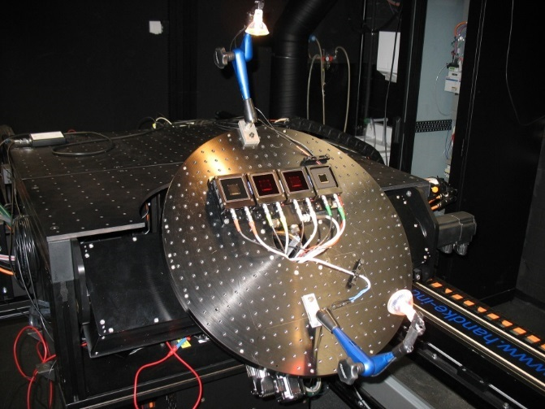

Angular dependent measurements
DSR-facility is equipped with an automated ϑ,φ-Goniometer
Change angle of incidence of the solar cell relative to optical axis of the monochromatic beam
Optical axis and center of rotation is kept fixed in the center and surface of the solar cell
Bias light mounted on Goniometer base plate → Bias irradiance does not change upon rotation
Φ
ϑ
λ
Typical measurement:
ϑ: 0 - 90°, Δϑ = 5°
Φ: 0 - 90°, ΔΦ = 15°
λ: 300 nm – 1150 nm, Δ λ =50nm

Slide 13
Angular dependent measurements
Normalization of measured current to normal incidence
Generally wavelength dependent angular response is observed
Validation: comparison of spectral angular responsivity with integral angular response using a halogen lamp (broadband light source of known spectral irradiance)

Slide 14
Angular dependent measurements
Calculation of weighted average of spectral angular response for different light sources
  Weights: spectral responsivity + AM1.5 spectrum
  Weights: spectral responsivity + Halogen lamp spectrum
Experimental halogen lamp angular response agrees well with spectral angular response weighted by spectral responsivity + halogen lamp spectrum
AM1.5 (or any other spectrum) angular response can be derived from spectral angular response measurements

Slide 15

Conclusion: DSR-calibration services
Energy rating related extended measurements :
+ irradiance dependence (Linearity) → already integral part of DSR-method (I_{SC})
+ temperature dependence → extended temperature range, based on relative DSR
+ angular dependence → additional spectral angular response measurements available
+ spectral dependence → already integral part of DSR-method (I_{SC})
$$φ, θ$$
Irradiance W m⁻² | Spectrum | 15°C | 25°C | 50°C | 75°C
1100 | AM1.5 | NA | 135.59 mA | 0.221% | 0.442%
1000 | AM1.5 | -0.0883% | 123.12 mA | 0.221% | 0.442%
800 | AM1.5 | 0.0883% | 98.23 mA | 0.221% | 0.442%
600 | AM1.5 | 0.0883% | 73.43 mA | 0.221% | 0.442%
400 | AM1.5 | 0.0883% | 48.73 mA | 0.221% | NA
200 | AM1.5 | 0.0883% | 24.19 mA | NA | NA
100 | AM1.5 | 0.0883% | 12.03 mA | NA | NA
These measurements can be used for validation measurements of solar simulator based AOI-measurements
These measurements can be performed by PTB for reference solar cells up to 6” size (and mini-modules)

Slide 16
Thank you.

