Slide 1
Uncertainties in
Energy Rating (ER) and
Module Performance Ratio (MPR)
7th Energy Rating and Module Performance Modelling Workshop
B.V. Mihaylov, M. Bliss*, R. Gottschalg
Centre for Renewable Energy Systems Technology (CREST), Loughborough University
*Email: M.Bliss@lboro.ac.uk ; Tel.: +44 1509 635327
30/03/2017

Slide 2
Outline
  Introduction
  Uncertainty
    Methodology
    Sources and Correlations
    ER and MPR estimates
  Conclusions

Slide 3
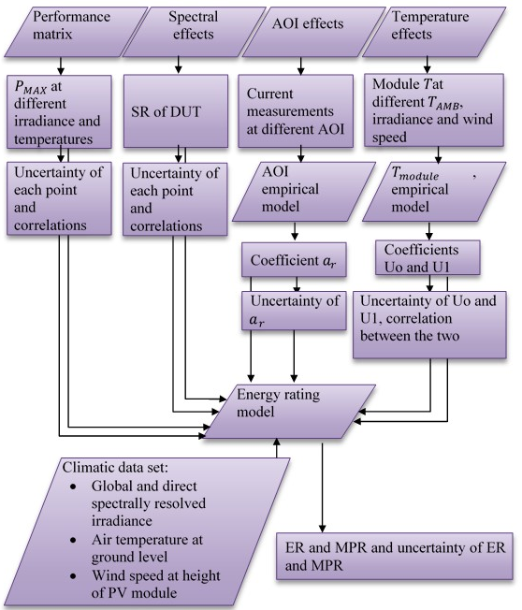
Introduction
For ER and MPR to be adopted and meaningful, the uncertainty analyses need to be consistent:
  worst-case assumptions may result in overestimation
  underestimating correlations may underestimate
Focus on uncertainty in performance matrix
  Methodology detailed
  Example given for CREST
Notes:
Device measurements are used in combination with standard climatic datasets for calculating the ER and the MPR.
ER and MPR uncertainties are dominated by the performance matrix and Faiman coefficient measurement uncertainties.

Slide 4
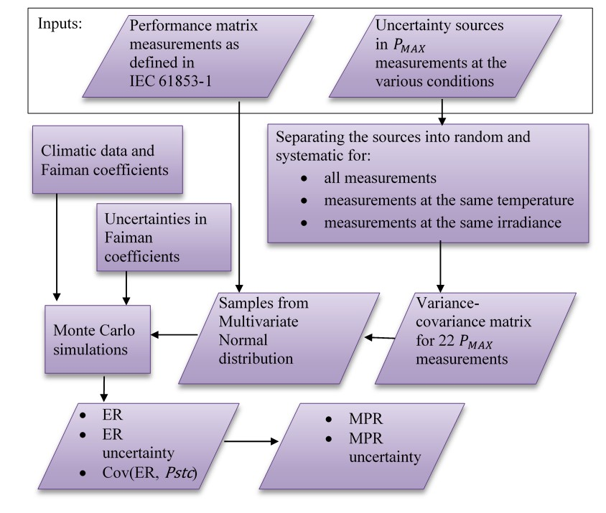
ER and MPR uncertainty methodology

Slide 5
ER and MPR uncertainty methodology

Slide 6
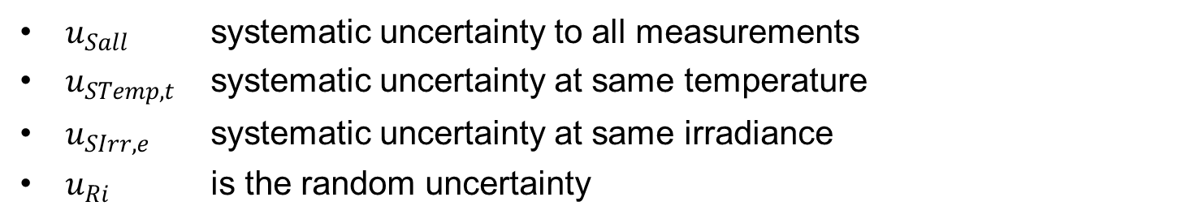
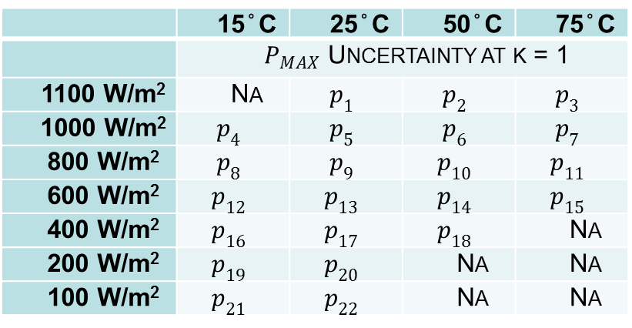

Uncertainty sources and correlation estimates
 | 15°C | 25°C | 50°C | 75°C
 | $P_{MAX}$ Uncertainty at k = 1
1100 W/m² | Na | $$p_{1}$$ | $$p_{2}$$ | $$p_{3}$$
1000 W/m² | $$p_{4}$$ | $$p_{5}$$ | $$p_{6}$$ | $$p_{7}$$
800 W/m² | $$p_{8}$$ | $$p_{9}$$ | $$p_{10}$$ | $$p_{11}$$
600 W/m² | $$p_{12}$$ | $$p_{13}$$ | $$p_{14}$$ | $$p_{15}$$
400 W/m² | $$p_{16}$$ | $$p_{17}$$ | $$p_{18}$$ | Na
200 W/m² | $$p_{19}$$ | $$p_{20}$$ | Na | Na
100 W/m² | $$p_{21}$$ | $$p_{22}$$ | Na | Na
$${u_{P}^{2}}_{i}=u_{Sall}^{2}+u_{STemp, t}^{2}{+u}_{SIrr, e}^{2}+u_{Ri}^{2}$$
$u_{Sall}$ systematic uncertainty to all measurements
$u_{STemp,t}$ systematic uncertainty at same temperature
$u_{SIrr,e}$ systematic uncertainty at same irradiance
$u_{Ri}$ is the random uncertainty

Slide 7
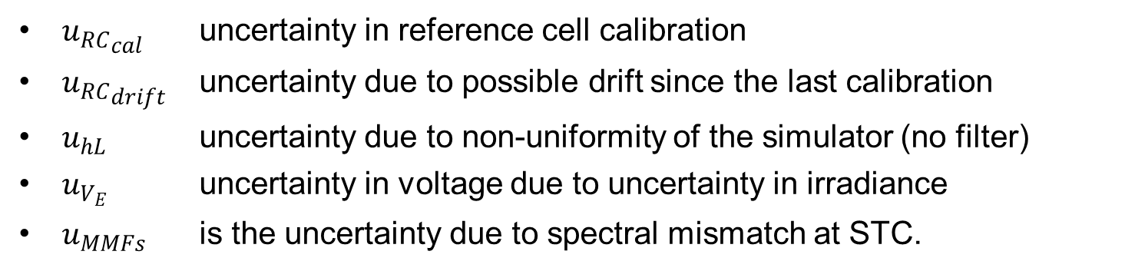
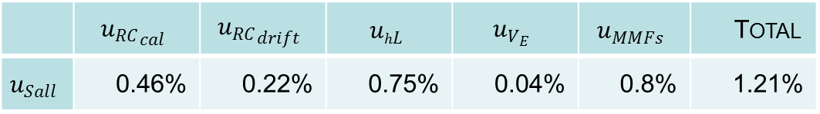
Uncertainty sources systematic to all measurements
$$u_{Sall}^{2}={u_{RC}^{2}}_{cal}+{u_{RC}^{2}}_{drift}+u_{hL}^{2}+u_{V_{E}}^{2}+u_{MMFs}^{2}$$
 | $${u_{RC}}_{cal}$$ | $${u_{RC}}_{drift}$$ | $$u_{hL}$$ | $$u_{V_{E}}$$ | $$u_{MMFs}$$ | Total
$$u_{Sall}$$ | 0.46% | 0.22% | 0.75% | 0.04% | 0.8% | 1.21%
${u_{RC}}_{cal}$ uncertainty in reference cell calibration
${u_{RC}}_{drift}$ uncertainty due to possible drift since the last calibration
$u_{hL}$ uncertainty due to non-uniformity of the simulator (no filter)
$u_{V_{E}}$ uncertainty in voltage due to uncertainty in irradiance
$u_{MMFs}$ is the uncertainty due to spectral mismatch at STC.

Slide 8
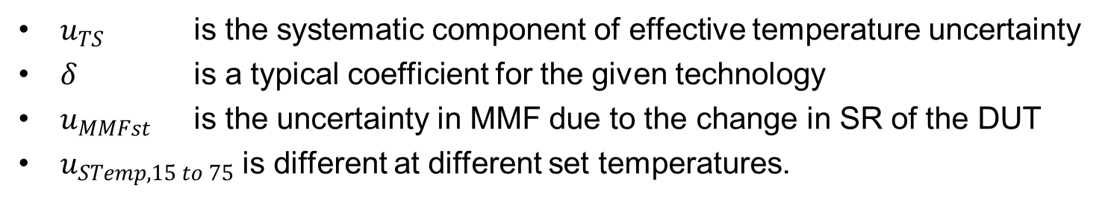

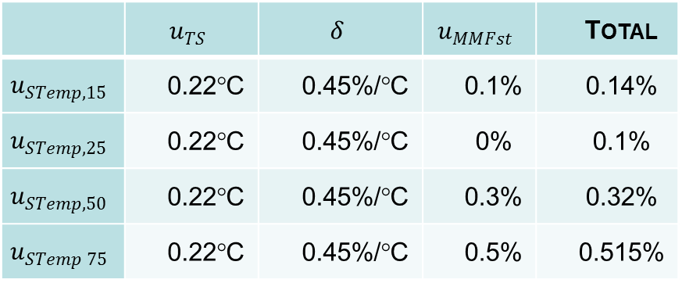
Uncertainty sources systematic at the same temperature
$$u_{STemp,15 to 75}^{2}=u_{TS}^{2}∗δ^{2}+u_{MMFst}^{2}$$
 | $$u_{TS}$$ | $$δ$$ | $$u_{MMFst}$$ | Total
$$u_{STemp,15}$$ | 0.22°C | 0.45%/°C | 0.1% | 0.14%
$$u_{STemp,25}$$ | 0.22°C | 0.45%/°C | 0% | 0.1%
$$u_{STemp,50}$$ | 0.22°C | 0.45%/°C | 0.3% | 0.32%
$$u_{STemp 75}$$ | 0.22°C | 0.45%/°C | 0.5% | 0.515%
$u_{TS}$ is the systematic component of effective temperature uncertainty
$δ$ is a typical coefficient for the given technology
$u_{MMFst}$ is the uncertainty in MMF due to the change in SR of the DUT
$u_{STemp,15 to 75}$ is different at different set temperatures.

Slide 9
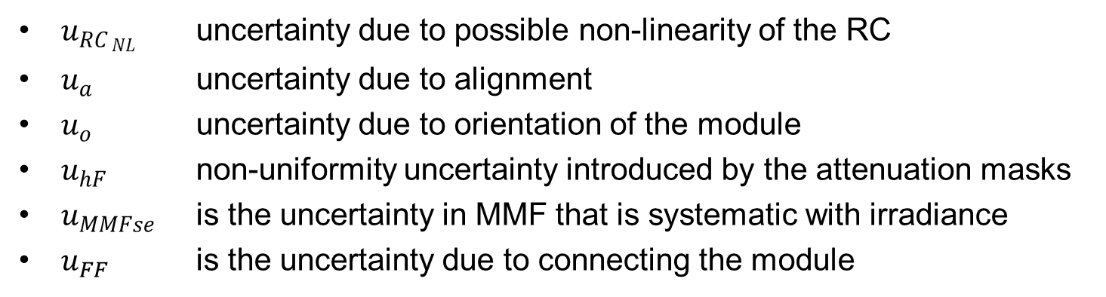
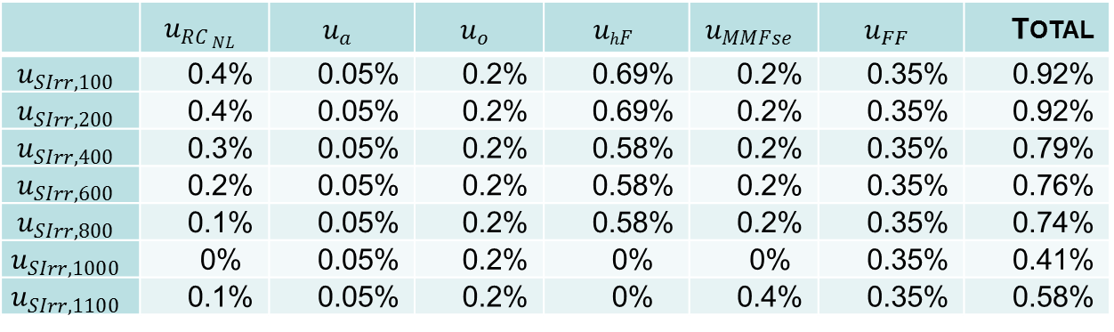
Uncertainty sources systematic at the same irradiance
$$u_{SIrr,100 to 1100}^{2}=u_{{RC}_{ NL}}^{2}{ +u_{a}^{2}+u_{o}^{2}+u_{hF}^{2}+u}_{MMFse}^{2}+u_{FF}^{2}$$
 | $$u_{RC_{ NL}}$$ | $$u_{a}$$ | $$u_{o}$$ | $$u_{hF}$$ | $$u_{MMFse}$$ | $$u_{FF}$$ | Total
$$u_{SIrr,100}$$ | 0.4% | 0.05% | 0.2% | 0.69% | 0.2% | 0.35% | 0.92%
$$u_{SIrr,200}$$ | 0.4% | 0.05% | 0.2% | 0.69% | 0.2% | 0.35% | 0.92%
$$u_{SIrr,400}$$ | 0.3% | 0.05% | 0.2% | 0.58% | 0.2% | 0.35% | 0.79%
$$u_{SIrr,600}$$ | 0.2% | 0.05% | 0.2% | 0.58% | 0.2% | 0.35% | 0.76%
$$u_{SIrr,800}$$ | 0.1% | 0.05% | 0.2% | 0.58% | 0.2% | 0.35% | 0.74%
$$u_{SIrr,1000}$$ | 0% | 0.05% | 0.2% | 0% | 0% | 0.35% | 0.41%
$$u_{SIrr,1100}$$ | 0.1% | 0.05% | 0.2% | 0% | 0.4% | 0.35% | 0.58%
$u_{RC_{ NL}}$ uncertainty due to possible non-linearity of the RC
$u_{a}$ uncertainty due to alignment
$u_{o}$ uncertainty due to orientation of the module
$u_{hF}$ non-uniformity uncertainty introduced by the attenuation masks
$u_{MMFse}$ is the uncertainty in MMF that is systematic with irradiance
$u_{FF}$ is the uncertainty due to connecting the module

Slide 10
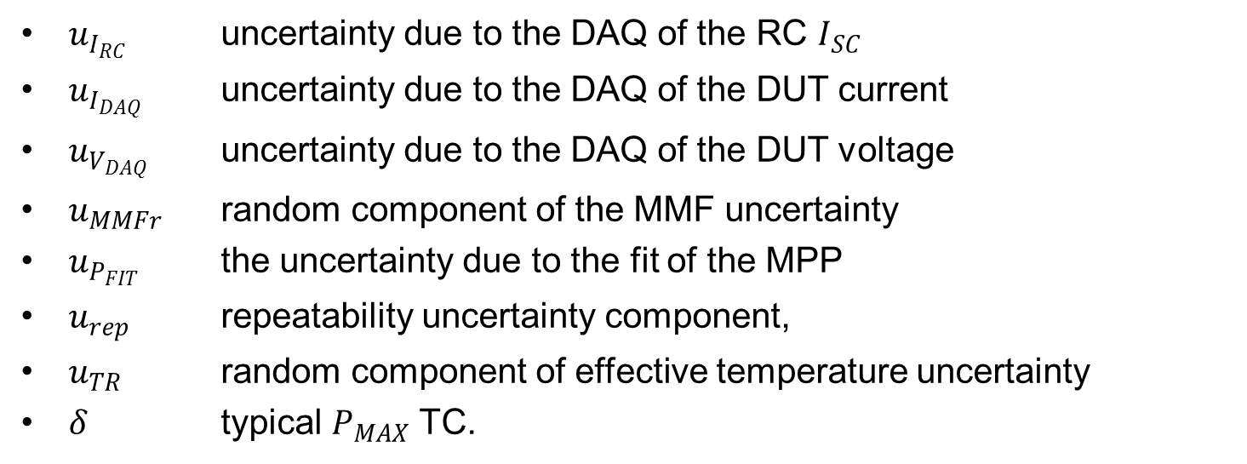
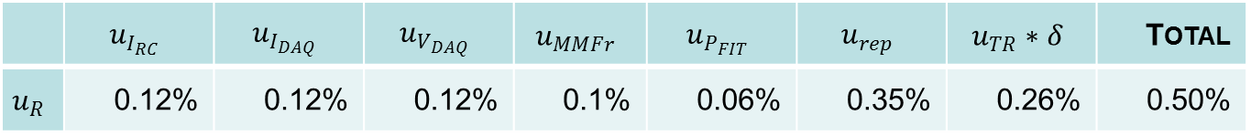
Uncertainty sources random to all measurements
$$u_{R}^{2}= u_{I_{RC}}^{2}+u_{I_{DAQ}}^{2}+u_{V_{DAQ}}^{2}+u_{MMFr}^{2}+u_{P_{FIT }}^{2}+u_{rep}^{2}+ u_{TR}^{2}∗δ^{2}$$
 | $$u_{I_{RC}}$$ | $$u_{I_{DAQ}}$$ | $$u_{V_{DAQ}}$$ | $$u_{MMFr}$$ | $$u_{P_{FIT}}$$ | $$u_{rep}$$ | $$u_{TR}∗δ$$ | Total
$$u_{R}$$ | 0.12% | 0.12% | 0.12% | 0.1% | 0.06% | 0.35% | 0.26% | 0.50%
$u_{I_{RC}}$ uncertainty due to the DAQ of the RC $I_{SC}$
$u_{I_{DAQ}}$ uncertainty due to the DAQ of the DUT current
$u_{V_{DAQ}}$ uncertainty due to the DAQ of the DUT voltage
$u_{MMFr}$ random component of the MMF uncertainty
$u_{P_{FIT}}$ the uncertainty due to the fit of the MPP
$u_{rep}$ repeatability uncertainty component,
$u_{TR}$ random component of effective temperature uncertainty
$δ$ typical $P_{MAX}$ TC.

Slide 11
ER and MPR uncertainty methodology

Slide 12
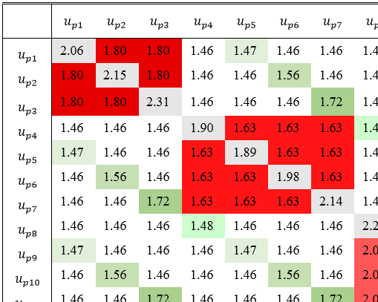
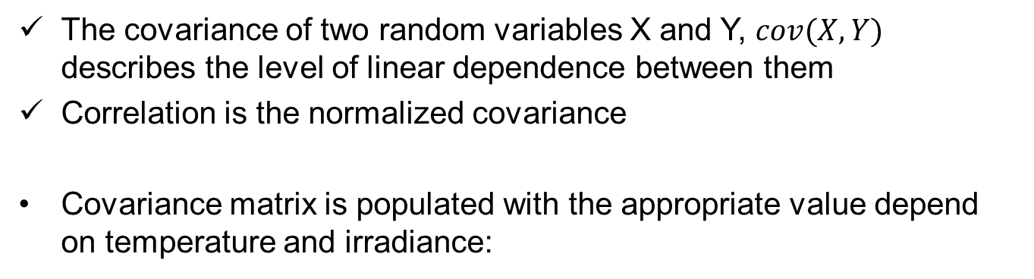



      Covariance / Correlation between measurements
The covariance of two random variables X and Y, $cov(X,Y)$ describes the level of linear dependence between them
Correlation is the normalized covariance
Covariance matrix is populated with the appropriate value depend on temperature and irradiance:
$$cov\left(p_{i}, p_{j}\right)={p_{i}p_{j}(u_{Sall}^{2}+u}_{SIrr,e}^{2})=S_{Eij,e}^{2}$$
$$cov\left(p_{i}, p_{j}\right)={p_{i}p_{j}(u_{Sall}^{2}+u}_{STemp,t}^{2})=S_{Tij,t}^{2}$$
$$cov\left(p_{i}, p_{j}\right)={p_{i}p_{j}u}_{Sall}^{2}= {S_{ij}}^{2}$$

Slide 13
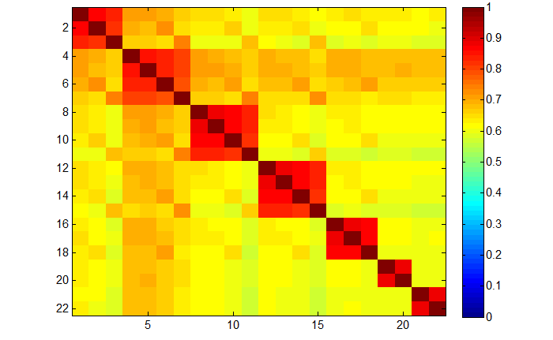
Correlation matrix of 22 $P_{MAX}$ measurements

Slide 14
ER and MPR uncertainty methodology

Slide 15

Sample Performance matrices
Max Power
Irradiance in W/m²
Temp in ºC

Slide 16
ER and MPR uncertainty methodology

Slide 17
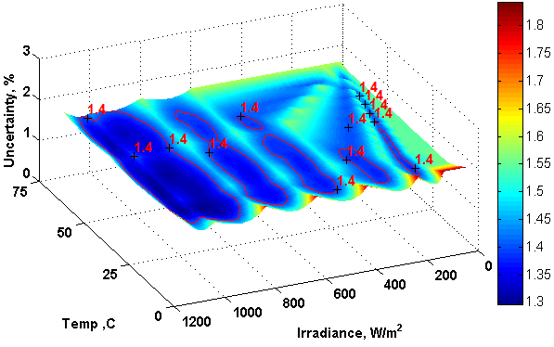
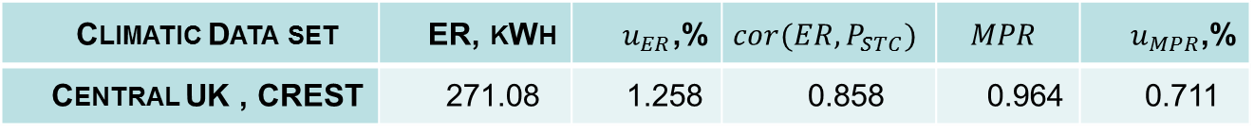
ER uncertainty with calculated correlations
Climatic Data set | ER, kWh | $u_{ER}$,% | $$cor(ER,P_{STC})$$ | $$MPR$$ | $u_{MPR}$,%
Central UK , CREST | 271.08 | 1.258 | 0.858 | 0.964 | 0.711
ER uncertainty is smaller than that at STC
Strong correlation leads to lower MPR uncertainty

Slide 18
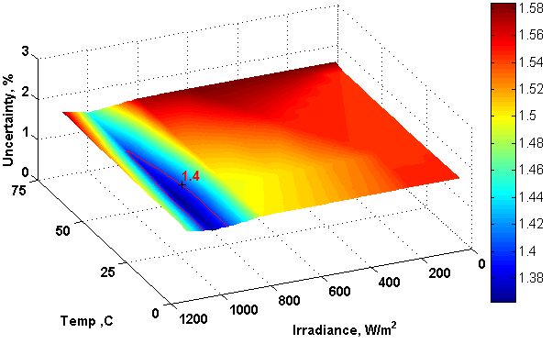

ER uncertainty if all measurements are fully correlated
Climatic Data set | ER, kWh | $u_{ER}$,% | $$cor(ER,P_{STC})$$ | $$MPR$$ | $u_{MPR}$,%
Central UK , CREST | 271.09 | 1.507 | 1.000 | 0.964 | 0.145
Overestimation of ER uncertainty
MPR uncertainty unrealistically small

Slide 19
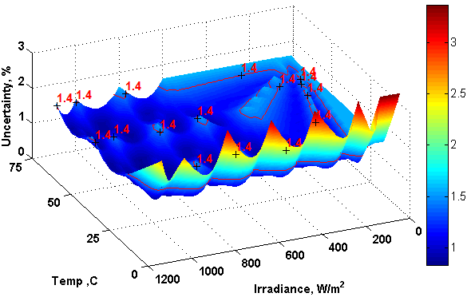

ER uncertainty if all measurements are independent
Climatic Data set | ER, kWh | $u_{ER}$,% | $$cor(ER,P_{STC})$$ | $$MPR$$ | $u_{MPR}$,%
Central UK , CREST | 271.08 | 0.455 | 0.158 | 0.964 | 1.393
Underestimation of ER uncertainty
MPR uncertainty very high

Slide 20
… up next …
  Introduction
  Uncertainty
    Methodology
    Sources and Correlations
    ER and MPR estimates
  Conclusions

Slide 21
Conclusions
Measurements would have a significant commercial value
Need a consistent and robust uncertainty analysis
A framework for calculating the uncertainty is provided
Estimating the measurement correlation is key in correctly calculating the overall uncertainty
Alongside a procedure for calculating ER and MPR, there should be a procedure / guideline for propagating the uncertainty

Slide 22



…Thank You…

Slide 23
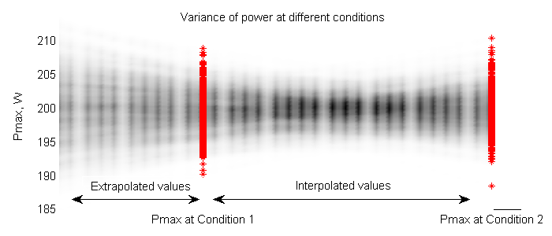
Difference in variance between extrapolated and interpolated conditions

