Slide 1

More Accurate Module Performance Predictions Using A New Model Based on IEC-61853 Data
Janine Freeman
7th PV Performance Modeling Workshop
Canobbio, Switzerland
March 30, 2017

Slide 2

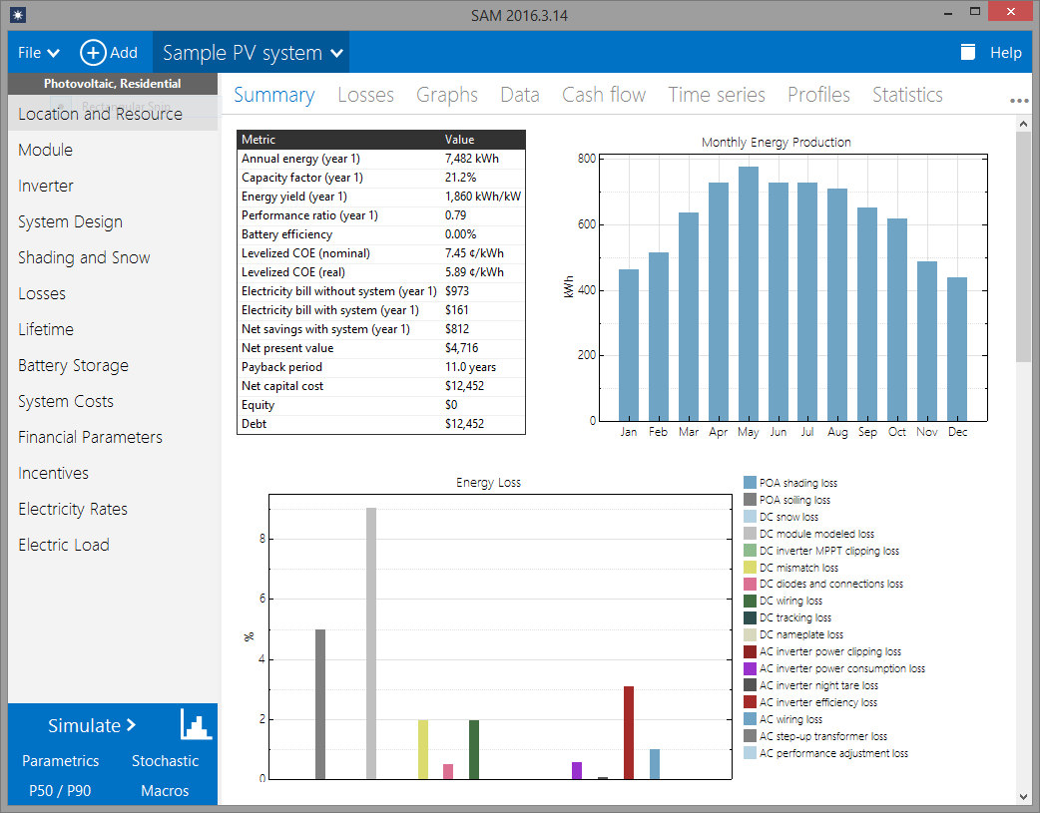
System Advisor Model (SAM)
System Advisor Model
Free software that enables detailed performance and economic analysis for renewable energy systems
Technologies
Photovoltaics,
Detailed & PVWatts
Battery Storage
Concentrating solar power
Wind
Geothermal
Biomass
Solar water heating
Financials
Behind-the-meter
residential
commercial
Power purchase agreements
single owner
equity flips
sale-leaseback
Simple LCOE calculator
http://sam.nrel.gov/download

Slide 3
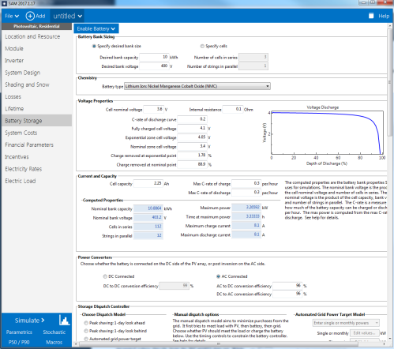
Detailed photovoltaic model
System Advisor Model
Irradiance
Transposition using Isotropic, HDKR, or Perez
Measured plane of array (POA) input
Shading
Irregular obstruction shading from 3D scene
Self-shading for regularly spaced rows
External input from SunEye, Solar Pathfinder
Snow cover loss model
Module
Simple efficiency model
Single diode model (CEC database or datasheet)
Extended single diode model (for IEC-61853 tests)
Sandia PV Array Performance Model
Inverter
Sandia/CEC grid-tied inverter model
Datasheet part-load efficiency curve
System
Sizing wizard or electrical layout
Multiple subarrays
Fixed, 1 axis, backtracking, azimuth axis, 2 axis
Battery storage
Degradation
Extrapolated single year
Lifetime simulation of all years
Simulation
1 minute to 1 hour time steps
֍

Slide 4
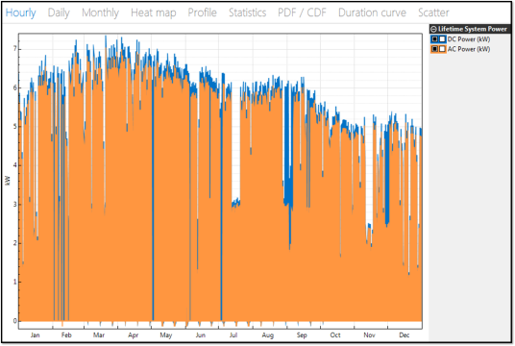
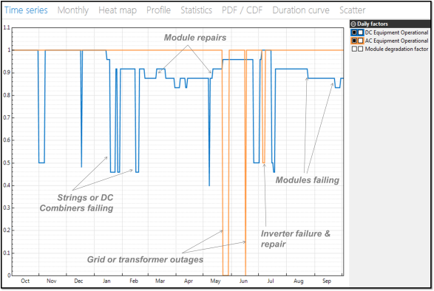
Stochastic Model for PV System Reliability & Performance
System Advisor Model
Coming soon: a newly developed Beta version of the Photovoltaic Reliability Performance Model (PVRPM) that has been implemented in SAM.
This model samples failure distributions for components in a PV system and predicts failure times, replacement costs, and performance/cost impacts for a more realistic representation of LCOE of PV systems.

Slide 5
IEC-61853 Module Model

Slide 6
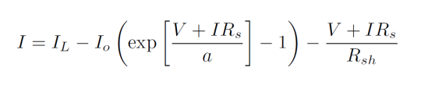
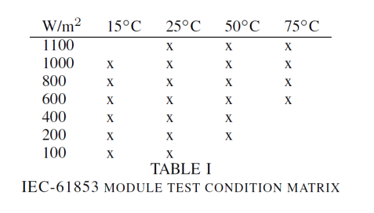
Background
System Advisor Model
Single diode model
Great at STC, but what about all these conditions?

Slide 7
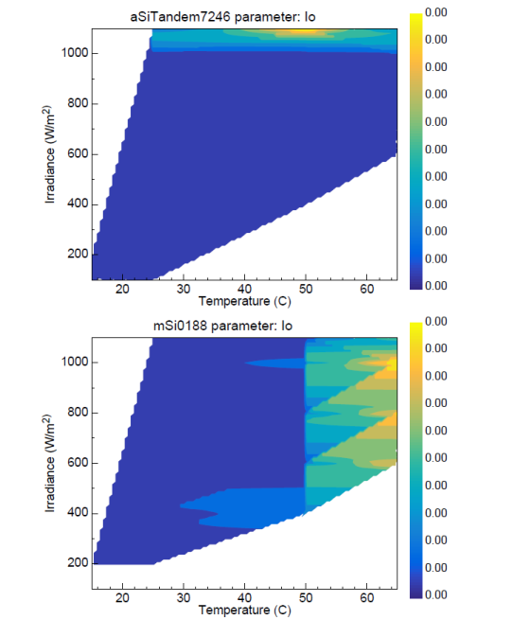
Estimating Parameters at Any Condition
System Advisor Model

Slide 8
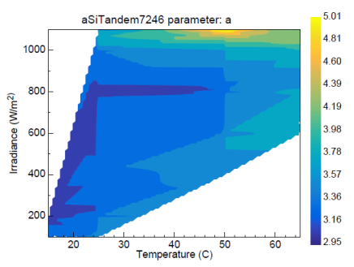
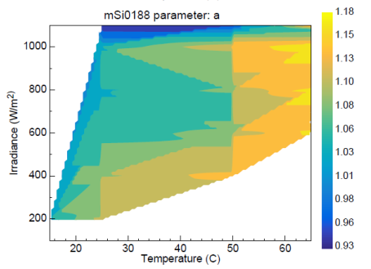
Estimating Parameters at Any Condition
System Advisor Model

Slide 9
Map Boundaries
System Advisor Model
If desired operating condition is…
sufficiently near edge of convex hull defined by test points, nearest known point used
Too far away, model reverts to standard single diode model equations
֍

Slide 10
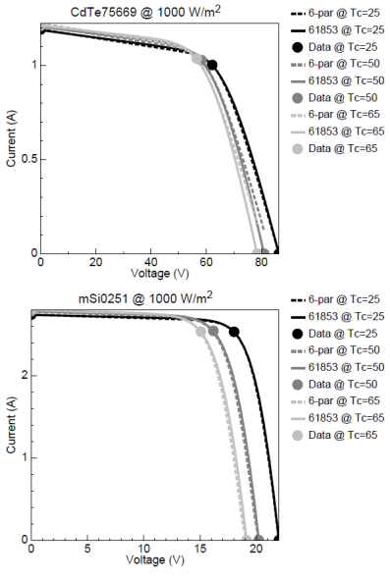
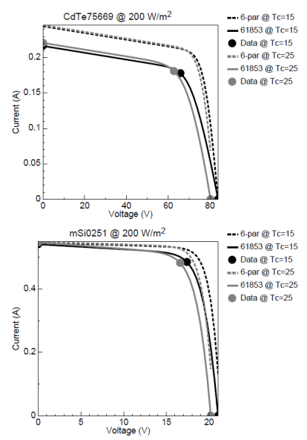
Comparison with 6 Parameter Model
System Advisor Model

Slide 11
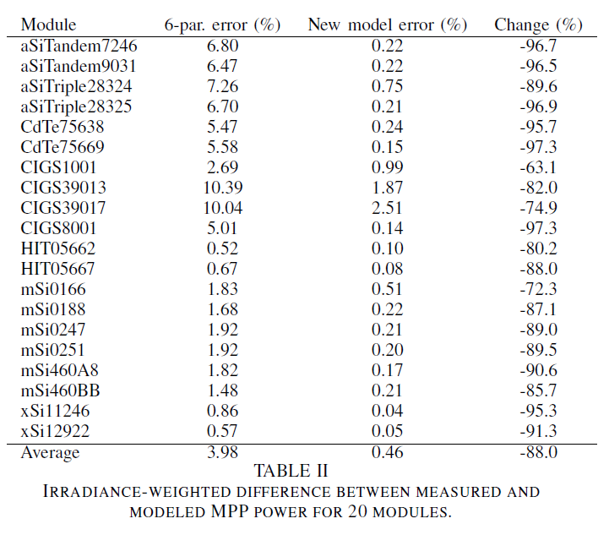
Comparison with 6 Parameter Model
System Advisor Model
88% reduction in error on average across 20 modules

Slide 12
Where can I get the new model?

Slide 13
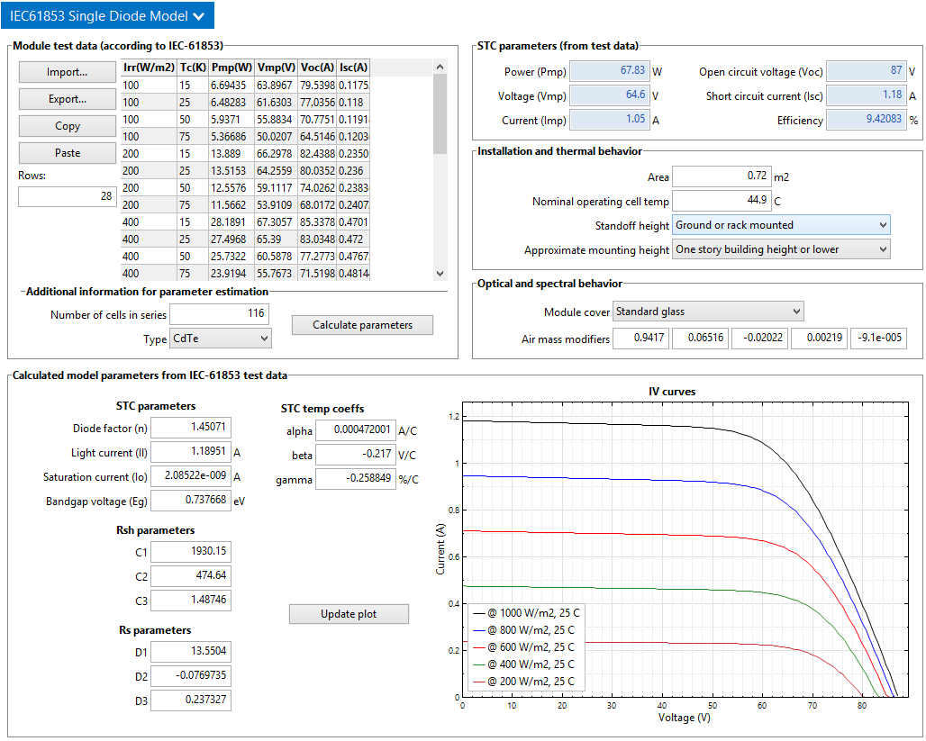
How can you access SAM models?
System Advisor Model
Desktop Application
Advanced Analysis Features
Parametric
Stochastic
P50/P90
Built-in Scripting Language
Macros
Software Development Kit (SDK)
C/C++
Matlab
Python
C#
Java
Web Services API (PVWatts Only)
Dobos, A.; Freeman, J.: Significant Improvement in PV Module Performance Prediction Accuracy Using a New Model Based on IEC-61853 Data, forthcoming

Slide 14
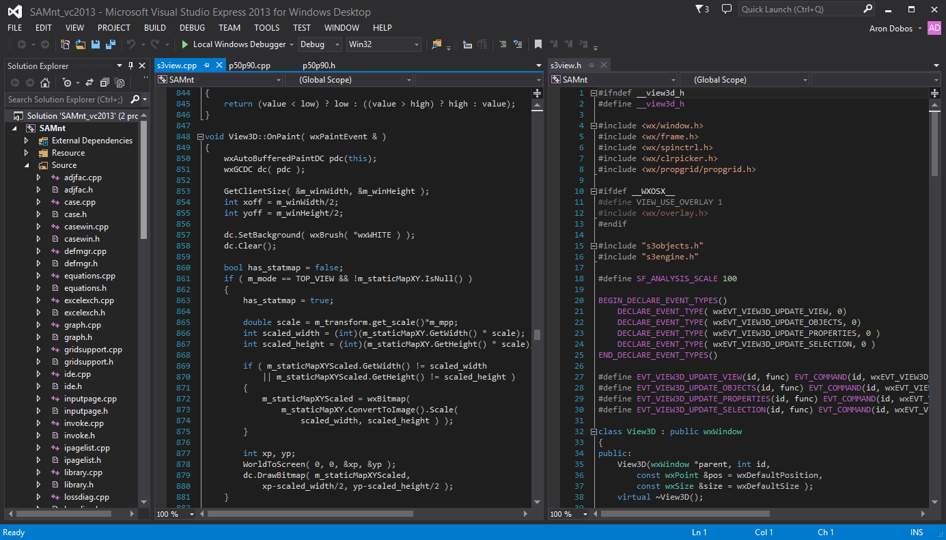
Open-Sourcing SAM
System Advisor Model
This summer, we will be open-sourcing the SAM project under a permissive license.
Ultimate code transparency
Ability for users to modify/add capabilities to better suit their particular modeling needs
Greater collaboration with industry through user contributions

Slide 15
Our team
Janine Freeman Project lead, PV and wind models
Nick DiOrio Software architecture, Battery storage models
Steve Janzou Programming, financial structures (subcontractor)
Paul Gilman User support and documentation (subcontractor)
Ty Neises Concentrating solar power models
Mike Wagner Concentrating solar power models
Nate Blair Emeritus lead, financials, costs, systems
http://sam.nrel.gov
System Advisor Model

