Slide 1
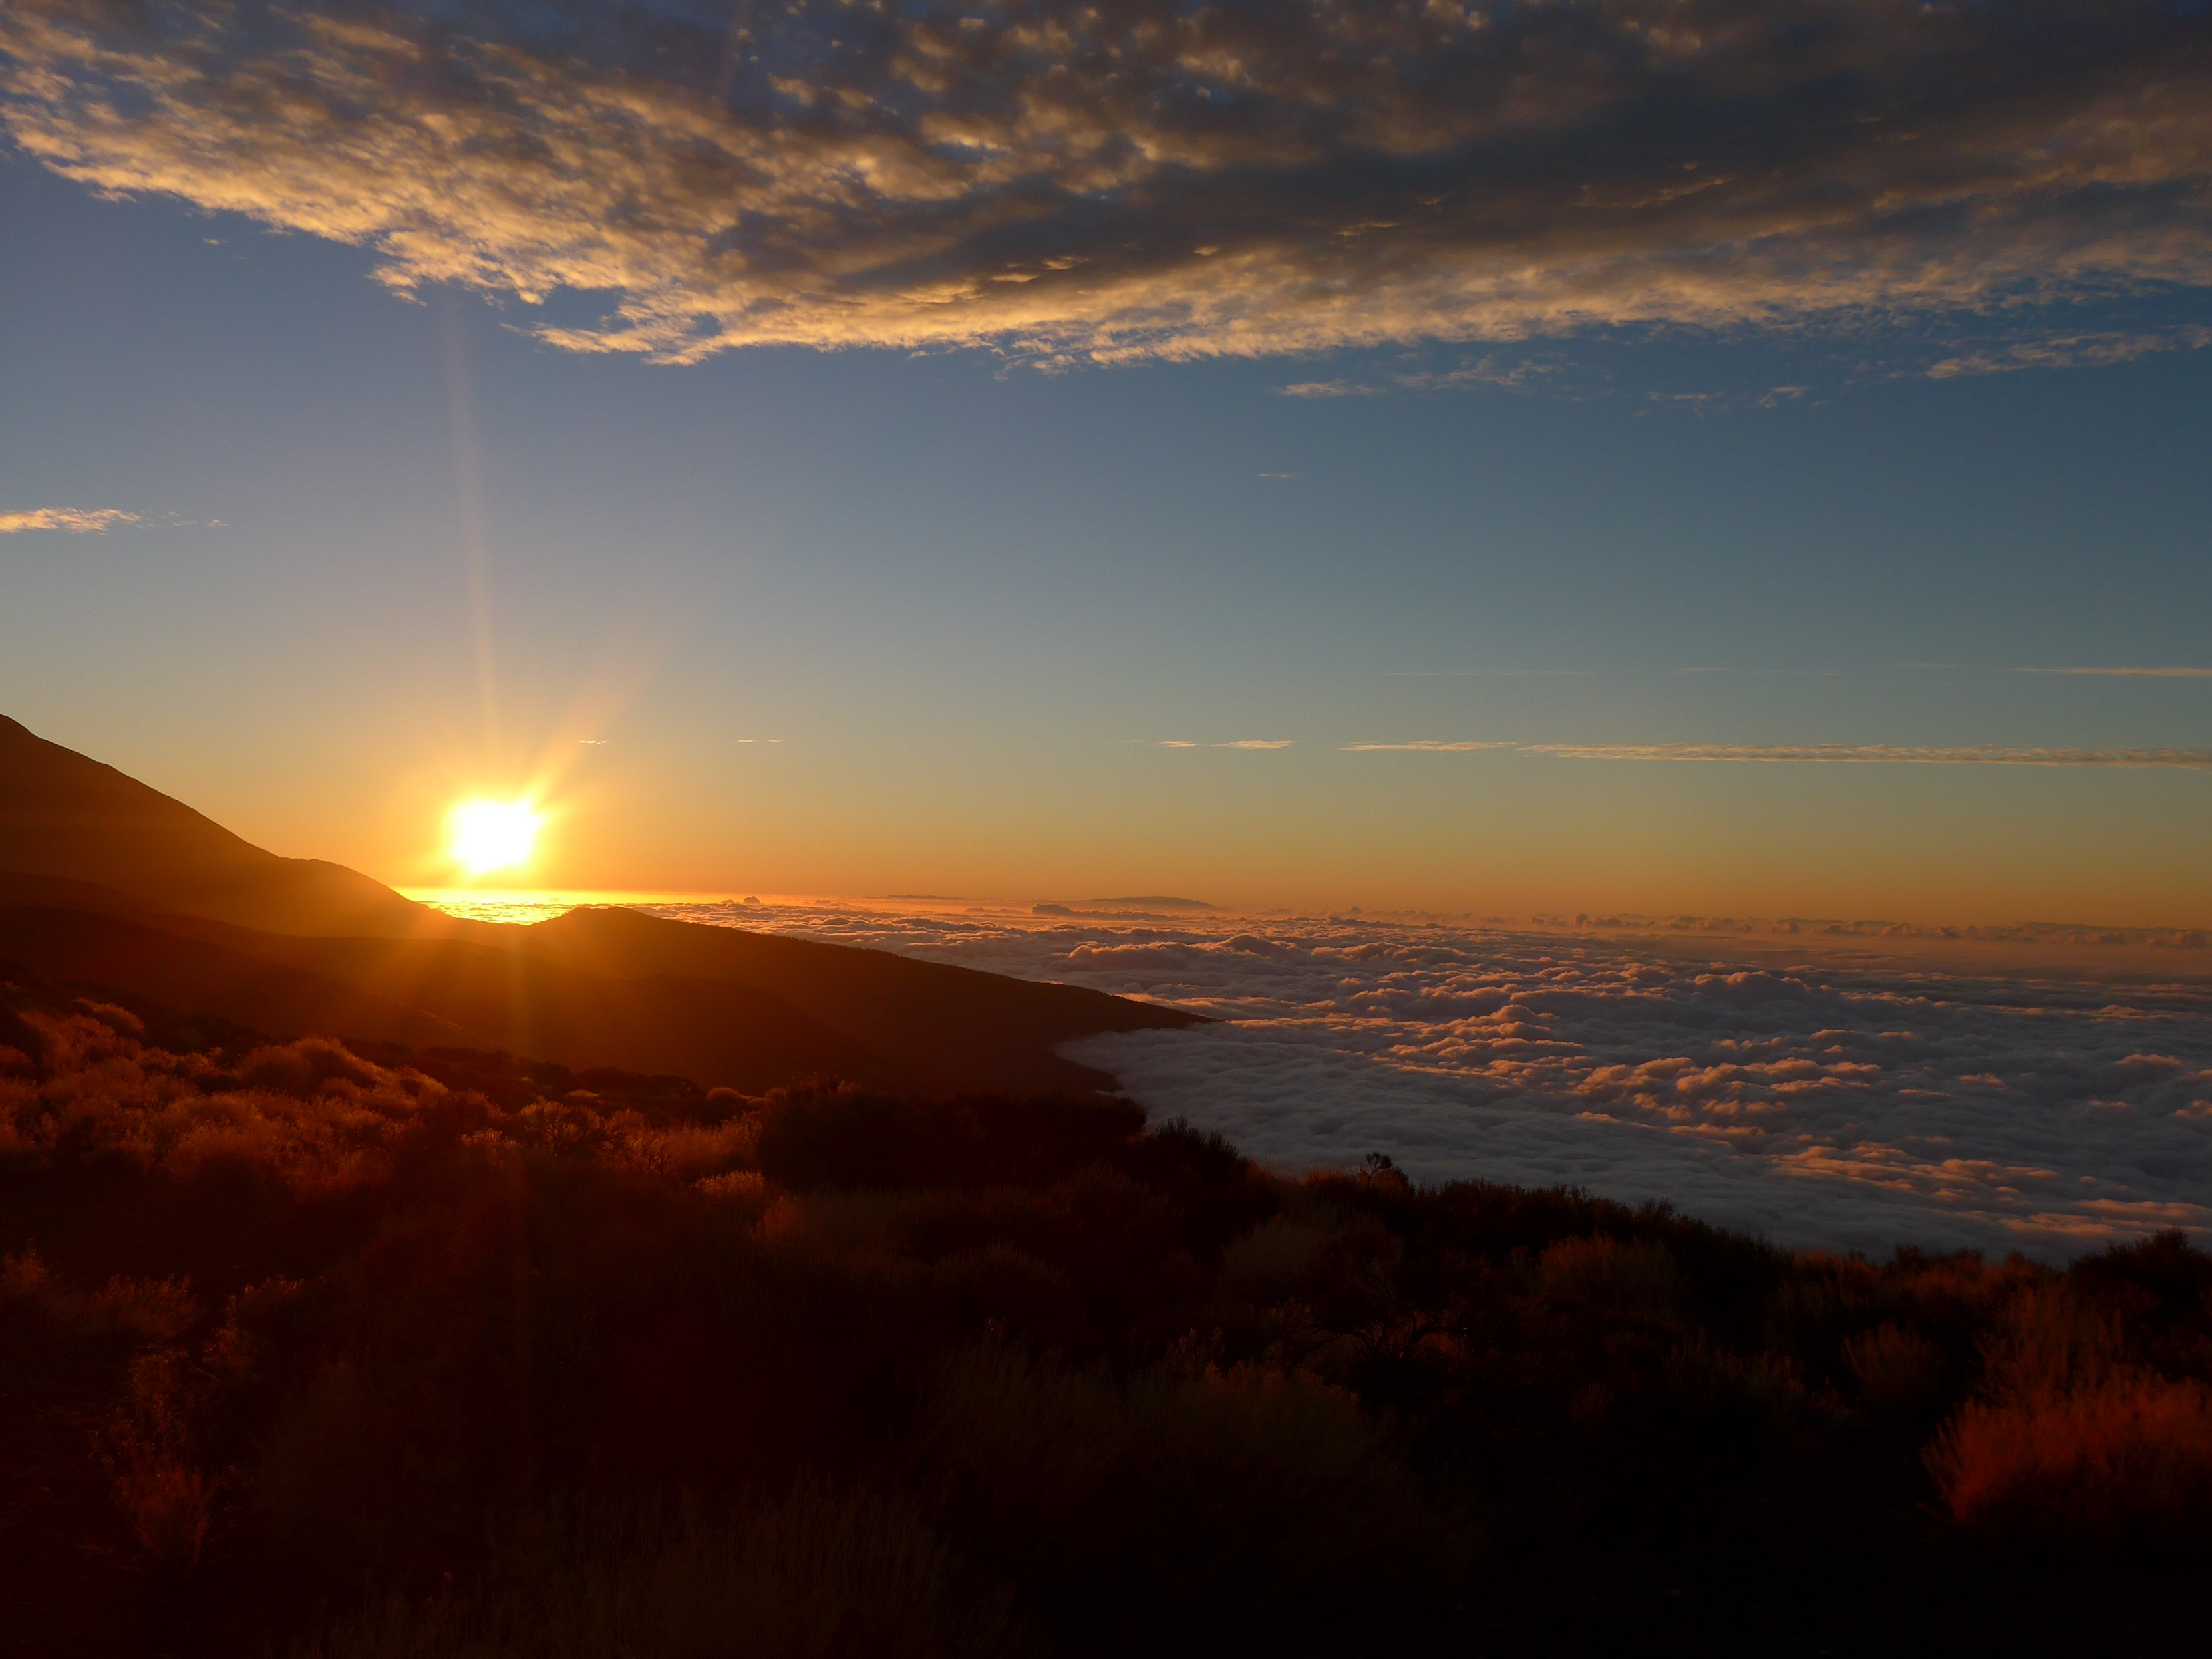


Measuring the spectral and angular distribution of the diffuse solar radiance
Stefan Riechelmann, Thomas Fey, Dirk Friedrich, Stefan Winter
Department 4.1: Photometry and Applied Radiometry
Working Group 4.14: Solar Cells

Slide 2
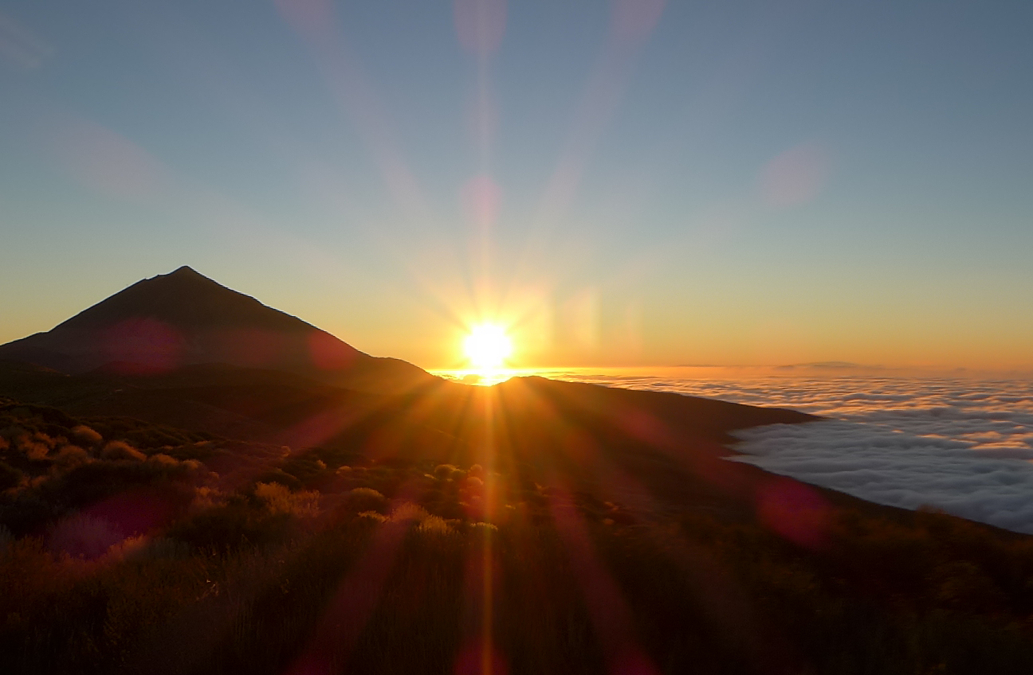
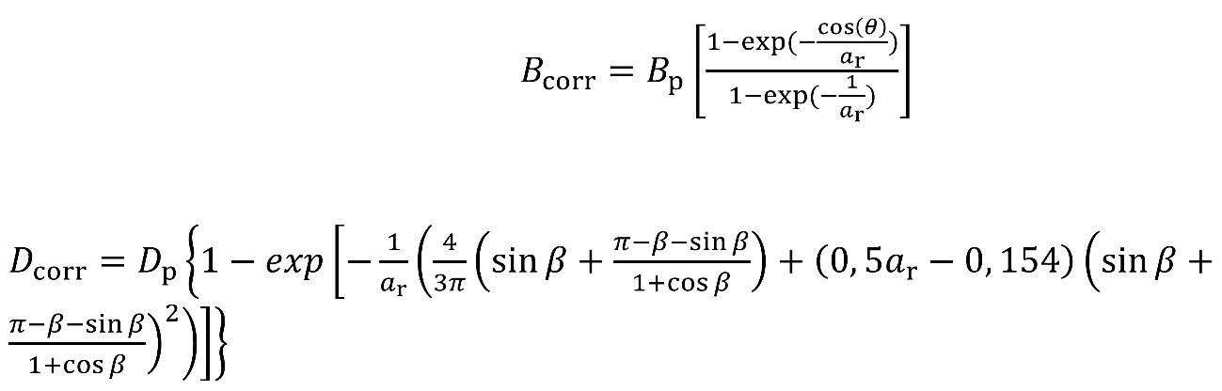
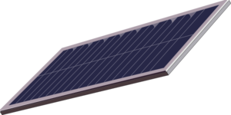

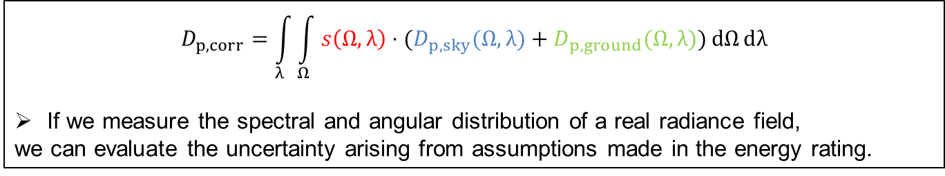


Why do we need the angular distribution?
61853-3 (Draft):
Angle of incidence correction of diffuse irradiance is proposed after (Martin and Ruiz 2001):
Assumption of an isotropic distribution of diffuse irradiance
$$D_{p,sky}$$
$$B_{p}$$
$$D_{p, ground}$$
$$D_{p,corr}=\int_{λ}{\int_{Ω}{s\left(Ω,λ\right)⋅(D_{p,sky}(Ω,λ)+D_{p,ground}(Ω,λ))}ⅆΩⅆλ}$$
If we measure the spectral and angular distribution of a real radiance field,
we can evaluate the uncertainty arising from assumptions made in the energy rating.

Slide 3
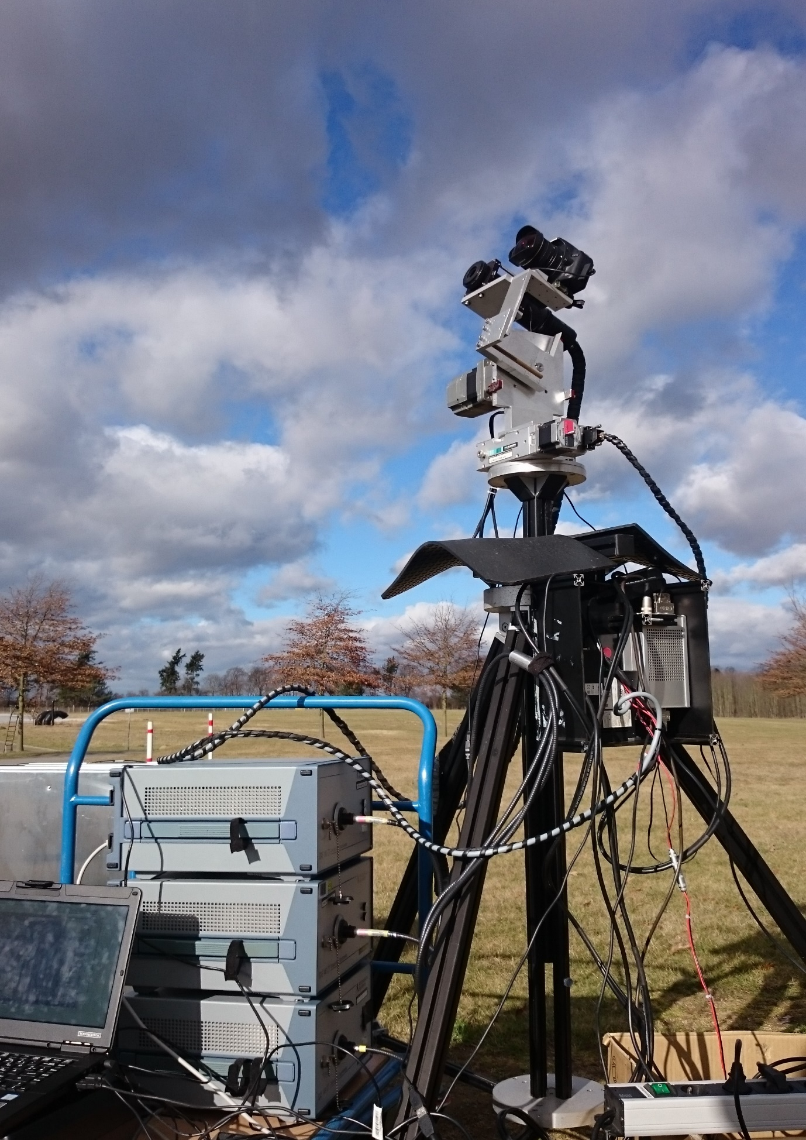
Measurement equipment - spectrometer
Digital Camera
Field of View: 120°
For quality control and documentation purposes
Entrance Optics
Field of View: 5° FWHM
Stray light reduced design
Dual Axis Tracking Unit
Range zenith: -42.5° - 105°
Range azimuth: -10° - 370°
UV+VIS Spektrometer (CAS 140CT – 154)
Wavelength range: 220 - 1020 nm
Bandwidth : 3,7 nm
Sampling interval : 0,8 nm
Infrared Spektrometer (CAS 140CT – 171)
Wavelength range: 780 - 1650 nm
Bandwidth: 9 nm
Sampling interval: 3 nm
Extended IR Spectrometer (CAS 140CT – 175)
Wavelength range: 1500 - 2150 nm
Bandwidth: 15 nm
Sampling interval: 4 nm

Slide 4
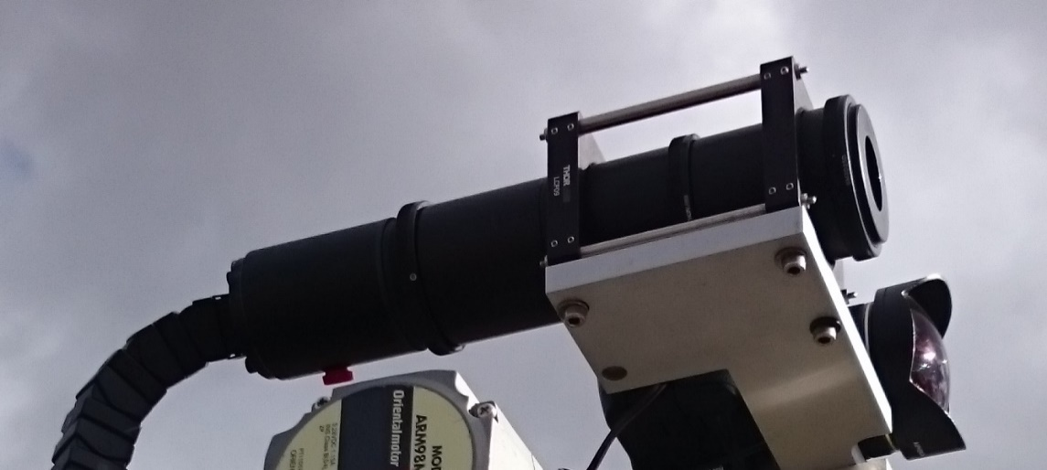
Measurement equipment – entrance optics
Radiance entrance optics:
Field of View of 5° FWHM
Reduced stray light effects by using black foil for the interior and soot for the baffles.
Stray light at incidence angles > 10° is lower than 10⁻⁶.

Slide 5
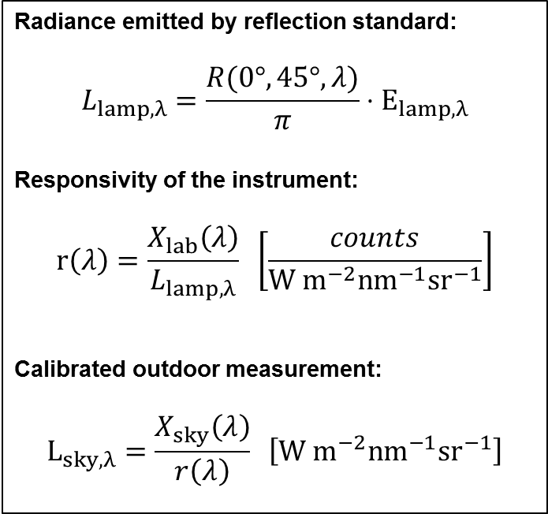
Measurement equipment – radiance calibration
Radiance emitted by reflection standard:
$$L_{lamp, λ}=\frac{R(0°,45°,λ)}{π}⋅E_{lamp, λ}$$
Responsivity of the instrument:
$$r\left(λ\right)=\frac{X_{lab}\left(λ\right)}{L_{lamp,λ}} \left[\frac{counts}{W m^{−2}nm^{−1}sr^{−1}}\right]$$
Calibrated outdoor measurement:
$$L_{sky,λ}=\frac{X_{sky}\left(λ\right)}{r\left(λ\right)} \left[W m^{−2}nm^{−1}sr^{−1}\right]$$
baffle
spectral irradiance transfer standard
reflection standard
entrance optics

Slide 6
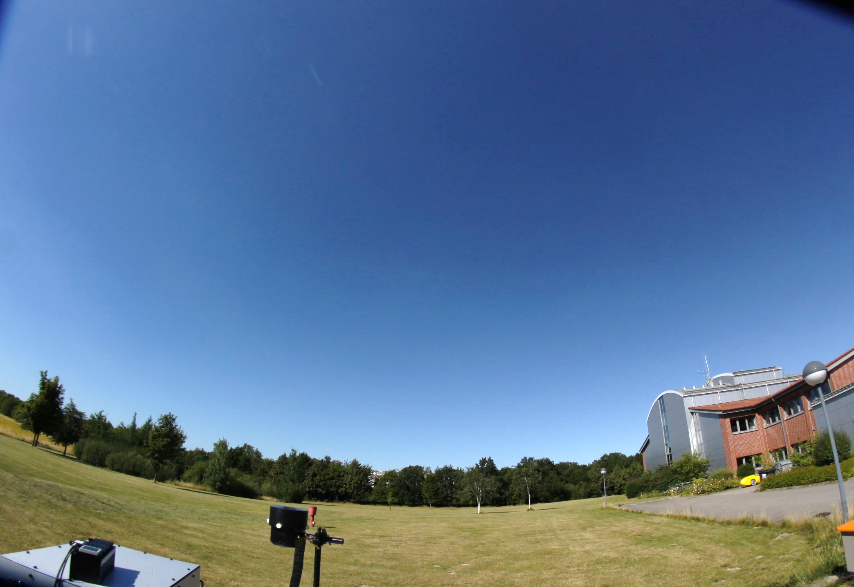
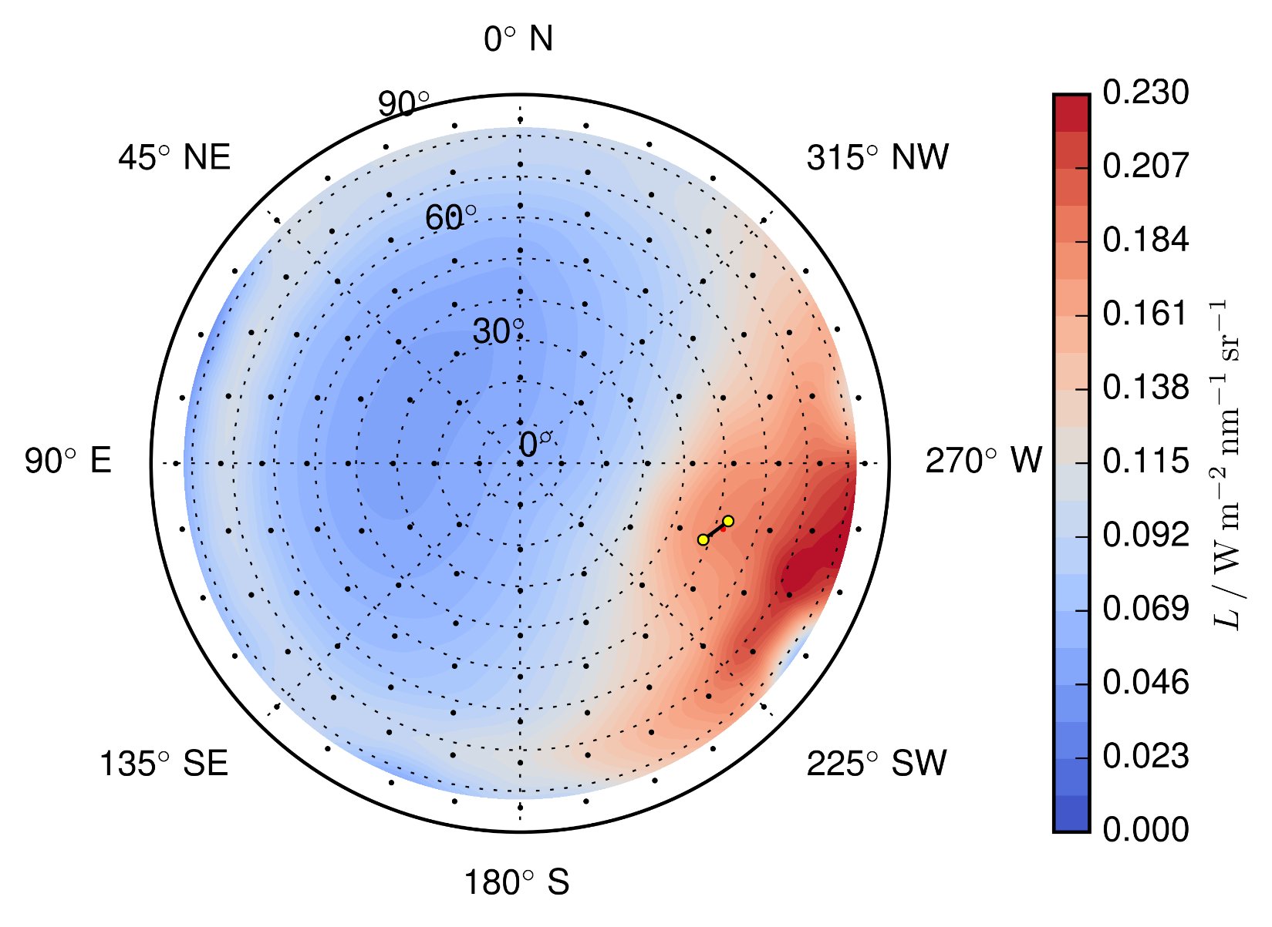
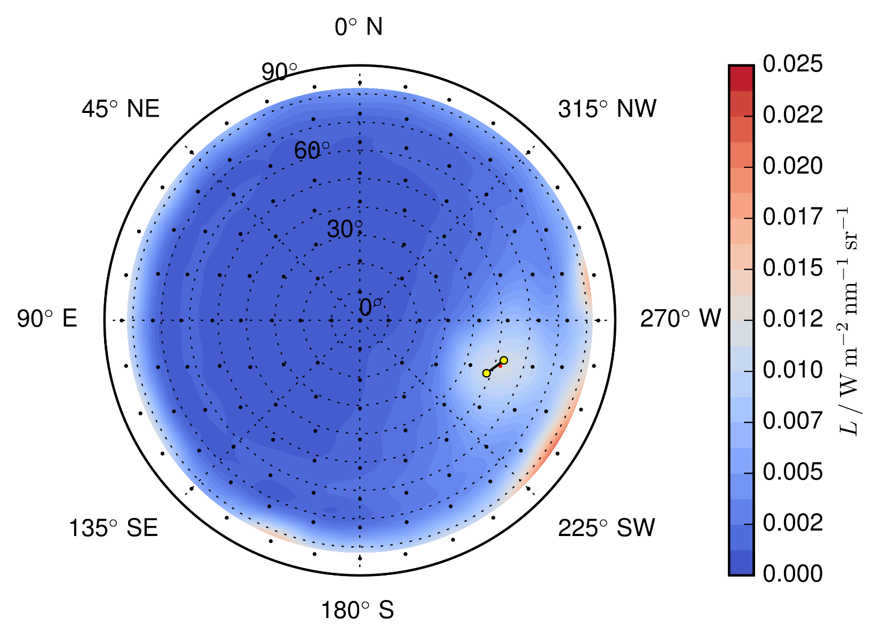
Sky radiance measurement at 20.07.2016, 14:34 MEZ (clear sky)
control picture (North direction)
Angular distribution at 400 nm
Angular distribution at 1000 nm

Slide 7
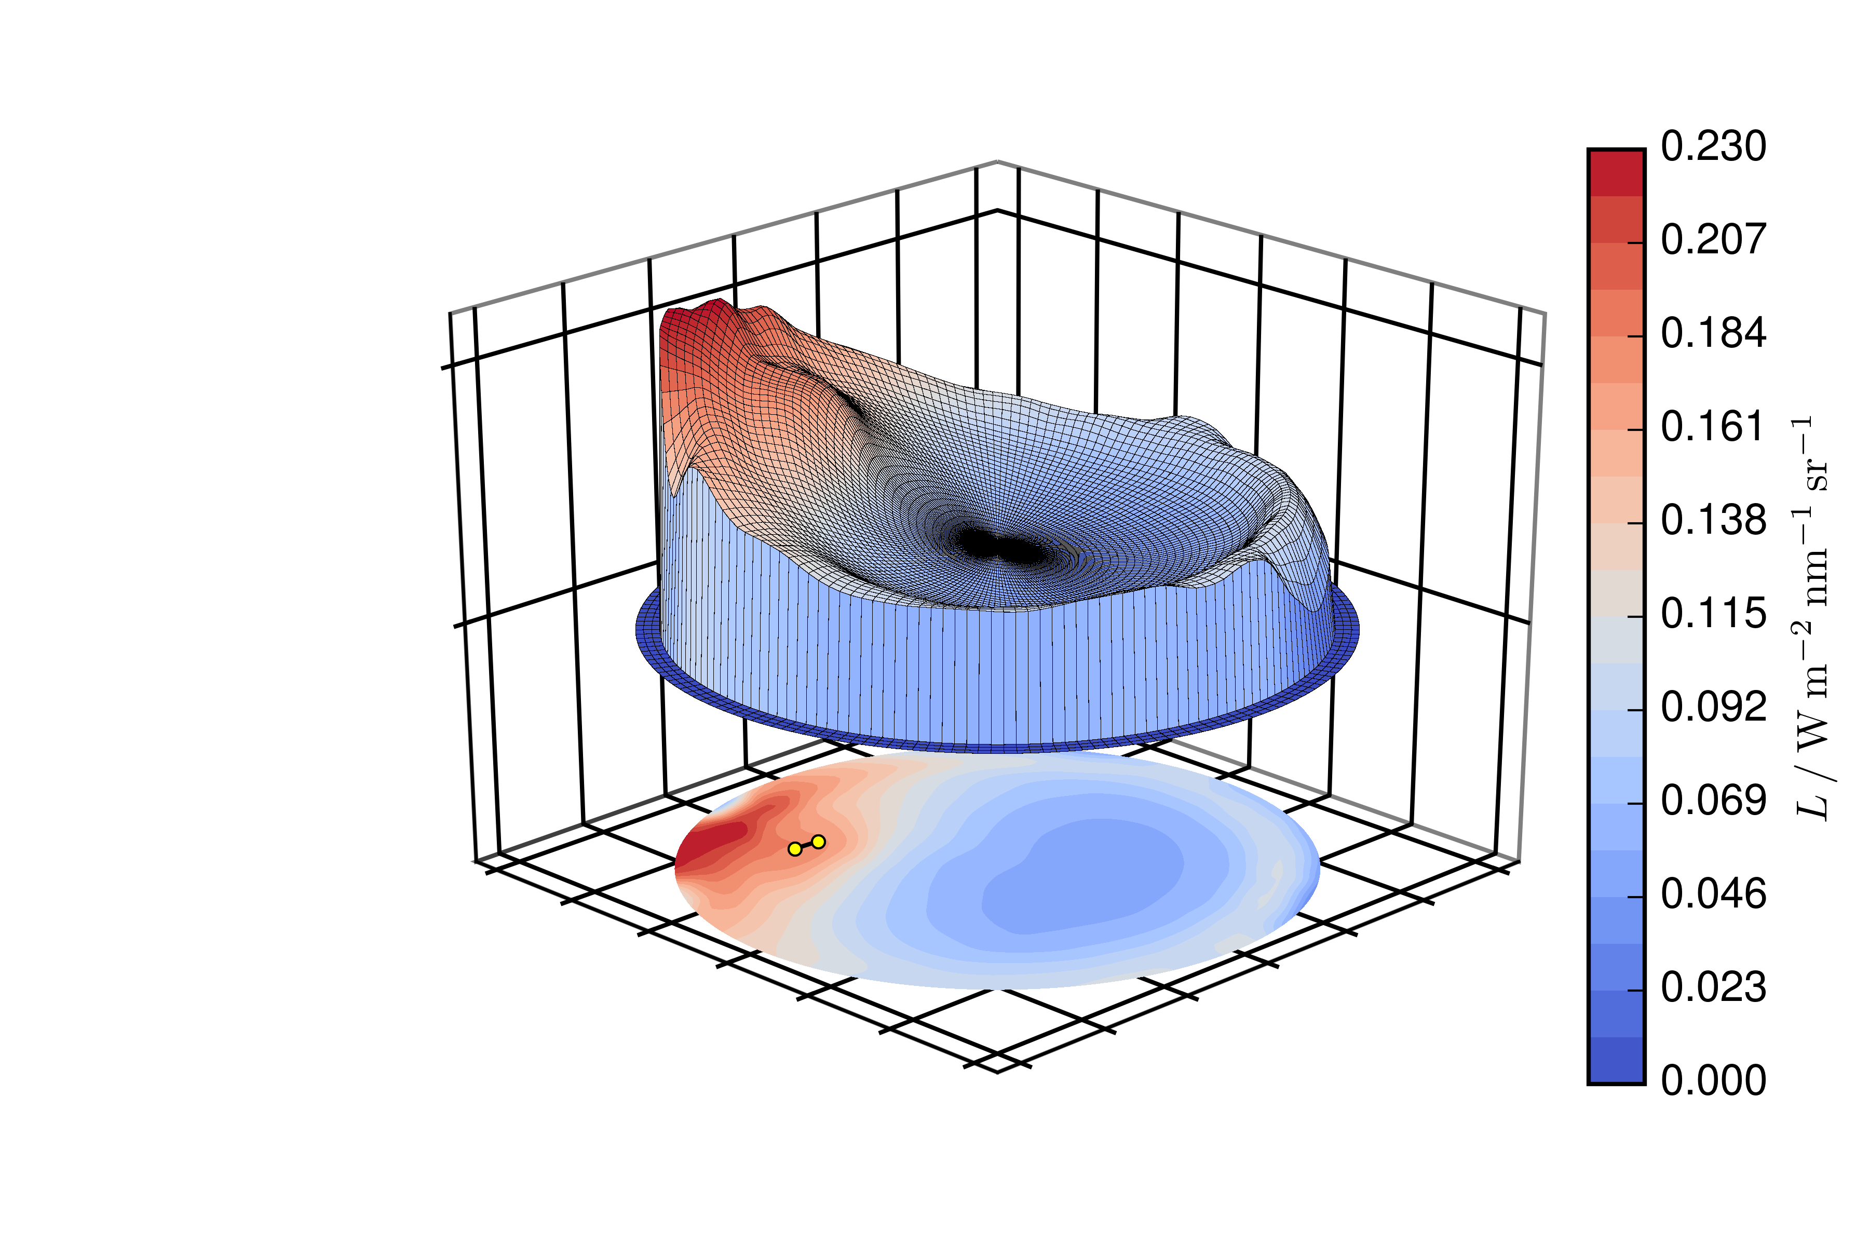
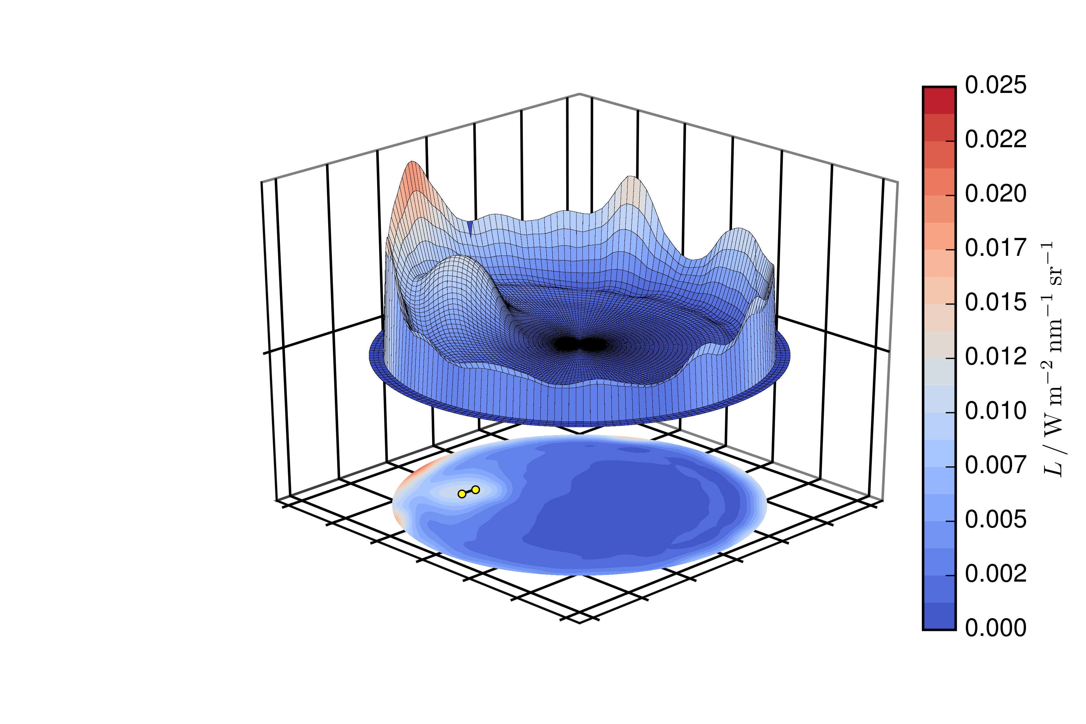
Sky radiance measurement at 20.07.2016, 14:34 MEZ (clear sky)
control picture (North direction)
Angular distribution at 400 nm
Angular distribution at 1000 nm

Slide 8
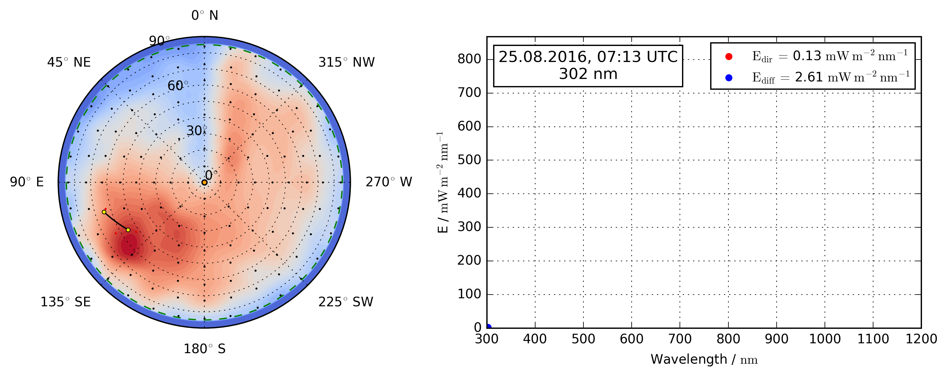
Wavelength dependence of sky radiance
Angular distribution of radiance:
Black points: 145 measurements
Yellow points: solar position during scan
Green line: horizon at 85° zenith angle
Ground albedo has been calculated based on horizontal global irradiance
Spectral Irradiance:
Direct irradiance measured at the beginning of the scan
Diffuse irradiance calculated by integral of the hemisphere

Slide 9
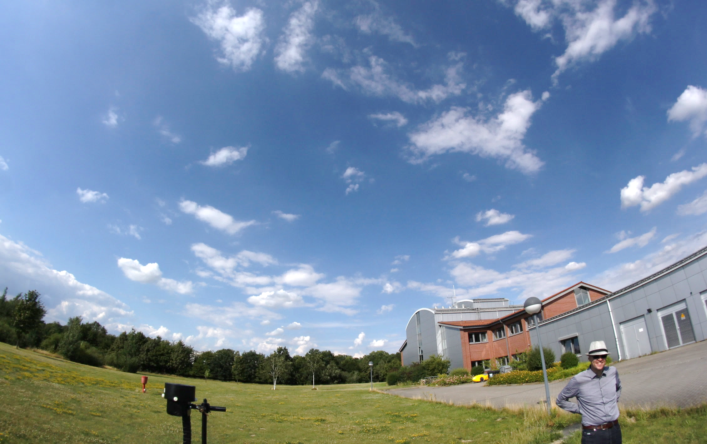
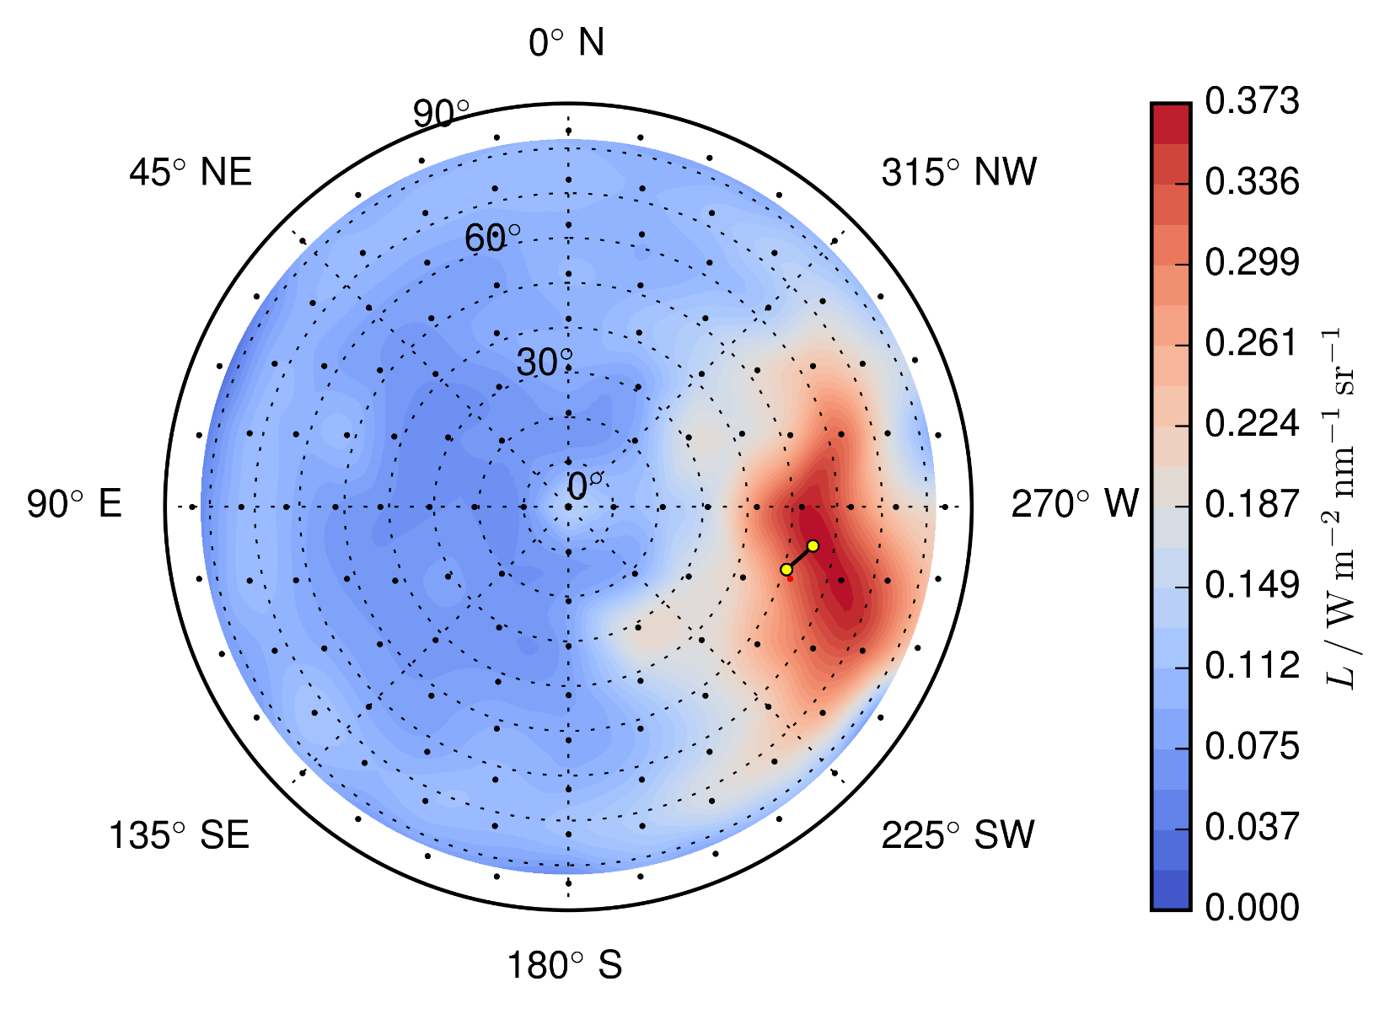
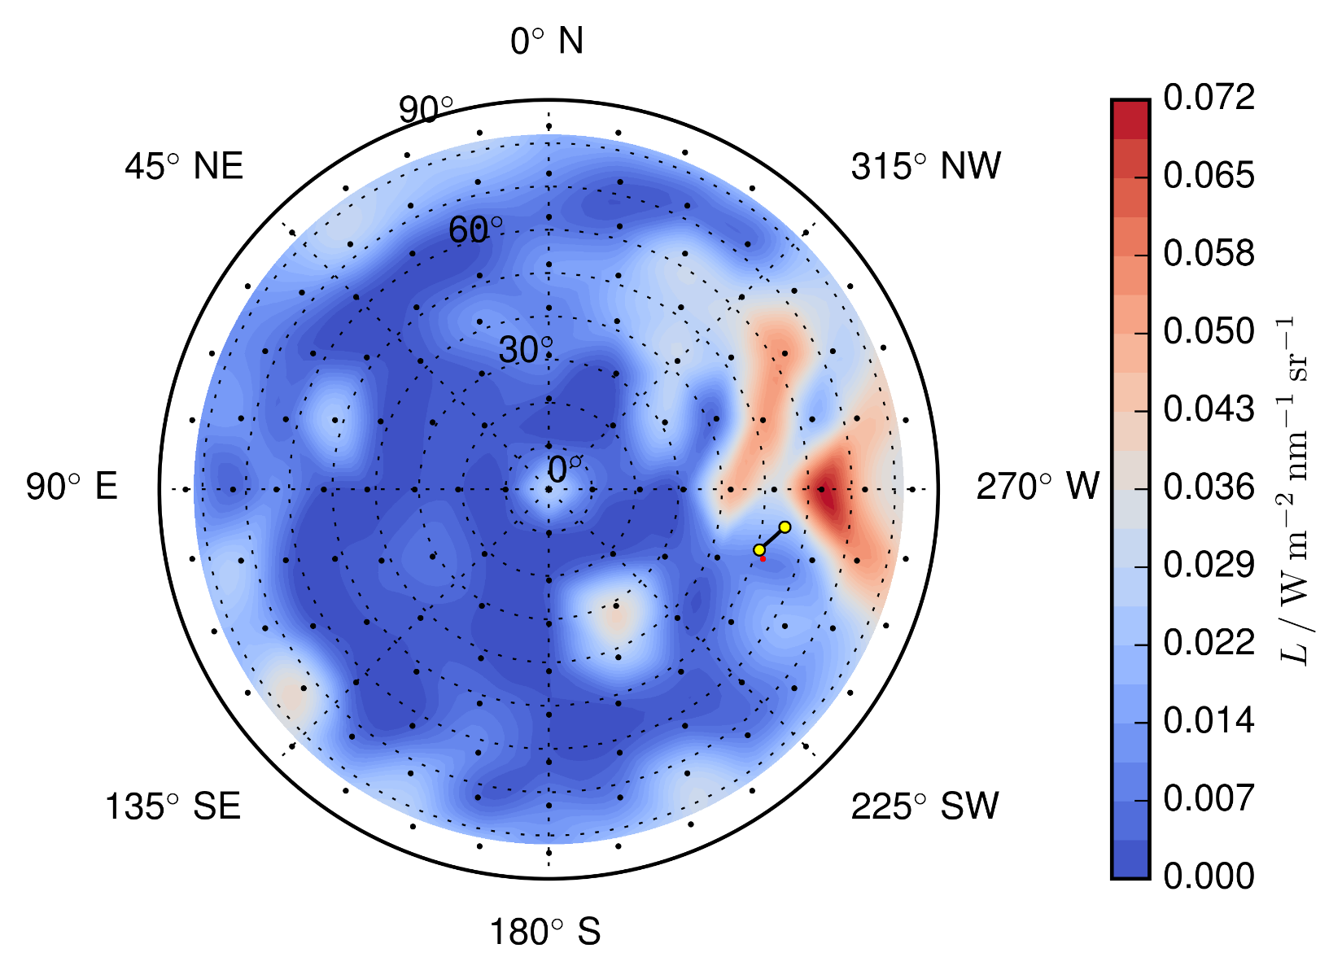
Sky radiance measurement at 12.07.2016, 14:56 MEZ (broken clouds)
control picture (North direction)
Angular distribution at 400 nm
Angular distribution at 1000 nm

Slide 10
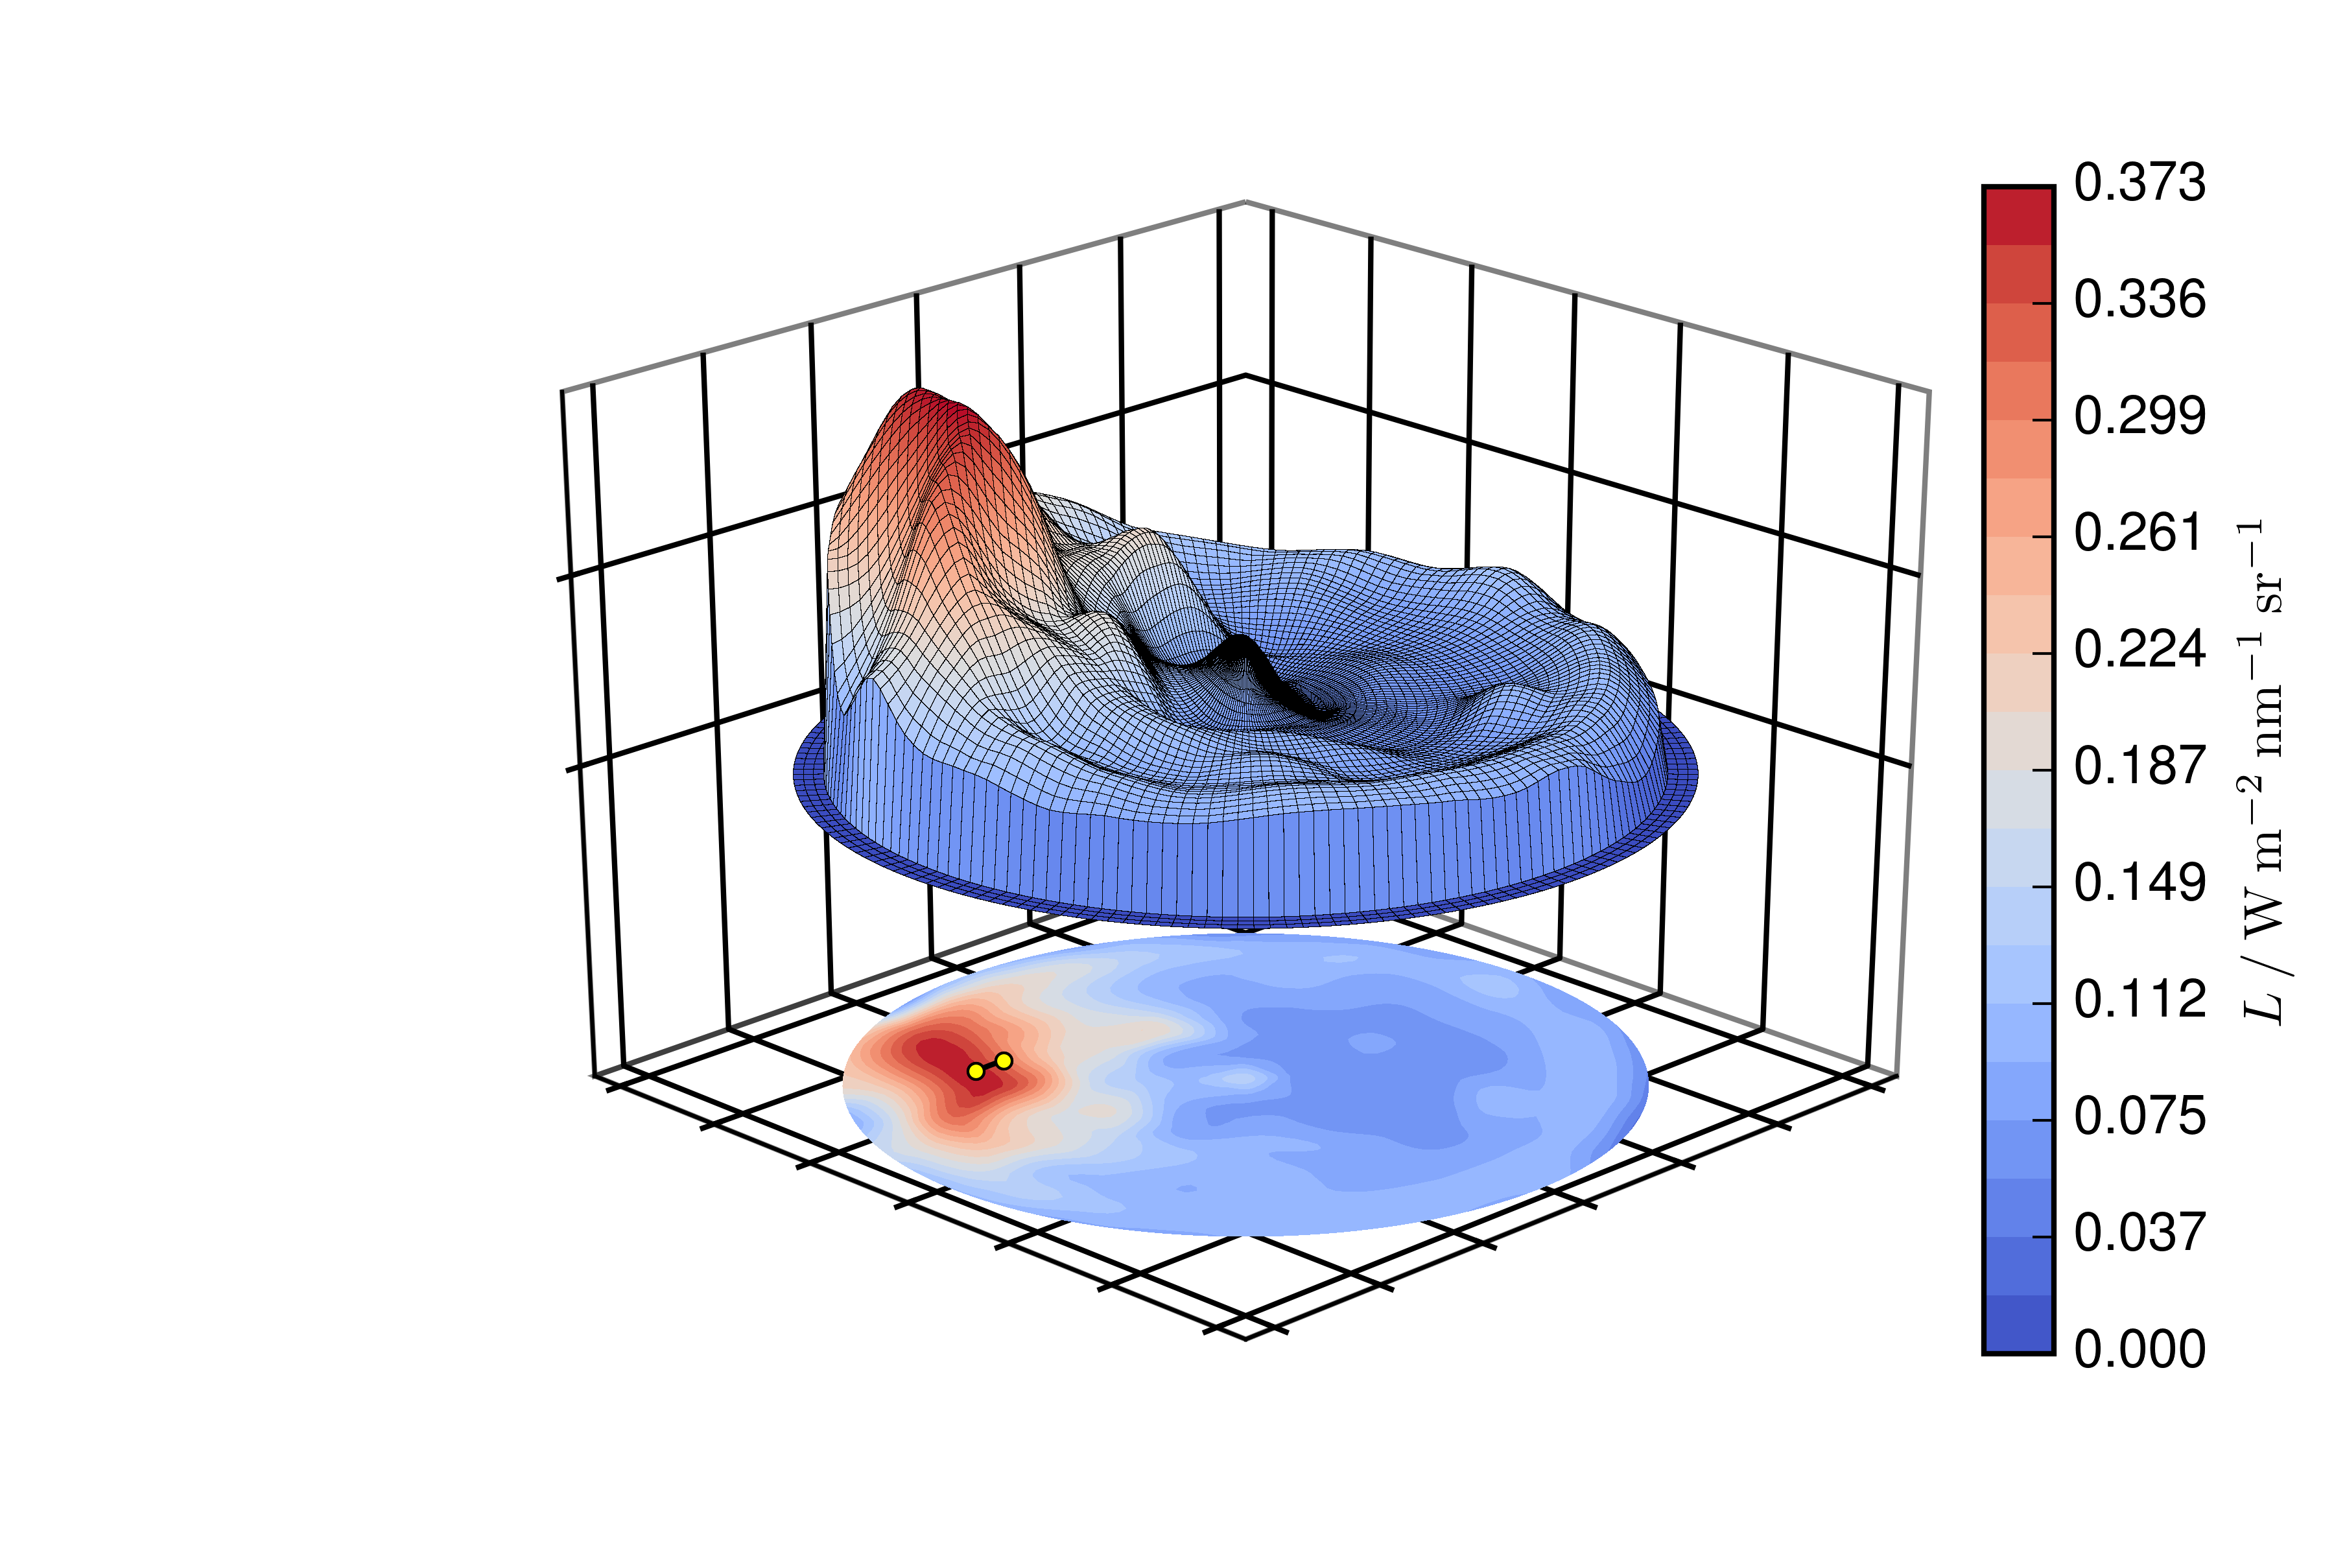
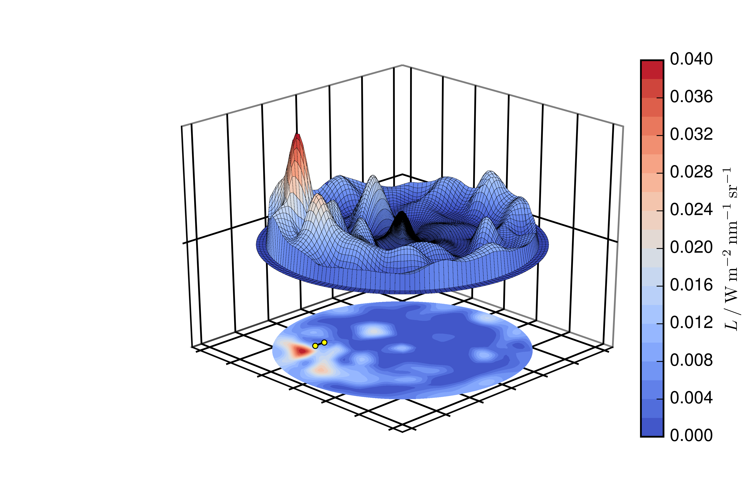
Sky radiance measurement at 12.07.2016, 14:56 MEZ (broken clouds)
control picture (North direction)
Angular distribution at 400 nm
Angular distribution at 1000 nm

Slide 11
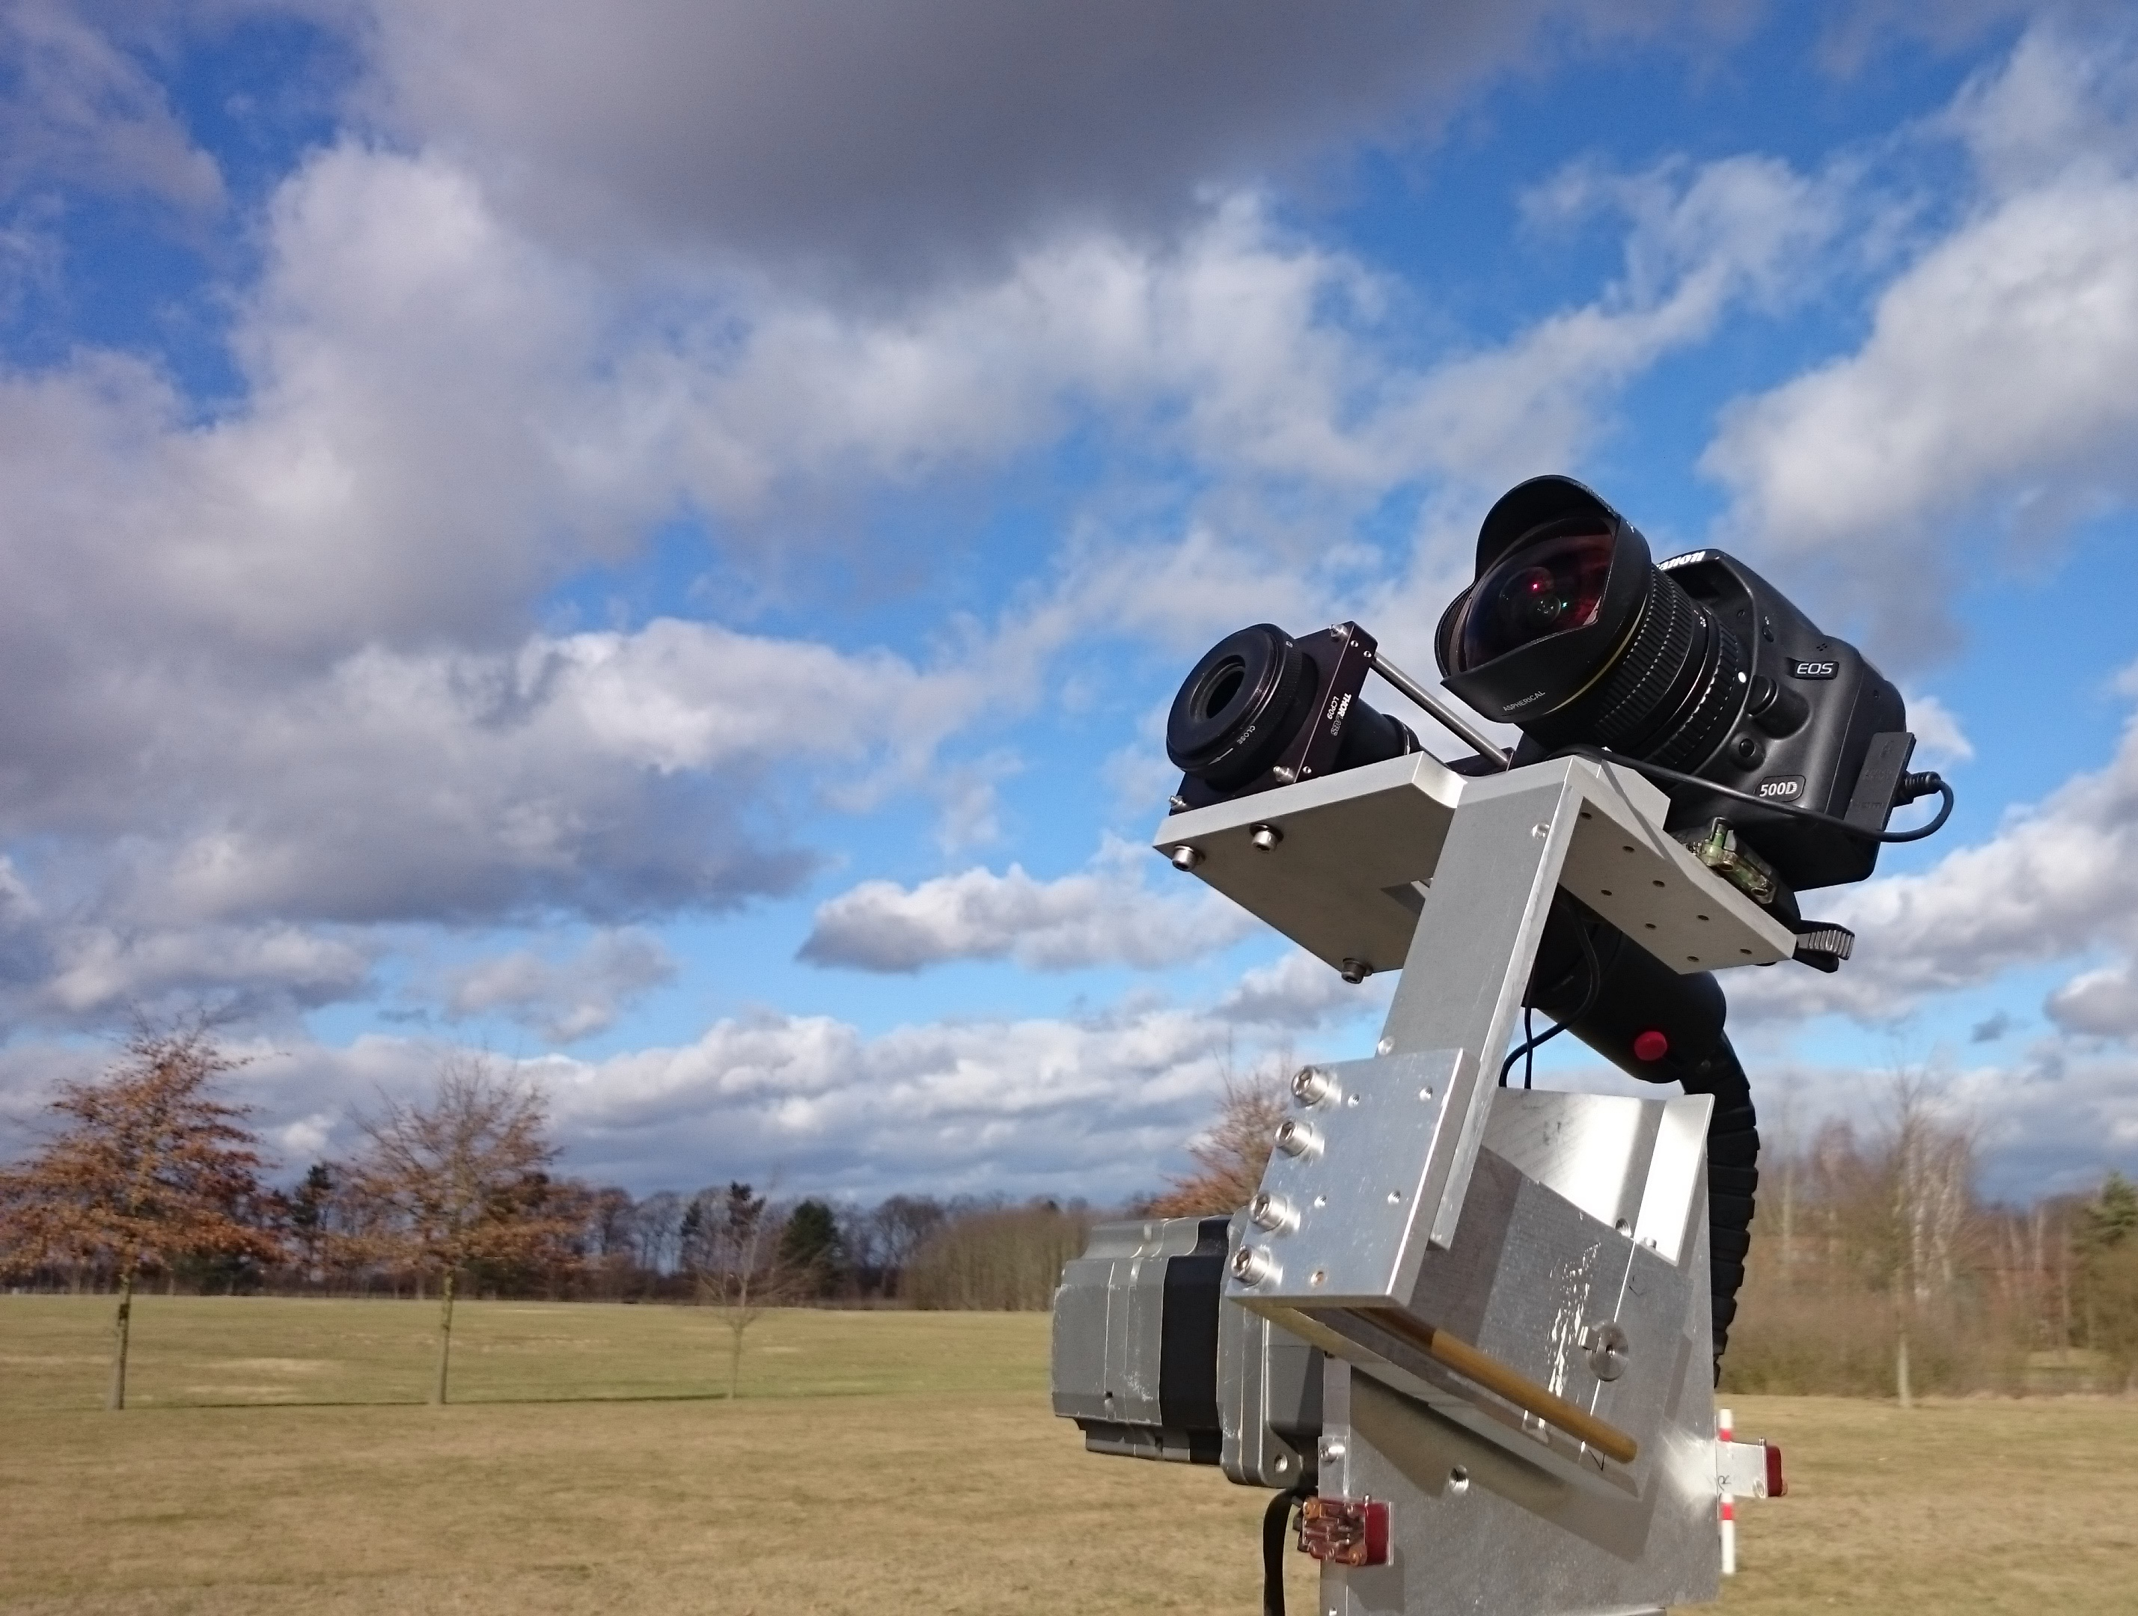
Follow-up tasks
Comparison to integrating measurement instruments (i.e. solar cells, pyranometer)
Weatherproof housing for measurement equipment
Longer time series of measurements
Especially necessary for performance evaluation under cloudy conditions
Comparison to isotropic / anisotropic models

Slide 12
Acknowledgements
This work was supported by the European Metrology Research Programme (EMRP) Project ENG55 PhotoClass, which is jointly funded by the EMRP participating countries within EURAMET and the European Union.

Slide 13
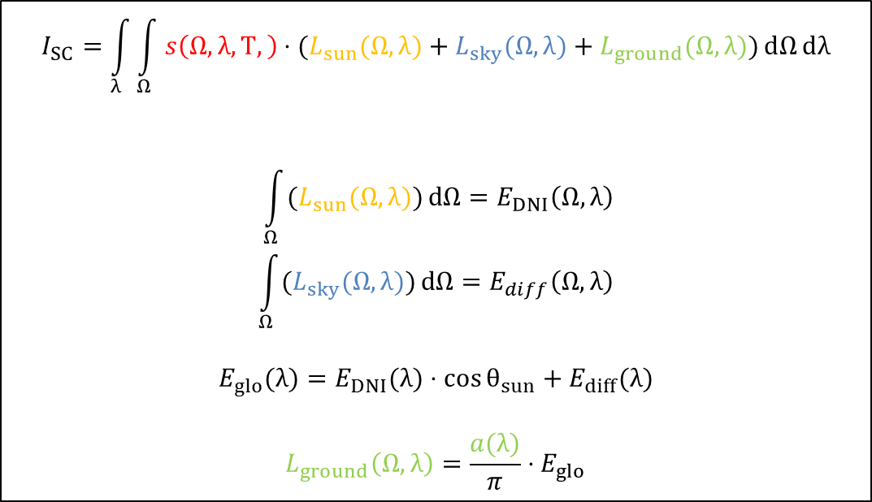
Describing the radiance field
$$I_{SC}=\int_{λ}{\int_{Ω}{s\left(Ω,λ,T,\right)⋅(L_{sun}(Ω,λ)+L_{sky}(Ω,λ)+L_{ground}(Ω,λ))}ⅆΩⅆλ}$$
$$\int_{Ω}{(L_{sun}(Ω,λ))}ⅆΩ=E_{DNI}\left(Ω,λ\right)$$
$$\int_{Ω}{(L_{sky}(Ω,λ))}ⅆΩ=E_{diff}\left(Ω,λ\right)$$
$$E_{glo}(λ)=E_{DNI}(λ)⋅\cos{θ_{sun}}+E_{diff}(λ)$$
$$L_{ground}\left(Ω,λ\right)=\frac{a(λ)}{π}⋅E_{glo}$$

