Slide 1
EN 50380 ed. 2.0:
What is new?
What’s coming next?
Bengt Jaeckel
UL International GmbH
Admiral-Rosendahl-Strasse 9, 63263 Neu-Isenburg (Zeppelinheim), Germany
Session 1: Energy rating (9:30-10:30)
7th Energy Rating and Module Performance Modeling Workshop
30-31 March 2017 Lugano / Switzerland

Slide 2
Who knows what EN 50380 is?
“Old” Title: Datasheet and nameplate information for photovoltaic modules
New Title: Marking and documentation requirements for Photovoltaic Modules
New scope:
This European Standard describes marking, including nameplate and documentation requirements for non-concentrating photovoltaic modules.
This European Standard provides mandatory information that needs to be included in the product documentation or affixed to the product to ensure safe and proper use. Best practices are included in this document giving guidance on additional information, for example module’s performance at different irradiance levels.
Markings, including nameplates, are permanently affixed information on the PV modules, which indelibly states the rating and other information as required by the relevant standard for safe use and maintenance. While, documentation information is a technical description separate from the photovoltaic module.
This European Standard is based on IEC and EN standards defining marking, nameplate and documentation requirements for PV modules.

Slide 3
Overview
History / Overview
Current status of EN 50380 project
Some details
Discussion points
Outlook for EN 50380
Summary

Slide 4

History EN 50380
Feb 2014
Project for maintenance initiated
1994 - early days!
Development of DIN 40025
„Datenblatt- und Typschild-angaben für Photovoltaik-Module“
Feb 2016
1st draft circulated with clear separation of mandatory requirements and best practices
Q3 2017
Publication as EN 50380 edition 2
May 1997
Publication of DIN 40025
Feb 2017
Final discussions during anual CENELEC Meeting
2012-2014
Several Meeting on GER NC level
Feb 1998
Project started for EN 50380 (TC 82 did not exist then)
Jan 2012
Kick-off Meeting for EN 50380 to “add Energy Rating”
Feb 2015
Change of Project leader
Nov 2016
Preperation of final draft for Vote, including NC comments
2003
Publication of EN 50380 ed. 1
July 2014
Project officially started:
PR=25384
April 2016
Voting process
July 2016
Comments received from NCs
Notes:
Die erste überarbeitete englische Fassung für die damalige Task Force CLC/ BTTF 86-2 (CLC/TC82 war noch nicht gegründet) habe ich im Februar 1998 versandt. Im Februar 2002 gründete sich CLC/TC82 und die EN 50380 war im März 2003 die erste veröffentlichte "homegrown" Norm von CLC/TC82

Slide 5
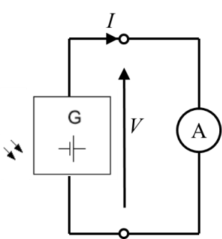
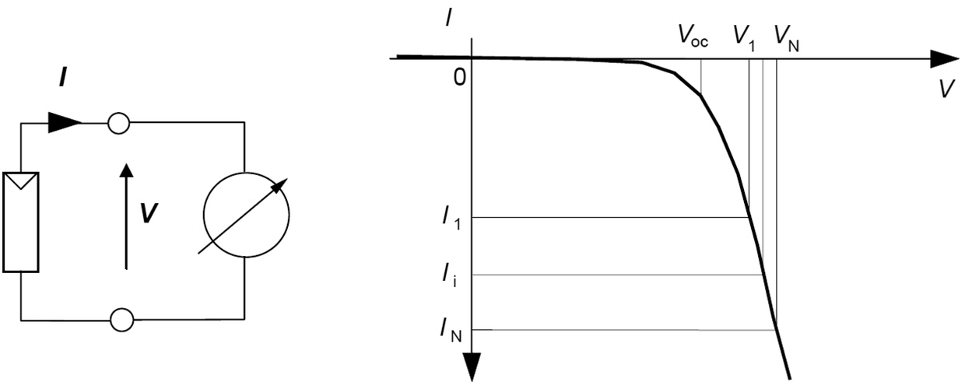
Current status of EN 50380
Comments received in July 2016: 116
Comments by type:
  General: 14
  Editorial: 64
  Technical: 38
  Comments received from:
  Austria
  Germany
  Finland
  UK
  Netherlands
  Portugal
ED: We must write for example:
“… devices with a 1 h, 1,35 I_{R} overload rating, …”
Instead of:
“… devices with a 1 hr, 1.35 I_{R} overload rating, …”
(ISO/IEC directives, Part 2, 2016)
ED: Change request from V to U
V_{OC} → U_{OC}
V_{MPP} → U_{MPP}
Photovoltaic cell
Final:
Proposal:
Original:
TE Comment: The main consequence of in-roof mounting with low radiant and convective cooling on the back side of the module is (much) higher temperature when compared to open rack mount in the same climate zone. | Proposal But how to specify in the data sheet? Maximum use temperature sufficient to prevent too hot running modules? | Answer: Noted - No proposal given to address issue and as of today no reference standard exist. IEC TC 82 WG 2 started discussions on that topic

Slide 6
Next project steps of EN 50380
Nov 2016: Comments worked into the draft
Nov 2016 – March 2017: CENELEC CO work on document
April 2017: CCMC starts the Vote (2 months period)
June 2017: Finalization of document (2 months)
Aug 2017: Publication

Slide 7
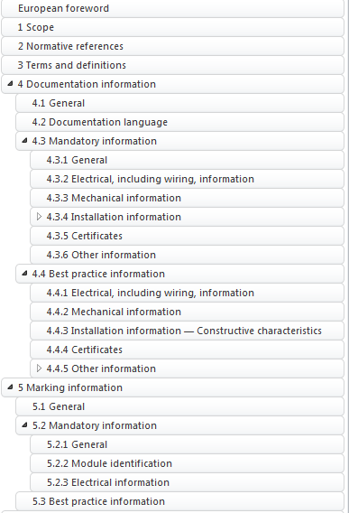
New document structure
Split content in:
  Mandatory information
  Best Practice information
From scope of EN 50380:
This European Standard provides mandatory information that needs to be included in the product documentation or affixed to the product to ensure safe and proper use. Best practices are included in this document giving guidance on additional information, for example module’s performance at different irradiance levels.

Slide 8
Mandatory & Best practice
What is mandatory information?
Everything that is needed to install, operate and maintain the PV modules safely.
What is best practice information?
Actually the answer is also very simple: Everything that is NOT needed to install, operate and maintain the PV modules safely.
That basically means all performance related information like low light behaviour, type of cell or even the dimensions of the PV module. As this information are quite important to perform project planning and yield forecasting they are NOT relevant to install a safe PV system
Why splitting?

Slide 9
Motivation for splitting
Nameplate/Marking requirements
IEC 61215-1 FDIS (July 2015) |  | IEC 61730-1 CDV (status July 2015) |  | EN 50380 draft (status June 2015) |  | IEC 61853-1 : 2011
Each module shall include the following clear and indelible markings: |  | Each PV module shall include the following clear and indelible markings:
a) name, registered trade name or registered trade mark of manufacturer; |  | a) name, registered trade name, or registered trade mark of manufacturer; |  | Name, registered trade name or registered trade mark of manufacturer; |  | Name, monogram or symbol of the manufacturer;
b) type or model number designation; |  | b) type or model number designation; |  | Type or model number designation; |  | Type or model number;
c) serial number (unless marked on other part of product); |  | c) serial number; |  | Serial number; The serial number identification must be placed in such a way that it is non-removable (preferable by encapsulation) and readable after installation. NOTE: It is allowed that this serial number identification is covered after installation by a frame e.g. in façade installations. |  | Serial number;
d) date and place of manufacture; alternatively serial number allowing to trace the date and place of manufacture; |  | d) date and place of manufacture; alternatively serial number assuring traceability of date and place of manufacture; |  | date and place of manufacture; alternatively serial number allowing to trace the date and place of manufacture |  | The date and place of manufacture shall be marked on the module or be traceable from the serial number.
Several standards have different requirements – not always aligned
Some are mandatory safety standards, some are helpful information sources
EN 50380 summarized and groups all given requirements/information
See outlook

Slide 10
Highlighting some requirements
Example: Mandatory
The documentation shall contain the following electrical information:
polarity of terminals or leads;
“Maximum system voltage” or V_{sys};
Maximum overcurrent protection (OCP) rating
Class of protection against electrical shock
“Voltage at open-circuit” or “V_{oc}” including rated production tolerance
“Voltages at maximum power point” or “V_{max}”
“Current at maximum power point”; or “I_{max}”
“PV module maximum power” or “P_{max} ”
“Current at short-circuit”; or “I_{sc}”
Relative temperature coefficients in [%/K] for I_{sc}, P_{max} and V_{oc} at STC
Example: Best practice
Nominal module operating temperature – NMOT (MQT 05)
Performance at NMOT (MQT 06.2).
Performance at low irradiance (MQT 07).
Safety relevant information
Yield relevant information

Slide 11
Discussion points
What are Mandatory and Best practice requirements?
  At some points some best practice information will be mandatory – dependent on country
Some terms and their verification
  What is “permanently affixed”, “permanent marking”, “indelibly” and “durable construction” ?
  How to verify that?
Proposal:
“The durability of markings (the permanently affixed information on the PV modules with all indelibly states ratings) is verified with Visual inspection MST 01 and Durability of markings Test MST 05 after passing all tests from Sequence A to F.“

Slide 12
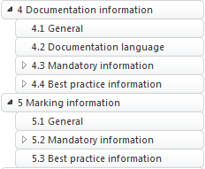
Outlook for EN 50380
IEC 61215 series
(Best practice)
IEC 61730 series
(Mandatory)
EN 50380
(More mandatory)
X
Part 1 – General requirements
Part 1 – Construction requirements
Marking and documentation
X
5. Marking and documentation
5.1. Name plate
  5.2. Documentation
5.2. Marking and documentation
    5.2.2. Marking
    5.2.3. Documentation
Part 1-1 c-Si
Part 2 – Test procedures
Part 1-2 CdTe
Combine
Part 1-3 a-Si & µ-Si
Part 1-4 CIS&CIGS
Part 2 – Test procedures

Slide 13
Outlook for EN 50380
Part 1 – General requirements
General requirements from IEC 61730 and IEC 61215
Part 2 - Marking and documentation
EN 50380 – summary from all marking and documentation requirements
Part 3 – Construction requirements
Construction requirements from IEC 61730
Part 1-1 c-Si
Part 1-2 CdTe
Special requirements for each technology
Part 1-3 a-Si & µ-Si
Part 1-4 CIS&CIGS
Part 4 – Test procedures
Testing procedures summarized from all used standards

Slide 14
Summary
Short history EN 50380
EN 50380 project status
Comments and new structure with
  Mandatory &
  Best practice information
Some discussion points
Outlook what could happen with EN 50380

Slide 15
Thank you for your attention

