Slide 1
Energy Rating Standards (IEC61853)
– Standards Body Perspective -
Prof Ralph Gottschalg
Centre for Renewable Energy Systems Technology
Loughborough University

Slide 2

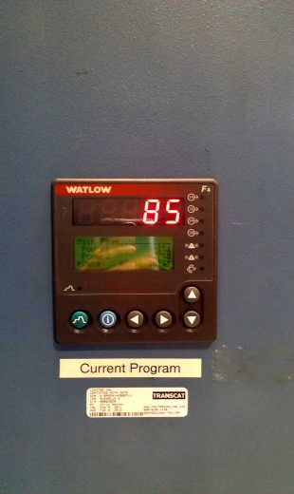
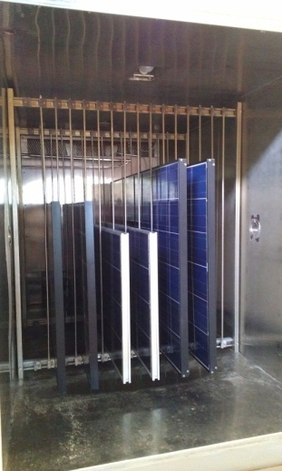
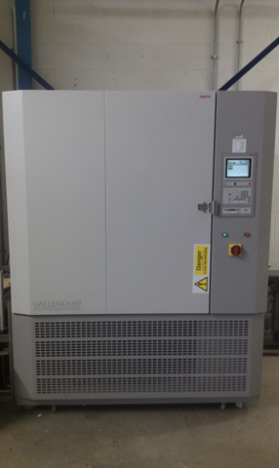
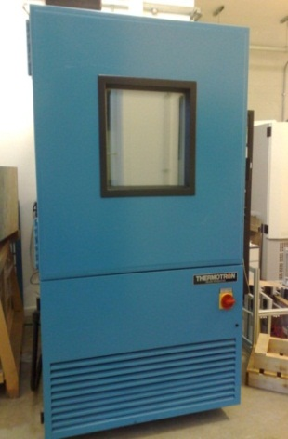
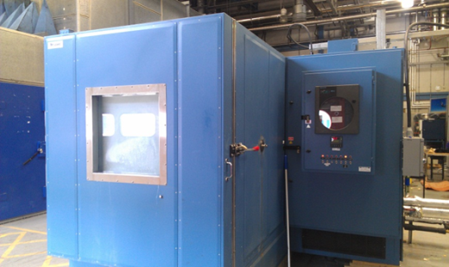
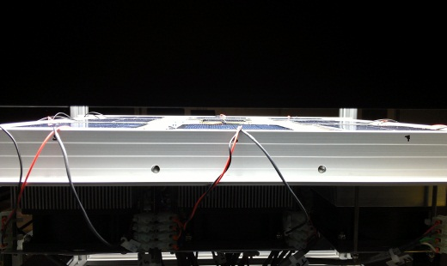
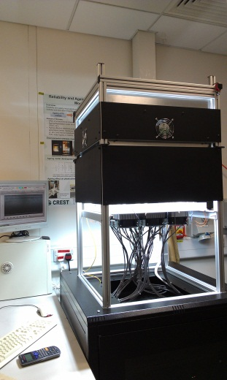
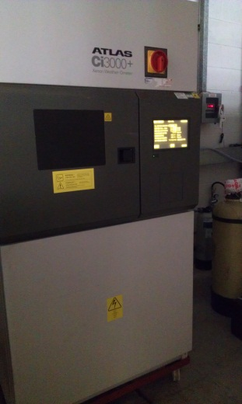
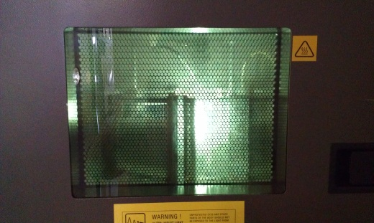
CPVMCL (CREST Photovoltaic Measurement and Calibration Laboratory)
CPVMCL is a laboratory accredited to calibration
level to support reseach and deployment.
Measurement and calibration services offered:
  Reference cell & pyranometer calibration
  Module power and energy measurements and ratings
Measurement and R&D support
  Module durability
  Pre-certification
  System/ module failure analysis

Slide 3
Outline
Standards Landscape – Where does the standard fit in?
Photovoltaic Standards: IEC TC82(-WG2)
What is the Energy Rating standard (IEC61853)?
Current status of IEC61853
Stakeholders: End User vs. Test House vs. WG2 constituency

Slide 4
Standards landscape
Standards are set by either trade bodies or standard bodies
Trade bodies often focus on supply chains (e.g. SEMI standards for PV)
International standard bodies may be
  world-wide (e.g. ISO or IEC)
  Regional (e.g. CENELEC)
In PV relevant standard body is IEC, ‘mirrored’ by CENELEC
National standards (e.g. BSi in the UK) mostly filter down from International standard bodies
Additionally there are national ‘special interest groups’ working on national standards (e.g. in UK: MCS, IET)

Slide 5
Photovoltaic Standards
Most PV standards originate in the IEC.
Technical committee TC is TC82 Solar Photovoltaic Energy Systems.
6 active working groups
TC82
Solar Photovoltaic Energy Systems
WG1
Glossary
WG6
Balance of system compon.
WG2
Modules, non-concentrating
WG7
Concentrator modules
WG3
Systems
WG8
Photovoltaic (PV) cells

Slide 6
Existing IEC Standards for PV
  There are currently 82 standards published by the IEC from Technical committee 82 (established in 1981)
    www.iec.ch
  …facilitate trade on an international level
  …achieve broadest possible acceptance in all countries
  …respond to … scientific and technological developments
  …think globally, for as many stakeholders as possible in markets around the world.

Slide 7
Some ‘Standards Speak’ – Stages of a Standard
NWIP
CD
CDV
FDIS
IS
NWIP – New Work Item Proposal
CD – Committee Draft
CDV – Committee Draft for Vote
FDIS – Final Draft International Standard
IS – International Standard
… filter through into regional and national standards

Slide 8
Existing standards (WG2)
IEC60904 – Photovoltaic Devices
IEC61853 – Module Performce & ER
Material standards
Measurements and
Ratings
Conformity Assessments
Safety
IEC61730 – safety qualification
IEC61215 – Design qualification

Slide 9
Aim of an energy rating standard (for modules)
Enable comparison of devices
Create a rating for PV devices
  …to enable international trade.
  …acceptable to many countries
  …allowing for technological developments
This implies
  Not technology specific
  Not manufacturing specific
  Not site specific
  … needs to be a general rating (similar to power-STC-rating)

Slide 10
History of IEC61853
Recognition that power and energy are not necessarily correlated (partially due to onset of new materials)
Middle of 1990s a draft was prepared covering everything from measurements, modelling and standard days (~120 pages draft)
Early 2002 this was submitted as a CDV and received >100 pages of comments.
Decision was made to split the standard into 4 parts and develop least controversial ones first

Slide 11
IEC61853: Photovoltaic (PV) module performance testing and energy rating
Part 1 - Irradiance and temperature performance measurements and power rating
  Published 2011
  (Final) project lead: John Wohlgemuth
Part 2 - Spectral responsivity, incidence angle and module operating temperature measurements
  Published 2016
  (Final) project lead: Ralph Gottschalg
Part 3 - Energy Rating of PV Modules
  Current status: CD
  Project lead: Thomas Huld
Part 4 - Standard reference climatic profiles
  Current status: CD
  Project lead: Thomas Huld

Slide 12
Some curiosities
The order these standards are published in means that measurements are taken without knowing the detailed model.
Finding acceptable standard datasets seems to be difficult as we are encountering IMBY-ism.
Some measurements appear to be arduous, but the standard must be technology independent (e.g. different glass covers, thermal properties, …)
Strictly speaking we offer currently an energy yield calculation methodology and some standard datasets, but no rating

Slide 13
Common misunderstanding:
Energy yield prediction vs energy rating
Rating allows comparison of devices, typically in one condition.
Yield prediction is specific for a site.
Climatic zone vs. local weather
Comparison with more commonly known power measurements are power-rated at STC which is
  Hardly ever seen in realistic operation
  An accepted measure for quality assurance and valuing PV modules
EYP would be comparable to power measurements at non STC

Slide 14
… but there is one problem in IEC61853 as currently planned
What is the actual rating attached to the module?
Frequent criticism: we don’t know what we are getting and rating measurements are expensive. Really?

Slide 15
Who would use it?
System designers: compare modules without need for detailed energy assessment
EPCs to warranty power levels
Finance/Investors during due diligence, bankability, …
… even in the worst case (i.e. no rating) IEC61853 would deliver most data required for a long term energy yield prediction at a certified accuracy.

Slide 16
Cost considerations
Considering that a rating measurement series (part 1 and part 2) would cost 50k€ (overestimation?)
General provision of modelling data for user base. Offsets many EPCs having to pay for e.g. *.pan files
The improved measurement quality (as measurements are taken at accredited laboratories) will increase prediction accuracy and thus operational risks.
Cost argument is largely made by the manufacturers as this is an additional expense which only benefits the customer. But what is 50k€ for a module design of ??GW production capacity?

Slide 17
User vs. Standard Specifiers
Constitution of WG2 does not include (m)any end users
Module manufacturers object because of costs, but no user can argue the benefit.

Slide 18
Summary of IEC perspective
An Energy rating standard is a tool for the general intercomparison of module yield expectations in a given climate.
As all standards it should
  Enable international trade.
  Be acceptable to many countries
  Allow for technological developments
The standard is partially still under development and done somewhat back to front.
Little involvement of potential users into the developments

Slide 19

Thank you very much for your attention

