Slide 1
Welcome to
7th Energy Rating and Module Performance Modeling Workshop
March 30–31, 2017
SUPSI²⁰ in Lugano
Roman Rudel - Head of ISAAC

Slide 2

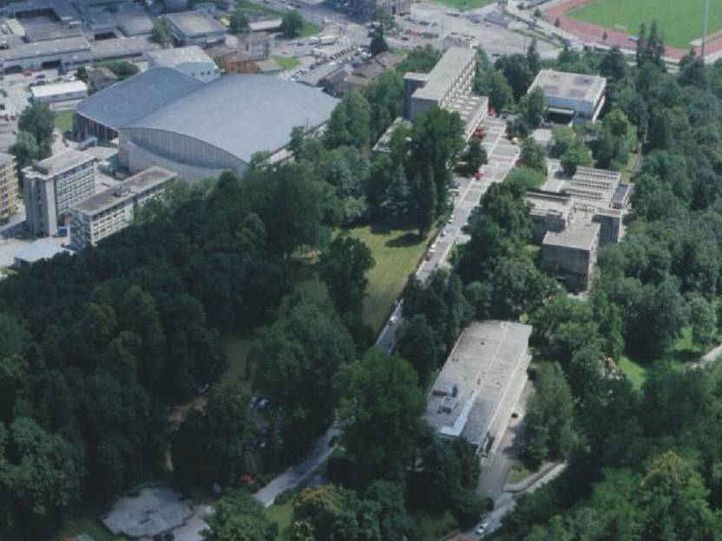
2
Department of Environment, Construction and Design
Campus Trevano
Education
Bachelor and Master
Continuing education
60+ courses for professional operators
MAS, DAS, CAS in construction, design
Energy and environment,
interaction design
Applied research
4 research institutes
Services
Services to companies and
support to the regional economy
and government

Slide 3
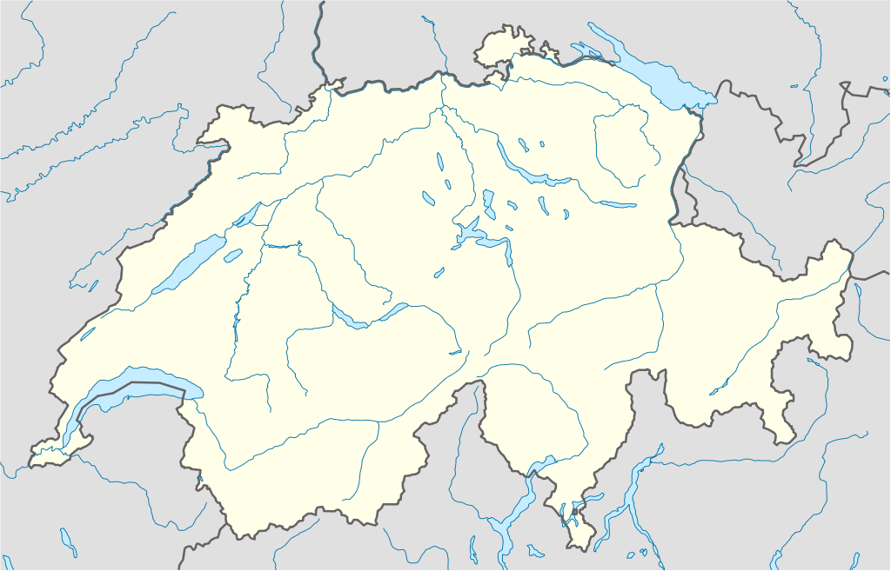




















Positioning of ISAAC in Switzerland: synergies and competition
Solar Cell
PV Module and BiPV
System technology

Slide 4
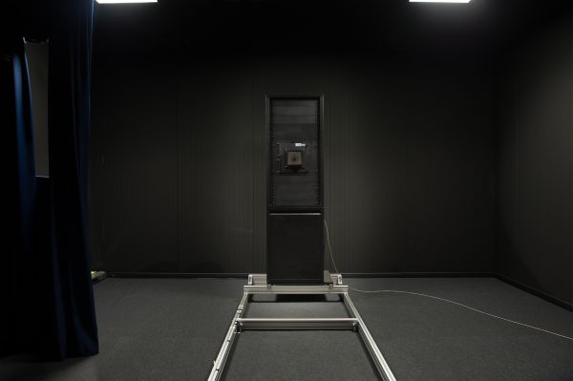
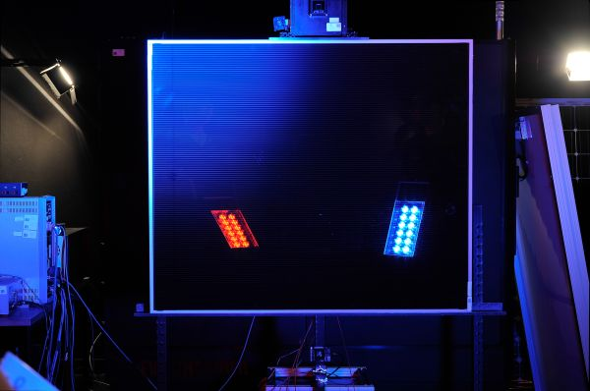
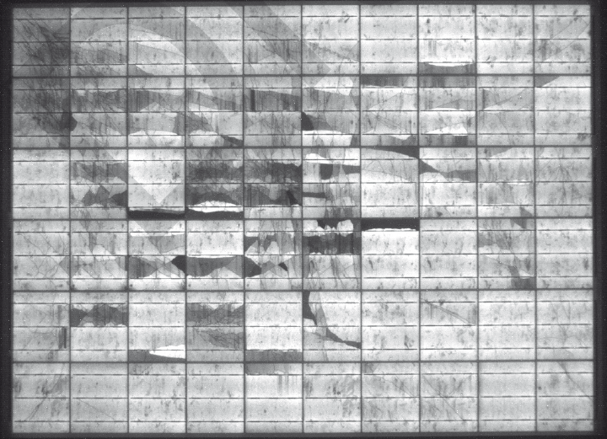
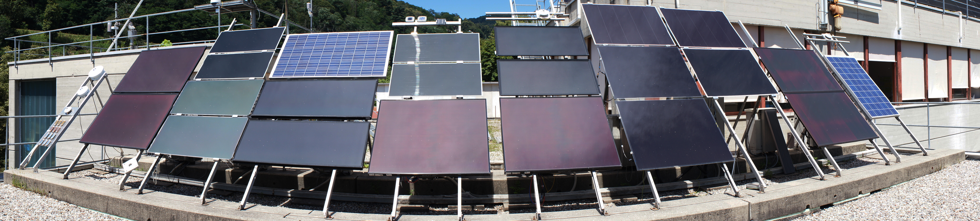
Module characterisation
Research and services in the energy system area
Electrical
Thermal
Optical
Mechanical
Field Performance
Outdoor yield evaluation
  Different climates
  Different technologies

Slide 5
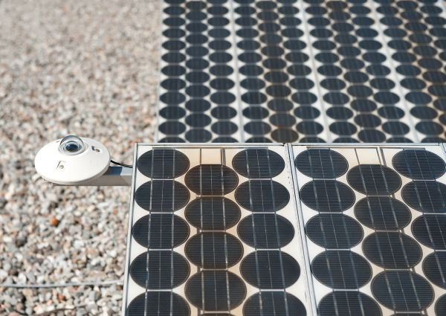
Failure Mode and Effects Analysis
Definition and ranking of all the failure modes of a product
Ranking based upon major indicators, for example:
  Severity: economic and safety impact
  Frequency
  Detectability
Survival probability
New tools for failure prediction
Failure occurrence
Failure mechanisms/modes
Development of test procedures
Approach
Reverse engineering on modules from old systems (>20 years of operation e.g TIS010)
Reproduction of early stage failures (case studies from clients, 1-5 years old systems)

Slide 6
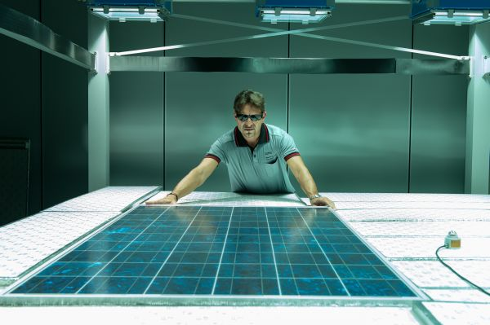
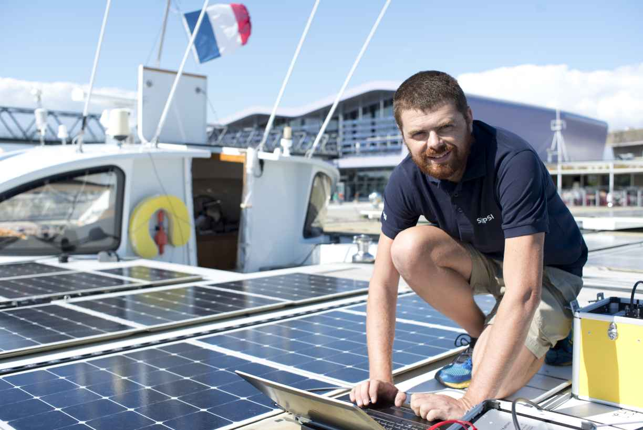
Services dedicated to quality
ISO 17025 accredited testing
  Prototype pre-testing
  Retesting activities
  Module characterisation:
    Lot acceptance verification
    Reference module characterisation
Energy Yield measurement
Field testing on PV systems
Quality Auditing
Accelerated testing procedures for industry:
  New products qualification
  Optimisation of R&D processes

Slide 7


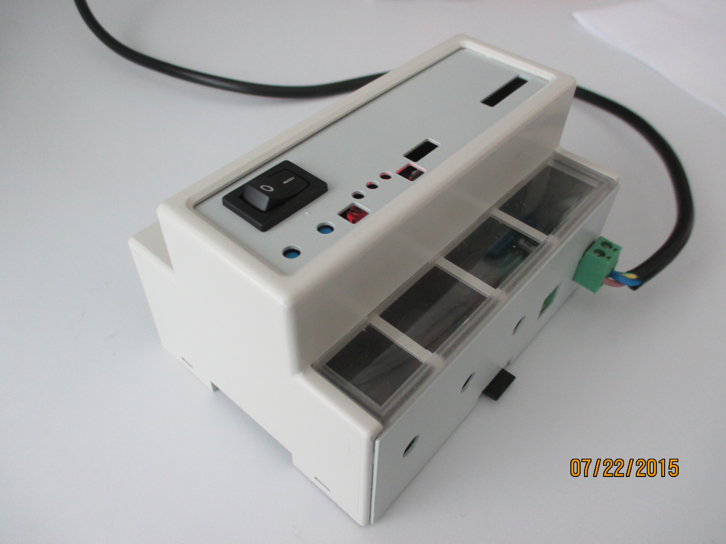
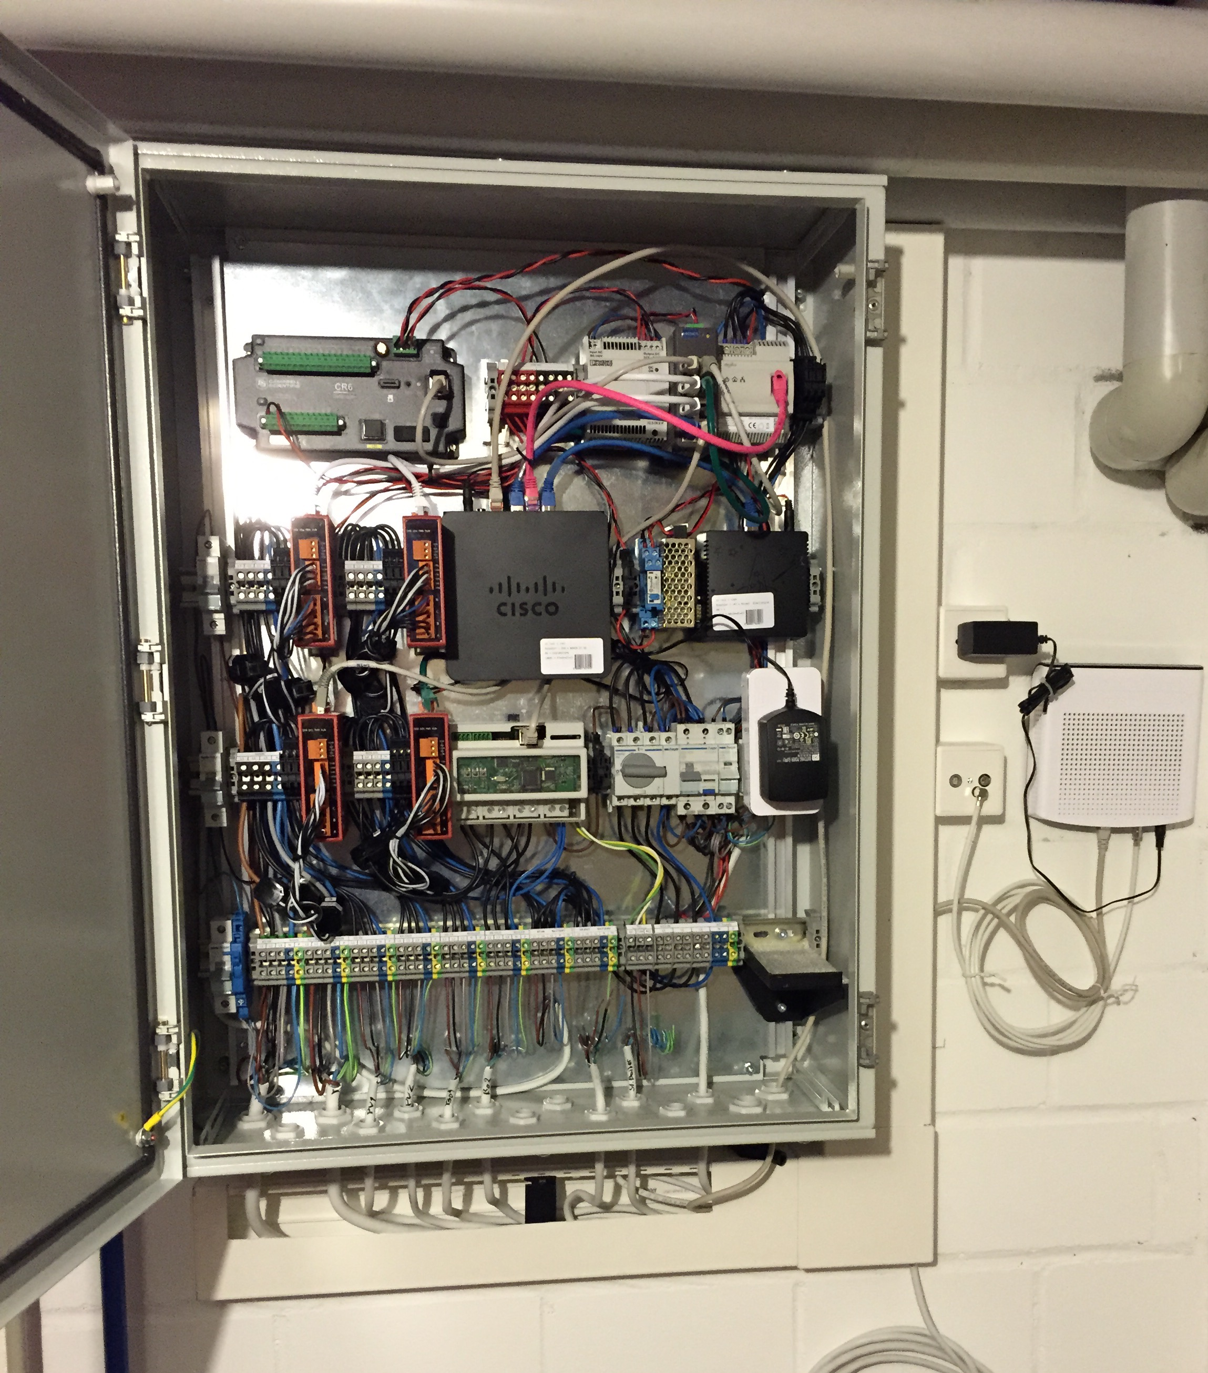
Algorithm based smart grid solution
A completely decentralized demand side managment system
Controls energivorous loads using custom built hardware
Solves a multi-objective optimization problem (energy cost + grid)
Adaptive (plug-and-play)
Pilot project set up
and operational

Slide 8

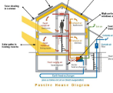
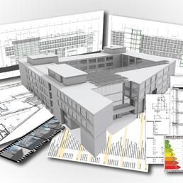
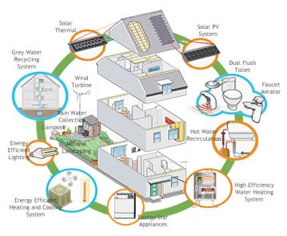
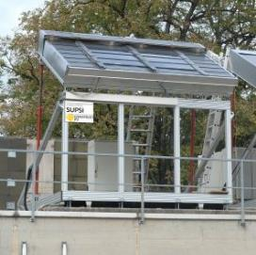
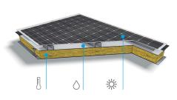
Research and Services in the building sector
Buidling area : Management of the building stock
Refurbishment and preventive maintenance tool
Efficient energy solutions and global.
BIM and virtual reality.
Innovative building skin(BIPV):
Active solar skin solutions (Building Integrated Photovoltaics)
Innovative building envelopes for energy efficieny
buildings
ENVELOPES

Slide 9
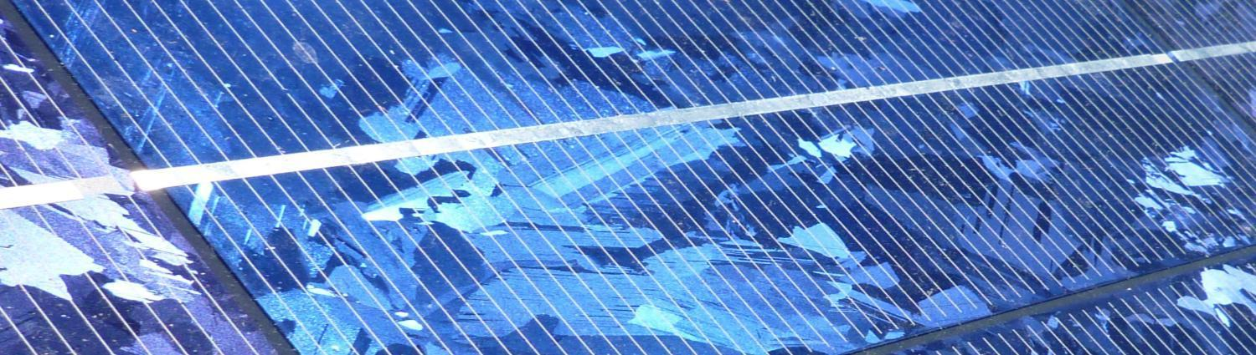
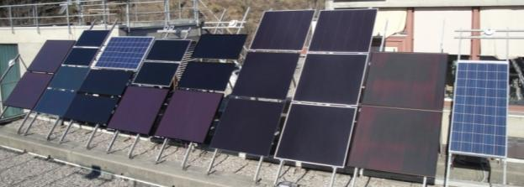
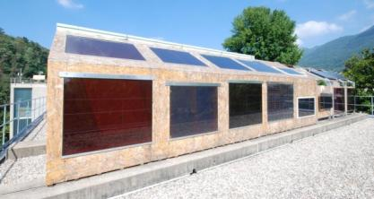
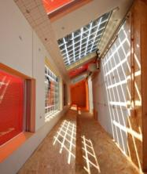
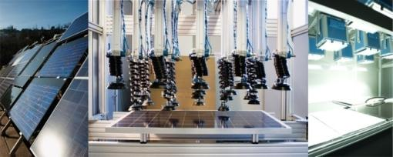
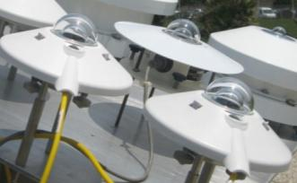
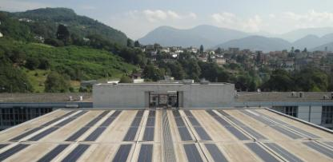
Thank you for coming to Lugano
Enjoy your workshop
Notes:
Ringraziamento all’organizzatori… Gabi, Ulrike e Adrianna

