Slide 1
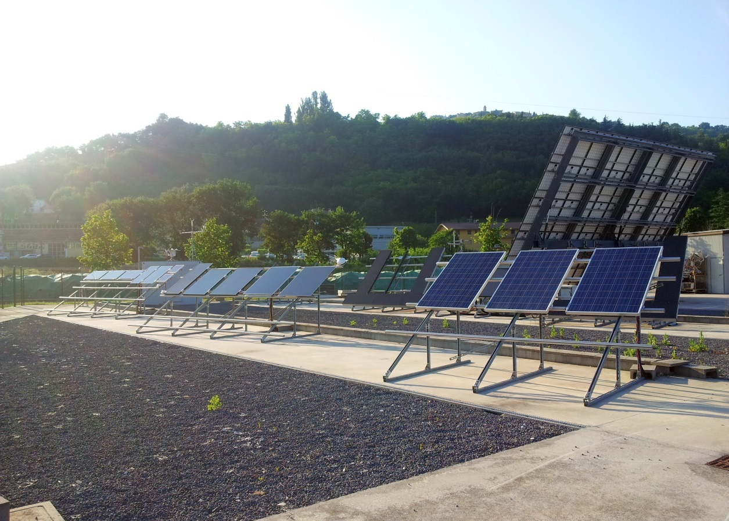
New Approach for Energy Yield Assessment with
Linear Performance Loss Analysis (LPLA)
Markus Schweiger, Werner Herrmann
TÜV Rheinland Energy GmbH, T +49 221 806 5585
markus.schweiger@de.tuv.com, http://www.tuv.com/solarpower

Slide 2
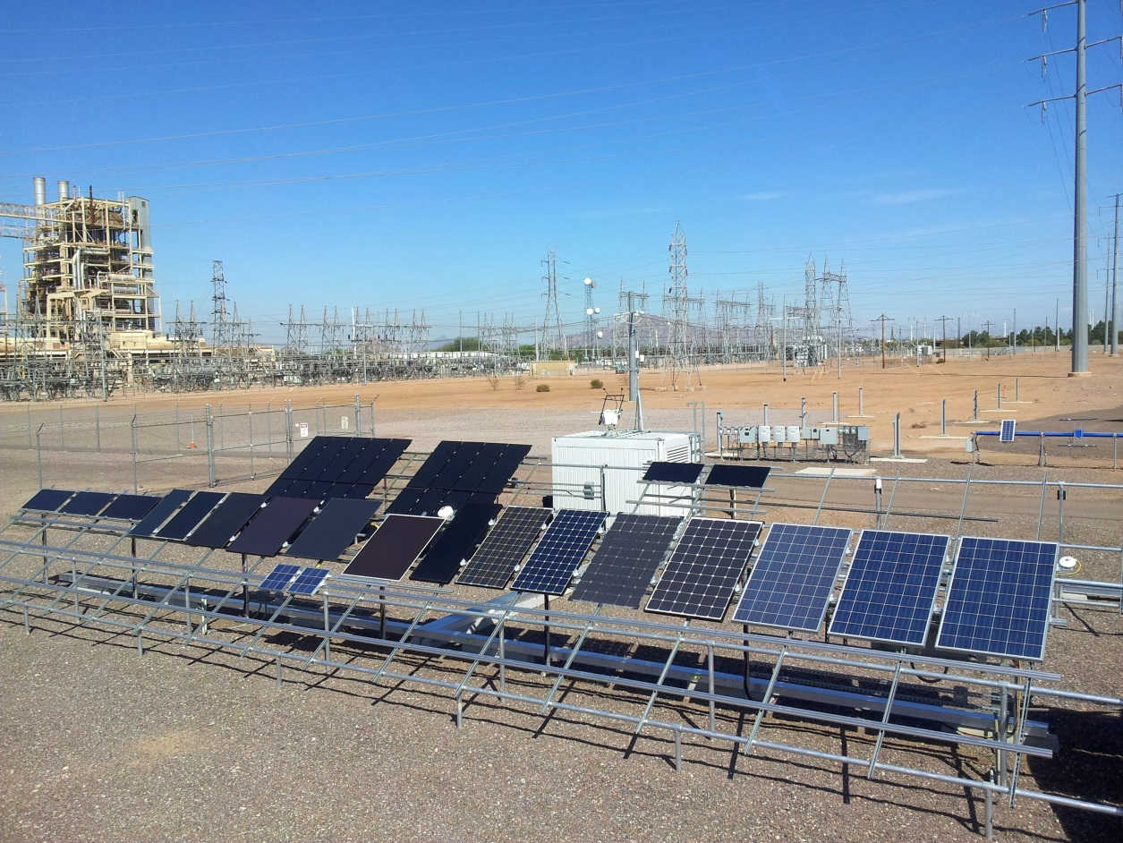

Contents
Specifications of Required Data Sets
Linear Performance Loss Analysis
Introduction
Results
Conclusions

Slide 3
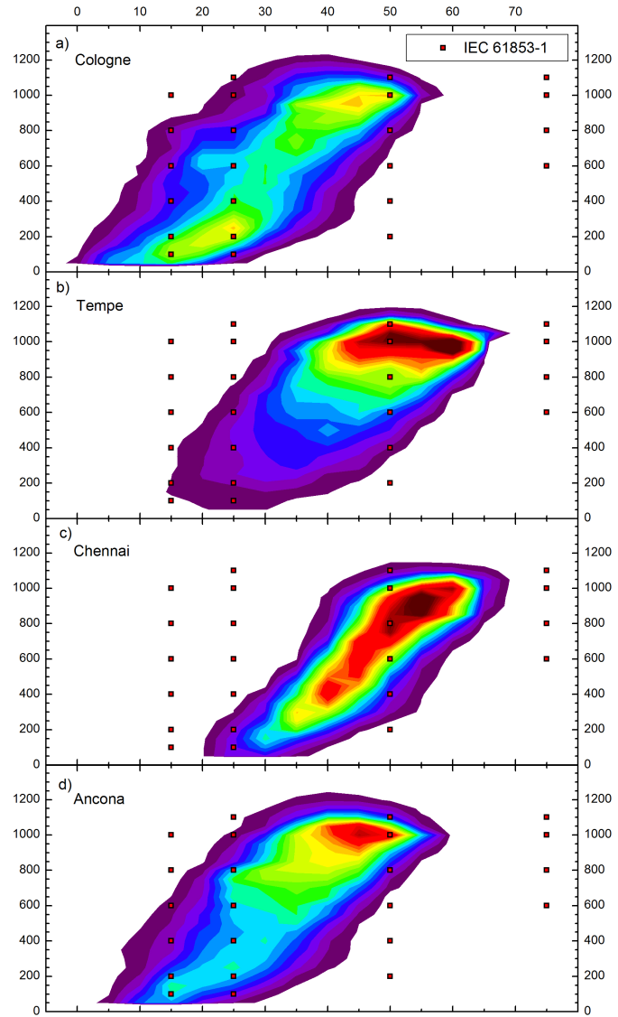
Introduction: Status Quo
Sales price of PV modules based on STC measurements
Real operating conditions depend on climate and differ from STC
PV modules with different technologies show different performance characteristics
Huge uncertainties for energy yield estimation of thin-film PV modules
Relevant standards IEC 61853 part 1-4 not yet published
Indoor measurements are cost intensive, outdoor measurements are time intensive and depend on annual fluctuations

Slide 4
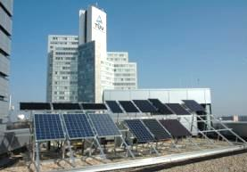
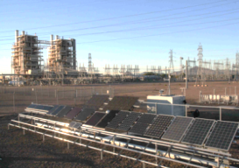

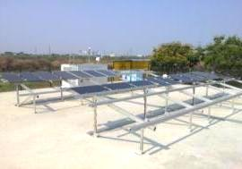
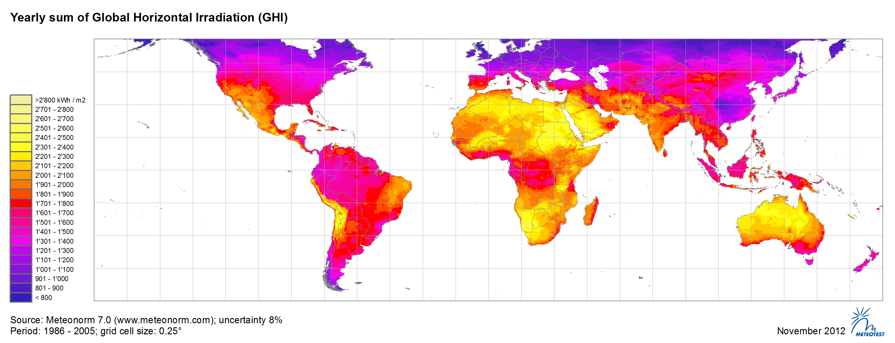




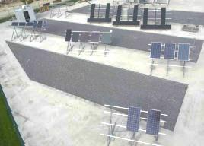
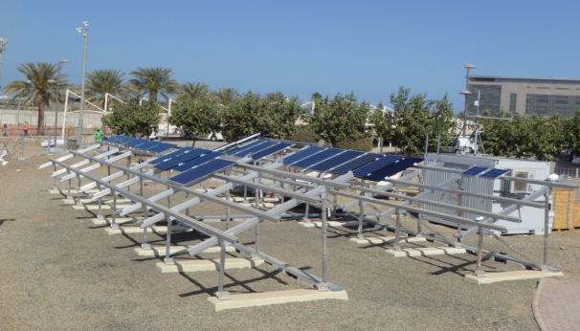
Introduction: Outdoor test sites TÜV Rheinland
1. Tempe, Arizona
3. Cologne, Germany
4. Chennai, India
2. Ancona, Italy
5. Thuwal, Saudi-Arabia

Slide 5
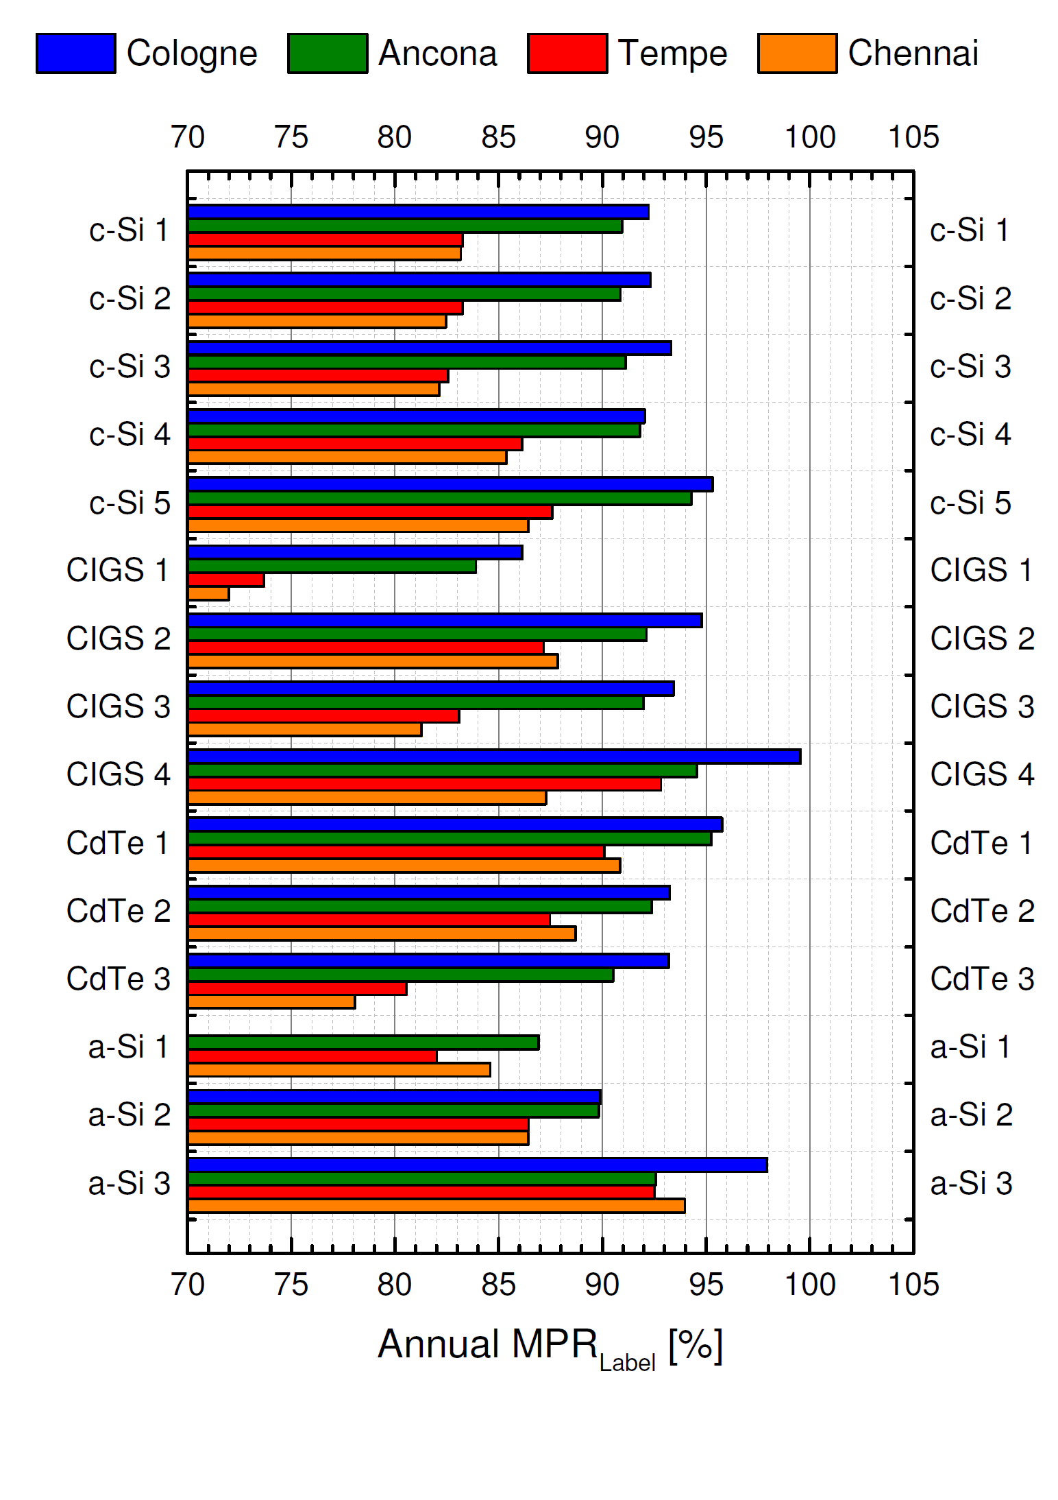
Introduction: Module Performance Ratio (MPR)
Discrepancy in energy yield after one year:
(based on stated nominal power)
23% Difference in Chennai (tropical)
21% Difference in Tempe (semi-desert)
14% Difference in Cologne (moderate)
12% Difference in Ancona (mediterranean)
(Operating efficiency of PV modules in the range of 6.7% to 18.4%)

Slide 6
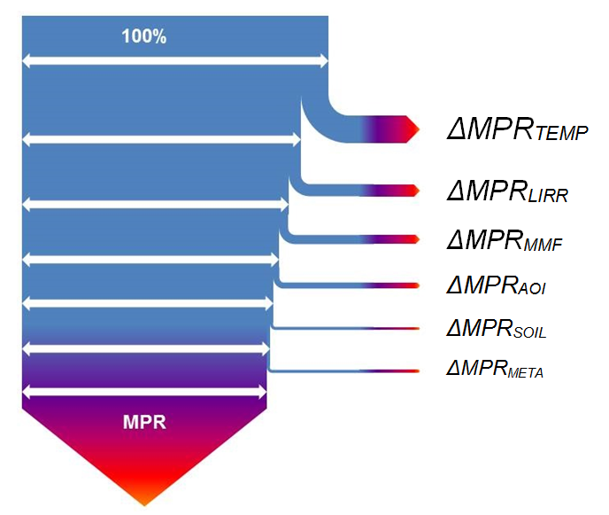
Linear performance Loss Analysis (LPLA)
LPLA
The MPR would be 100% if the efficiency would be always the same like for STC and independent of operating conditions
Linear approach of individual loss mechanisms
Second order effects are neglected

Slide 7
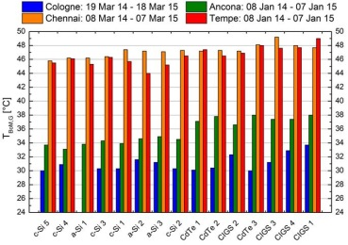
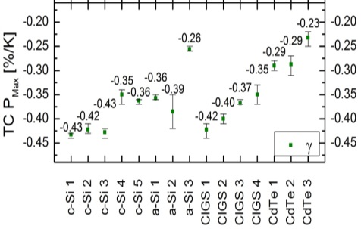
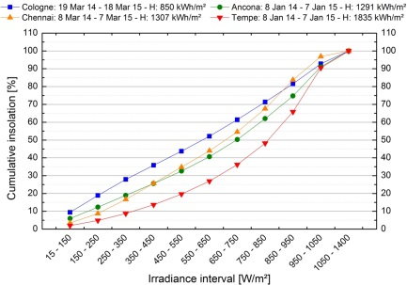
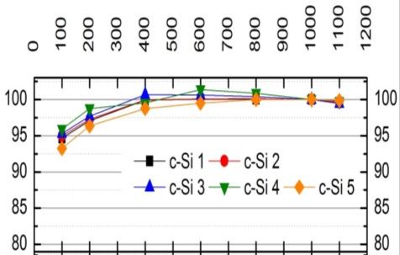
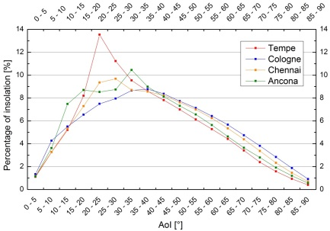
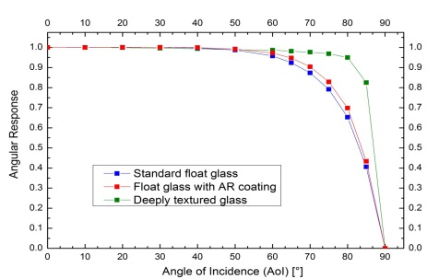
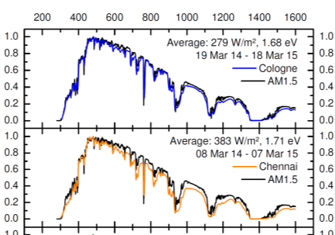
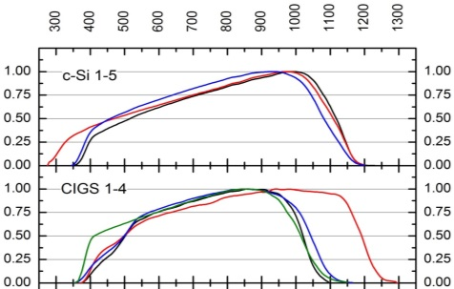
Linear performance Loss Analysis (LPLA)
Weighted Operating Temperature
Temperature Coefficient
MPR_{Estimated} =
ΔMPR_{Temperature}
+
ΔMPR_{Low Irradiance}
+
ΔMPR_{Angular Effects}
+
ΔMPR_{Spectral Effects}
Low Irradiance Profile
Low Irradiance Behavior
Angular Irradiance Profile
Angular Response
Average Spectral Irradiance
Spectral Response

Slide 8
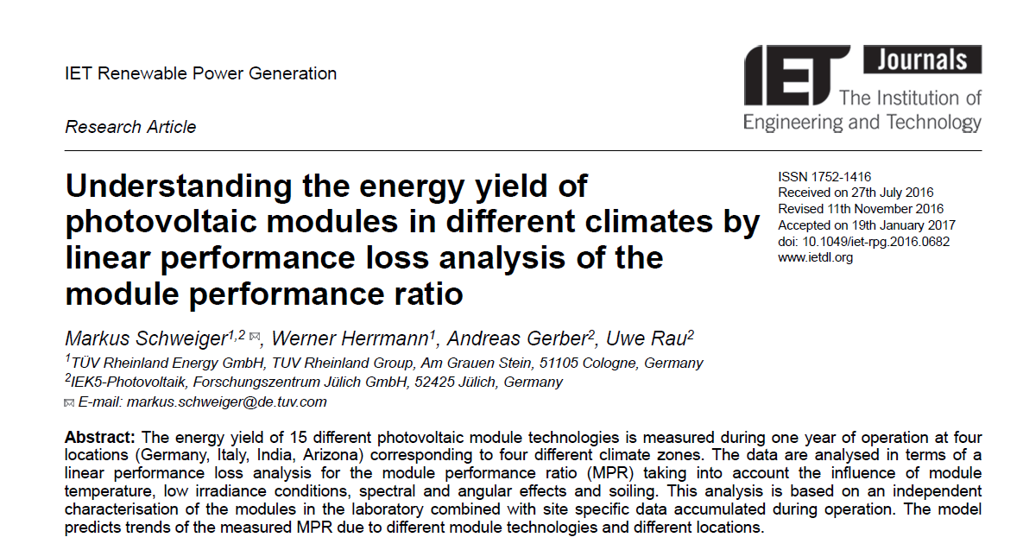
Linear performance Loss Analysis (LPLA)
LPLA

Slide 9
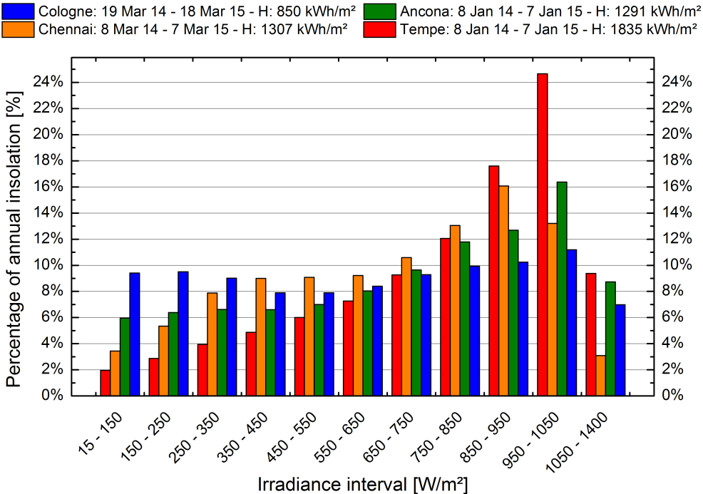
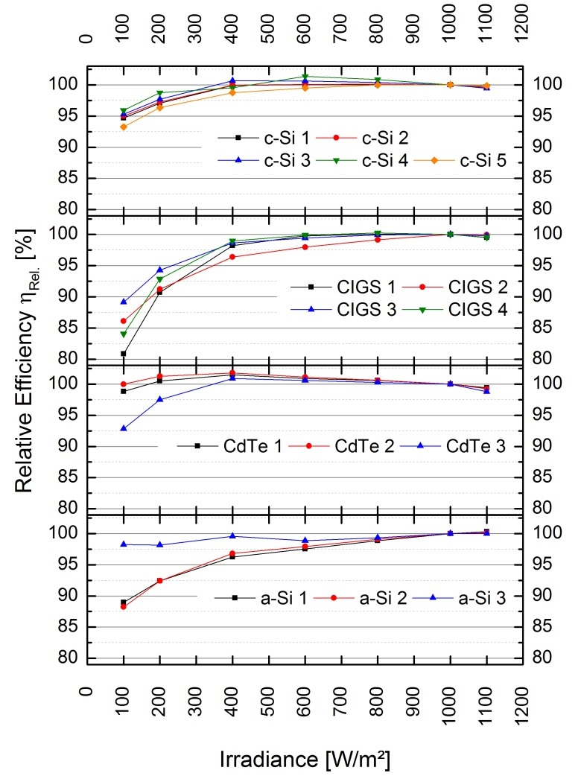
Required Data Sets: Low irradiance behavior
 | ∆MPR_{LIRR} Min. | Sample type | ∆MPR_{LIRR} Max. | Sample type
Ancona | 0.33 % | CdTe 2 | -3.21 % | CIGS 4
Tempe | 0.26 % | CdTe 1 | -1.82 % | CIGS 2
Chennai | 0.63 % | CdTe 1 | -2.86 % | CIGS 4
Cologne | 1.13 % | CdTe 2 | -3.63 % | CIGS 2

Slide 10
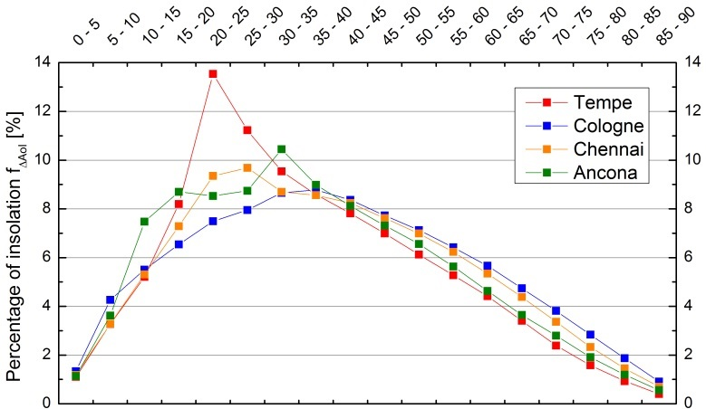
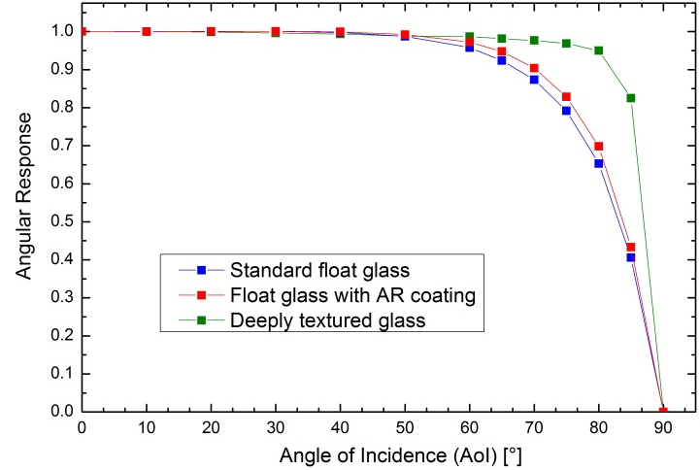
Required Data Sets: Angular response
G_{Direct}
(cosine corrected)
+
G_{diffuse}
(isotropic distribution)
Front glass | Standard float | AR coating (improvement) | Textured (improvement)
Cologne | -3.45% | -2.77% (0.68) | -1.62% (1.83)
Ancona | -2.43% | -1.90% (0.53) | -1.19% (1.24)
Chennai | -2.91% | -2.30% (0.61) | -1.38% (1.53)
Tempe | -2.03% | -1.56% (0.47) | -1.00% (1.03)

Slide 11
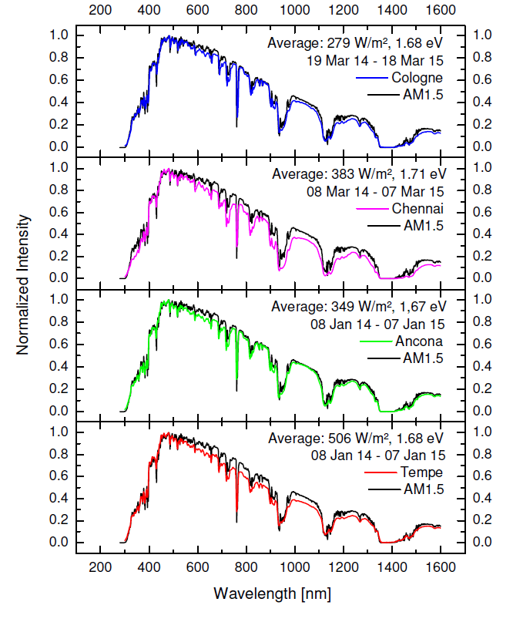
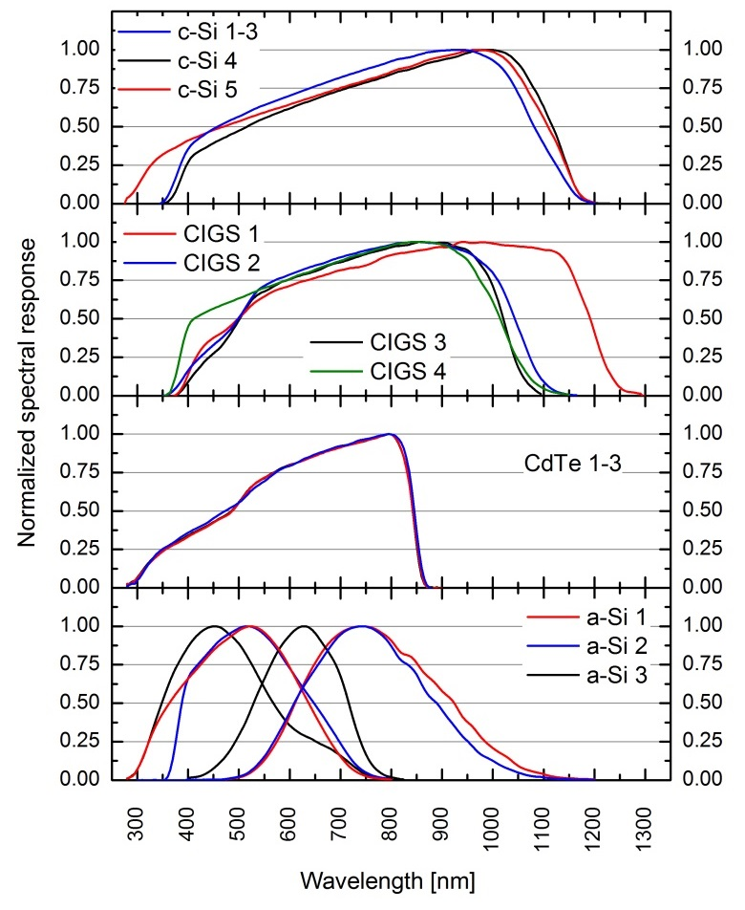
Required Data Sets: Spectral effects

Slide 12
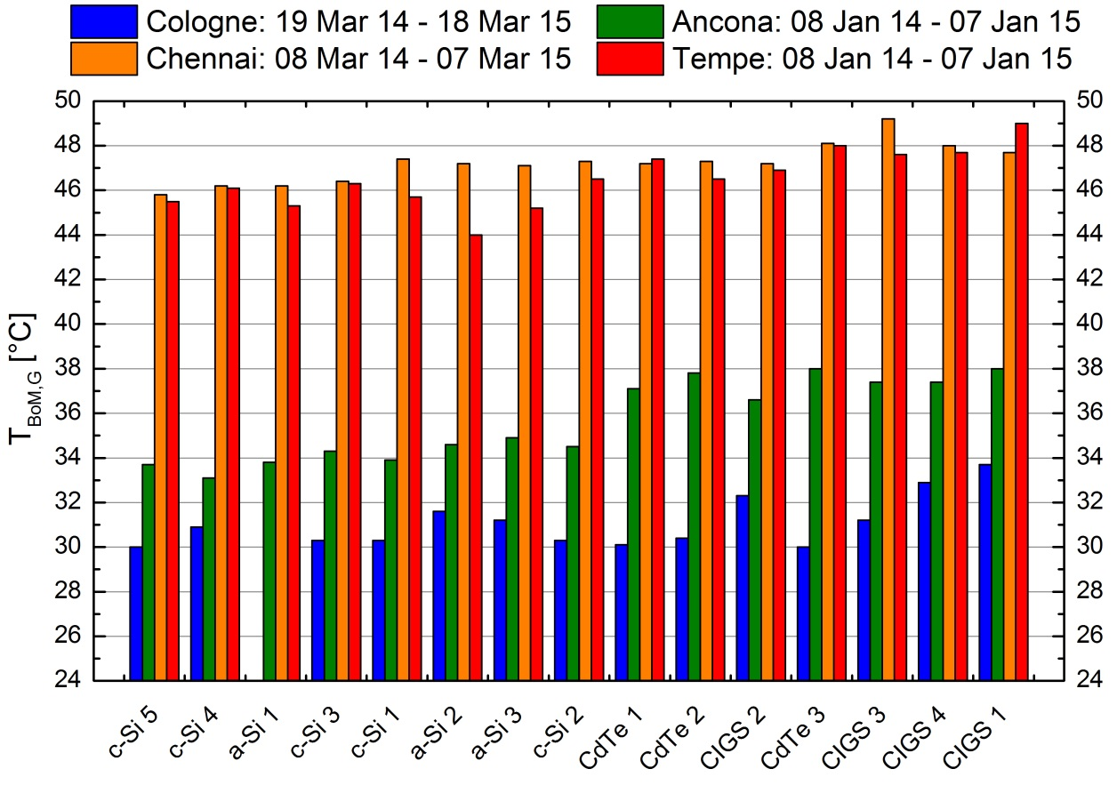
Required Data Sets: Temperature losses
Difference within tested samples:
3.4 °C in Chennai,
5.0 °C in Tempe,
4.9 °C in Ancona,
3.7 °C in Cologne

Slide 13
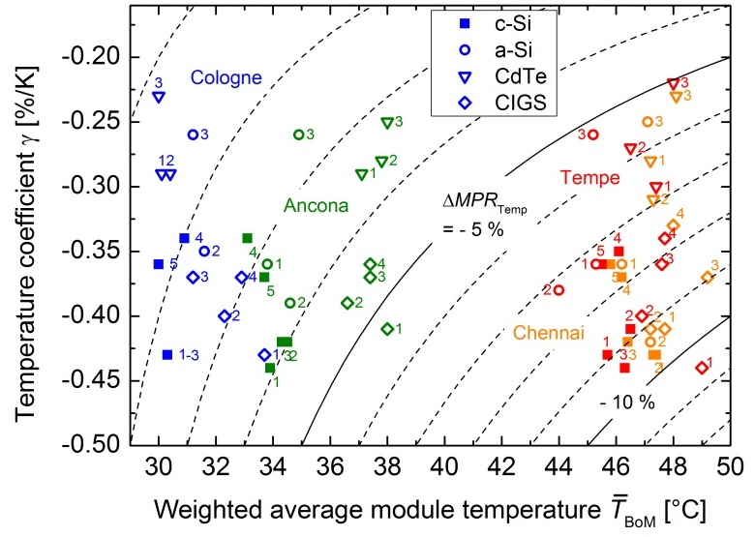
Required Data Sets: Temperature losses
Location | Energy Yield loss due to temperature:
Germany | -1.2 % to -3.7 %
Italy | -2.6 % to -5.3 %
India | -5.3 % to -9.6 %
Arizona | -5.1 % to -10.6 %
How to estimate average weighted module temperature?
→ Working on solution using NMOT

Slide 14
Specifications of Required Data Sets
It is not possible/convenient to measure all operating conditions in the laboratory
Operating conditions can be translated according to IEC 60891
Required PV module data:
TC @ 1000 W/m²
(TC (G) can be neglected)
ƞ (G) @ 25°C
Spectral response
ƞ (AoI)
→ Less extensive measurements required as stated in IEC 61853-1

Slide 15
Specifications of Required Data Sets
Requirements for reference climate data set:
Annual in-plane solar irradiation H
H (G) in percentage
H (AoI) in percentage
Average E_{λ}
Reference average operating temperature
Reference soiling factor
Necessary step size can be discussed
Due to simple structure of environmental data sets, we or the user can define and generate as much reference climates as desired for all of the world and also for different mounting conditions
Example ΔMPR_{Lowirr} in Cologne for a c-Si sample
G [W/m²] | H(G) | ƞ (G) | H x ƞ
15 - 150 | 9% | 0.93 | 8,73%
150 - 250 | 9% | 0.96 | 9,12%
250 - 350 | 9% | 0.97 | 8,77%
350 - 450 | 8% | 0.99 | 7,79%
450 - 550 | 8% | 0.99 | 7,82%
550 - 650 | 8% | 1.00 | 8,36%
650 - 750 | 9% | 1.00 | 9,26%
750 - 850 | 10% | 1,00 | 9,94%
850 - 950 | 10% | 1,00 | 10,25%
950 - 1050 | 11% | 1,00 | 11,19%
1050 - 1400 | 7% | 1,00 | 6,99%
 | 100% | - | 98.24%
100% – 98.24% = 1.76% Loss due to ƞ (G)

Slide 16
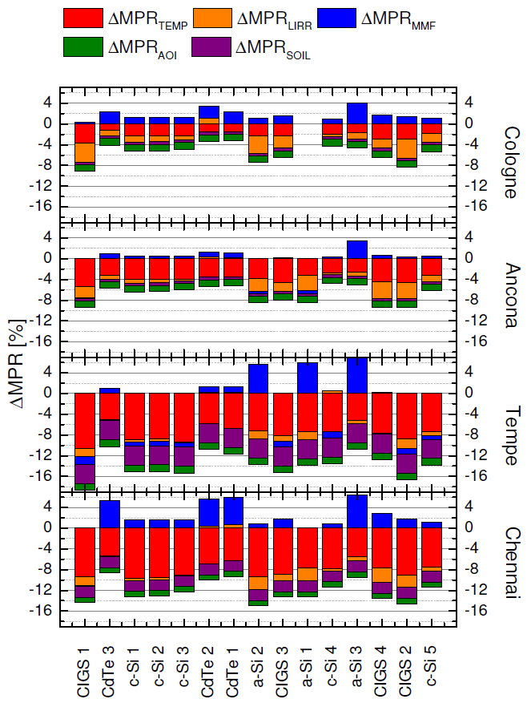
Results: Quantifying the Impact on Energy Yield by LPLA
Highest avg. module temperature in Chennai 42.4°C → ΔMPR_{TEMP}: -5.3% to -9.6%
Low irradiance behavior most pronounced in Cologne → ΔMPR_{LIRR}: +1.1% and losses of -3.6%
Spectral impact ΔMPR_{MMF} mostly positive and high for CdTe technologies with a spectral gain of up to 5.3% (Chennai)
Max. ΔMPR_{SOIL} observed in Tempe → -3.7% soiling loss per year
ΔMPR_{AOI} greatest in Cologne with -3.5% for standard float glass

Slide 17
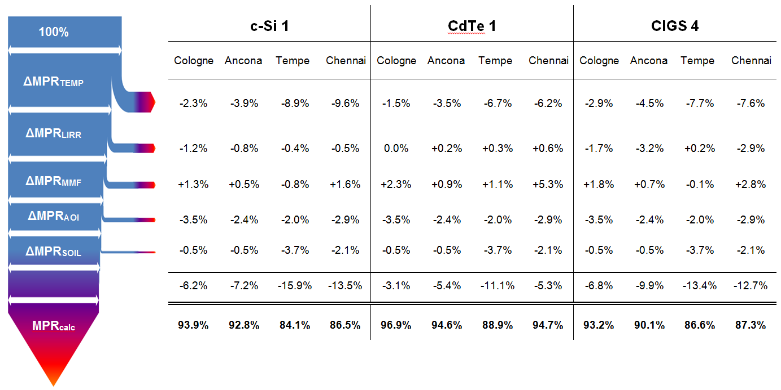
Results: Quantifying the Impact on Energy Yield by LPLA
Example: CdTe 1 generates 88.9/84.1-1= 5.7% more energy than c-Si 1 in Tempe
→ The investor gets 5.7% more yield for the same STC power.

Slide 18
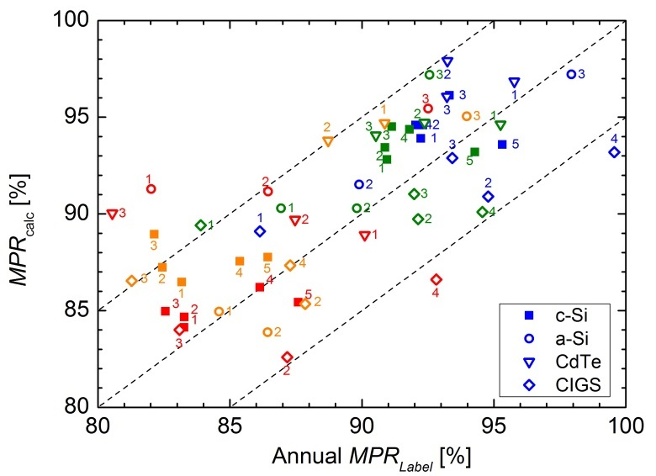
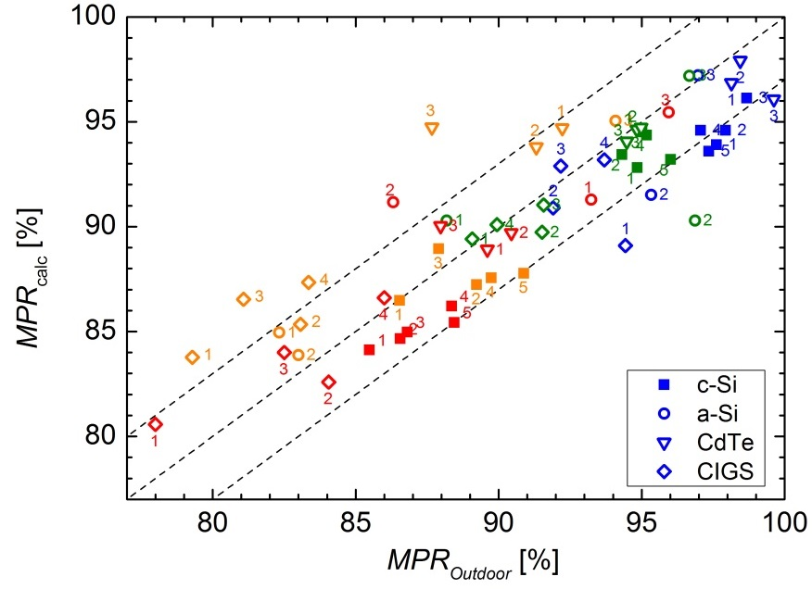
Results: Quantifying the Impact on Energy Yield by LPLA
±3% accuracy can be achieved for all technologies with measured average nominal power
Paper on stability of nominal power submitted in PiP

Slide 19
Conclusions
It is possible to estimate the energy yield or module performance ratio within 3% for all technologies using laboratory data and reference climate data sets
The LPLA method is a simplified way which fits the needs of the market for an energy rating of different technologies in different climates
The accuracy of nominal power measurements and its stability is the main barrier for reliable energy yield predictions – this method is independent of power uncertainty
Method based on internationally approved standards and measurements
Simple compilation of reference environmental data sets and module characteristics
Transparent results cause every loss factor is quantified in relative units (percentage)
Considering second order effects will increase accuracy
→ further improvements are easy to implement

Slide 20
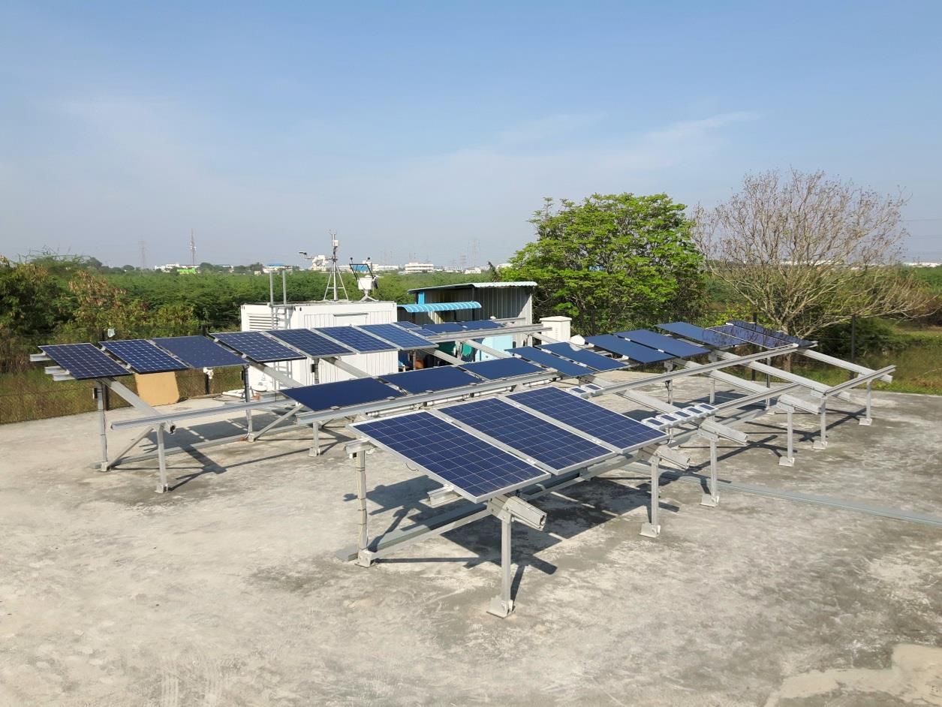
Thank you for your attention!
ACKNOWLEDGEMENT: This work is supported by the German Federal Ministry for Economic Affairs and Energy (BMWi) as part of contract no. 0325517B.

Slide 21
References
[1] | W. Herrmann: Solar simulator measurement procedures for determination of the angular characteristic of PV modules, 29th EU PVSEC, Amsterdam, 2014.
[2] | IEC 61853-1, Photovoltaic (PV) module performance testing and energy rating - Part 1: Irradiance and temperature performance measurements and power rating, 2011.
[3] | IEC 61853-2, Photovoltaic (PV) module performance testing and energy rating - Part 2: Spectral response, incidence angle and module operating temperature measurements (IEC 82/774/CDV), 2013.
[4] | Y. Tsuno, Y. Hishikawa and K. Kurokawa, "A Method for Spectral Response Measurements of Various PV Modules," in 23rd European Photovoltaic Solar Energy Conference and Exhibition, Valencia, 2008.
[5] | IEC 60904-8, Photovoltaic devices - Part 8: Measurement of spectral responsivity of a photovoltaic (PV) device, 2015.
[6] | Schweiger, M.; Herrmann, W.; Gerber, A.; Rau, U. (2016): Understanding the Energy Yield of Photovoltaic Modules in Different Climates by Linear Performance Loss Analysis. Accepted for Publication in IET Renewable Power Generation.
[7] | IEC 60891: `Photovoltaic devices. Procedures for temperature and irradiance corrections to measured current voltage characteristics´, 2013.
[8] | IEC 61646: `Thin-film terrestrial photovoltaic (PV) modules - Design qualification and type approval´, 2013.
[9] | Schweiger, M., Herz, M., Kämmer, S., Herrmann, W.: ` Fabrication Tolerance of PV-Module I-V Correction Parameters for Different PV-Module Technologies and Impact on Energy Yield Prediction´. 29th European Photovoltaic Solar Energy Conference and Exhibition, Amsterdam, 2014, pp. 3227 - 3230.
[10] | Schweiger, M., Bonilla, J., Herrmann, W., Gerber, A., Rau, U.: `Performance Stability of Photovoltaic Modules in Different Climates´, manuscript under review.
[11] | Herrmann, W., Schweiger, M.: `Soiling and self-cleaning of PV modules under the weather conditions of two locations in Arizona and South-East India´. 42nd Photovoltaic Specialist Conference (IEEE PVSC), New Orleans, United States, 2015, pp. 1-5.
[12] | M. Schweiger, W. Herrmann: Energy rating label for PV modules to improve energy yield prediction in different climates, 30th European Photovoltaic Solar Energy Conference and Exhibition, September 2015, Hamburg, Germany.

